Slide 1


Artificial Intelligence
Assisted Grantwriting

Slide 2

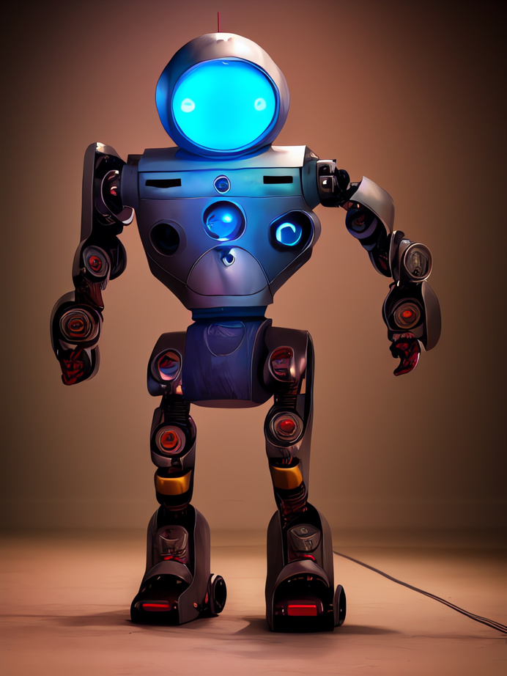
Agenda
02
Introduction to Artificial Intelligence (AI)
Overview of AI and Terminology
Practical Applications of AI
Limitations of AI
Questions and Answers

Slide 3
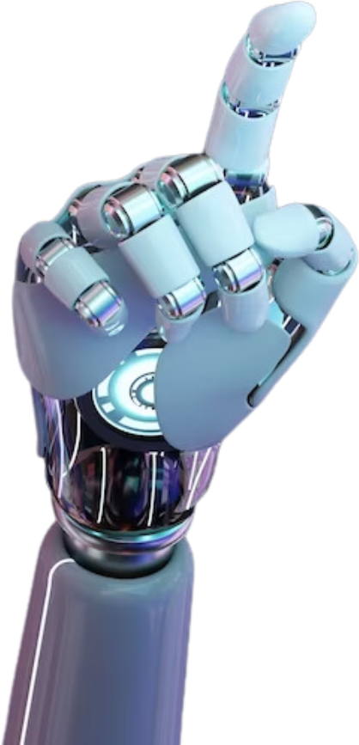
Introduction
03
Artificial Intelligence (AI) is a branch of computer science focused on creating machines capable of performing tasks that typically require human intelligence. These tasks include learning, reasoning, problem-solving, visual perception, speech recognition, decision-making, and understanding natural language. AI is transforming various industries, making processes more efficient and creating new opportunities.

Slide 4
Overview of AI
04
Narrow AI | Designed for specific tasks like facial recognition or voice assistants. It excels at its function but lacks general intelligence.
General AI | Mimics human intelligence across various activities, learning and applying knowledge in different contexts.
Superintelligent AI | A theoretical AI that surpasses human intelligence in all aspects, with potential for both great benefits and significant risks.

Slide 5
Terminology
05
Algorithm | A set of instructions for a computer to follow in order to solve a problem or perform a task
Data Mining | The process of discovering patterns in large datasets
Deep learning | A subset of machine learning that involves the use of neural networks with many layers to enable machines to learn from complex data such as images, speech, and natural language
GPT Models | Generative Pre-trained Transformer models, one of the most advanced language models in the world, trained on massive amounts of text data scraped from the internet
Large Language Model (LLM) | A type of artificial intelligence algorithm that uses deep learning techniques and massively large data mined sets to understand, summarize, generate and predict new content.

Slide 6
Terminology (cont.)
06
Machine Learning | A subset of AI that involves the use of statistical models and algorithms to enable machines to improve their performance on a task as they are exposed to more data
Model Training | The process of using data to train an AI model to perform a specific task
Neural Networks | A type of machine learning algorithm inspired by the structure of the human brain, consisting of interconnected nodes that process and transmit information
Natural Language Processing (NLP) | A type of AI that enables machines to understand, interpret, and generate human language
Prompt engineering | Prompt engineering is the process of carefully crafting input instructions or queries for natural language processing models to generate desired responses or behaviors

Slide 7
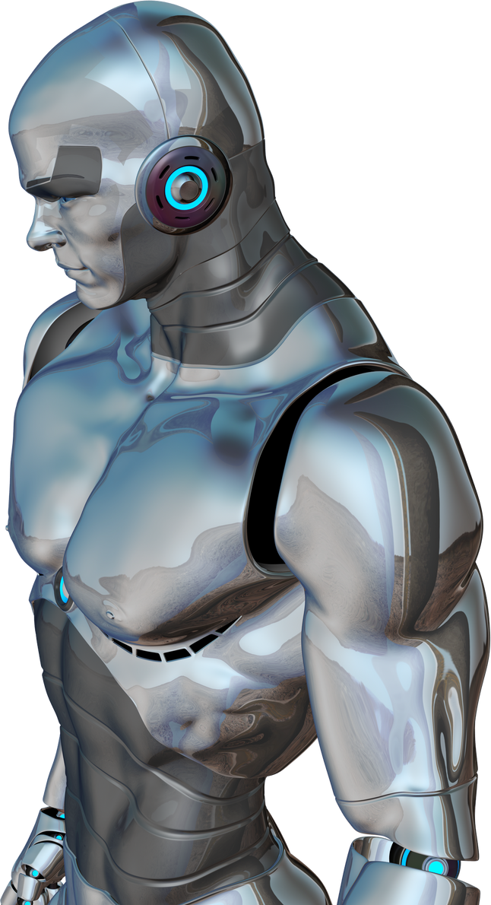
AI Chatbots
07
ChatGPT - OpenAI
Gemini - Google
CoPilot - Microsoft
Claude - Anthropic
Perplexity

Slide 8
Customized
AI Chatbots
08
Fundwriter.ai
Grantable.co
Grantboost.io
Grantedai.com
Instrumentl.com
Grantai.com
Grantwriteai.com
GrantAI.co
GrantGenie.com
Graphia.ai
Junia.ai
OpenGrants.io
Writesonic.com
Designer
Canva
Grammarly

Slide 9
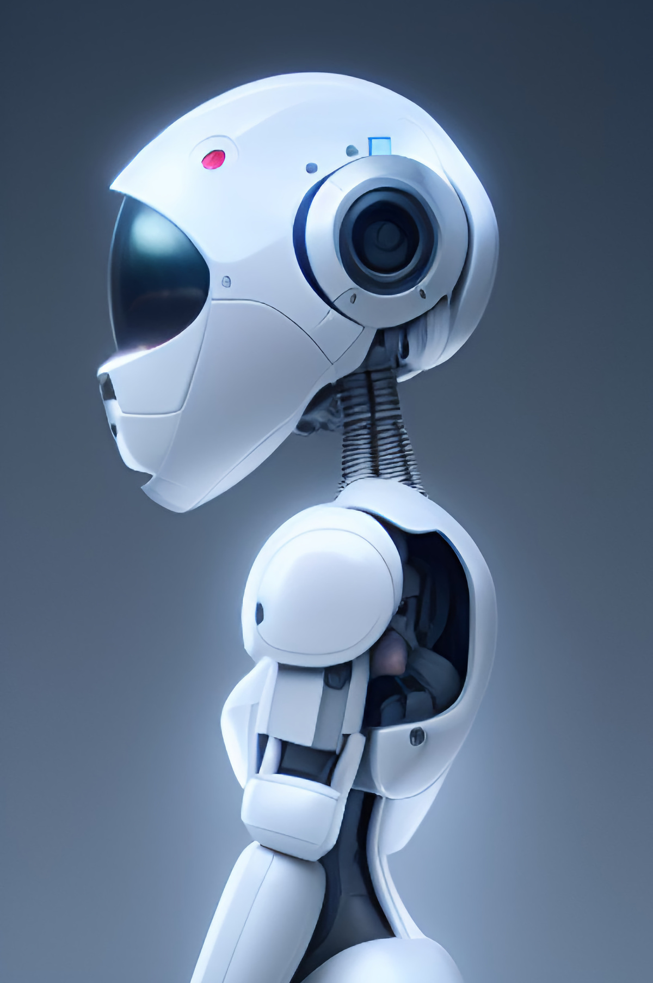
Benefits of AI
09
Efficiency
Productivity
Better Processes
Brainstorming
Review
Summarize
Rewrite (Condense/Expand)
Word Counts

Slide 10
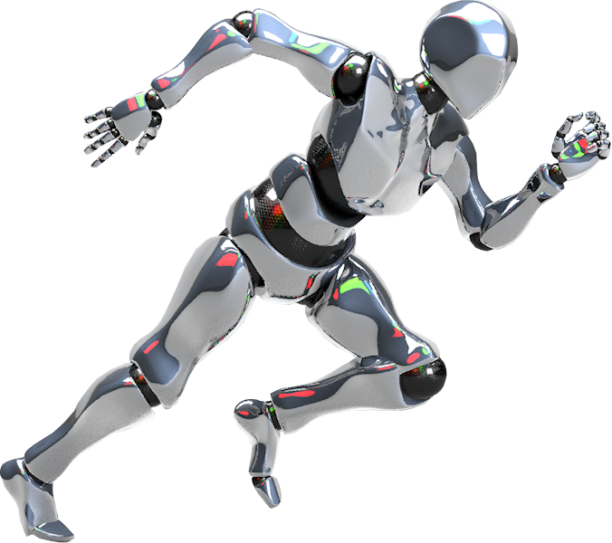
Demonstrations
10
Letter of Inquiry (LOI)
Grammar, Spelling, & Punctuation
Clarity, Conciseness & Word Count
Style & Consistency
LOI: Multi-Step Process

Slide 11
Letter of Inquiry
11
I am a West Texas rural volunteer fire department nonprofit whose mission is to preserve and protect life and property during incidents such as fires, inclement weather, vehicle crashes, and other emergencies. Please provide me a 3-paragraph letter of inquiry that I can use to submit to a local private foundation for an operating grant of $20k.
Notes:
Prompt #1:
I am a nonprofit whose mission is to preserve and protect life and property. Please provide me a 3-paragraph letter of inquiry that I can use to submit to a foundation for an operating grant of $20k.
Prompt #2:
I am a West Texas rural volunteer fire department nonprofit whose mission is to preserve and protect life and property during incidents such as fires, inclement weather, vehicle crashes, and other emergencies. Please provide me a 3-paragraph letter of inquiry that I can use to submit to a local private foundation for an operating grant of $20k.

Slide 12
Grammar, Spelling & Punctuation
12
I need to demonstrate the use of AI and its ability to make corrections. Please write an executive summary of a grant request from a volunteer fire department in West Texas that contains at least 3 examples of grammatical errors, 3 examples of spelling errors, and 3 examples of punctuation errors. Please summarize each error.

Slide 13
Grammar, Spelling & Punctuation
13
I have an Executive Summary that needs correcting and proofreading.
Please correct the following summary and provide a summary of corrections.

Slide 14
Clarity, Conciseness & Word Count
14
I want to improve my nonprofit’s executive summary. Can you paraphrase the following paragraphs to make it clearer and more concise without changing the original meaning?
Count the number of words in your response.
The paraphrased executive summary exceeds the word limit. Can you condense it to meet a word count of 100 words without losing essential information?

Slide 15
Style & Consistency
15
I want to improve the following needs section for my grant proposal. Please modify the language to make it more compelling and persuasive for community-based funding organizations.
In 2019, 91% of the fires were in rural areas and outside the city limits. The coverage area includes challenging and some mountainous terrain, very little or no natural water sources, and very few roads for fire trucks to use when fighting fires. Since 99.89% of the area served is without fire hydrants, a water tank on the trucks is essential. Brush fire trucks with off-road capabilities for driving across the rural terrain and water tanks to supply water for fighting fires, are vital for rural fire departments. The history of this small fire department has shown fires can spread quickly, threatening life and destroying property such as the 2014 fires. After the initial purchase of the brush fire truck, fuel, maintenance, and repairs for the fire truck will be included in the fire department yearly budget.

Slide 16
Multi-Step Process
16
I am going to provide information about our nonprofit organization. Please store and organize this information for future reference. Respond with "ready" after each input. I'll indicate when all relevant information has been provided.
First here’s information on our (background): Copy & Paste
Here’s information about our (need): Copy & Paste
All information has been provided. Now using the information above create a Letter of Inquiry to a local private foundation. The letter should include information about our organization that highlights the need and overall impact. The Letter of Inquiry should be around 200 words.

Slide 17
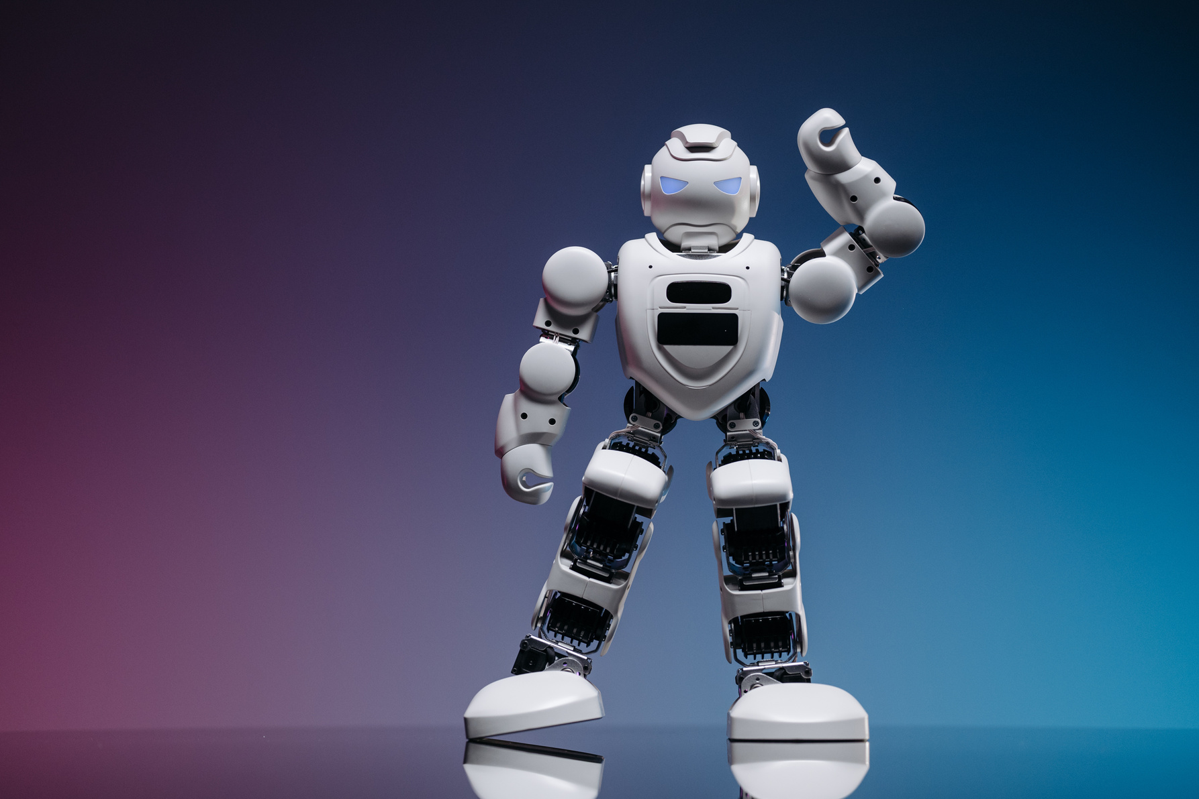
Limitations of AI
17
Lack of Context
Overreliance on Templates
Insufficient Human Touch
Inaccurate Data

Slide 18

Questions & Answers
18

Slide 19
Thank You!
Thank you for exploring the world of AI with us.

