Slide 1
Technology and Cyber Security
October 13, 2022

Slide 2




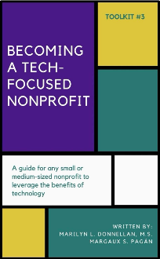



Recommended Books
The Accidental Techie
Sue Bennet
Managing Technology to
Meet Your Mission
Holly Ross, Katrin Vercias
The Future of Nonprofits:
Innovate and Thrive in the Digital Age
David J. Naff and Randal C. Moss
Wired for Good:
Strategic Technology Planning for Nonprofits
Joni Podolsky
Becoming a Tech-Focused Nonprofit
Marilyn Donnellan and Margaux Pagan
Nonprofit Essentials
Managing Technology
Jeannette Woodward
The Networked Nonprofit:
Connecting with Social Media to Drive Change
Beth Kanter
Measuring the Networked Nonprofit: Using Data to Change the World
Katie Dlahaye Paine and Beth Kanter

Slide 3
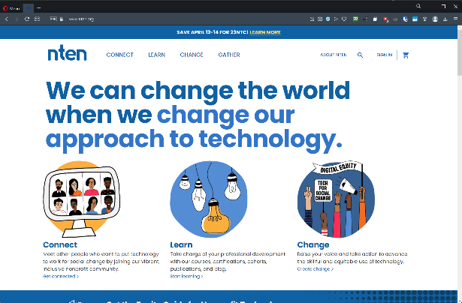
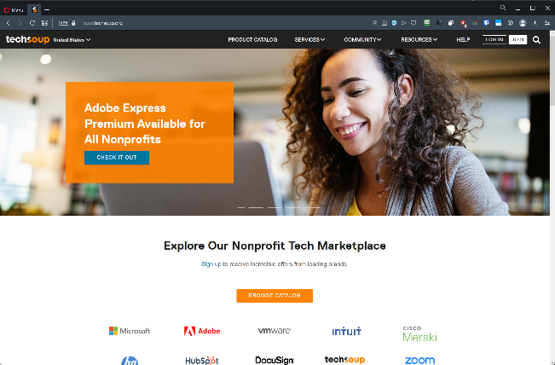
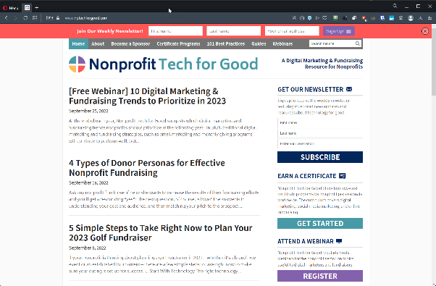
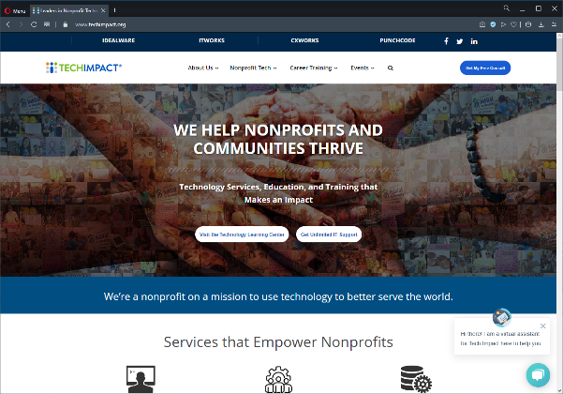
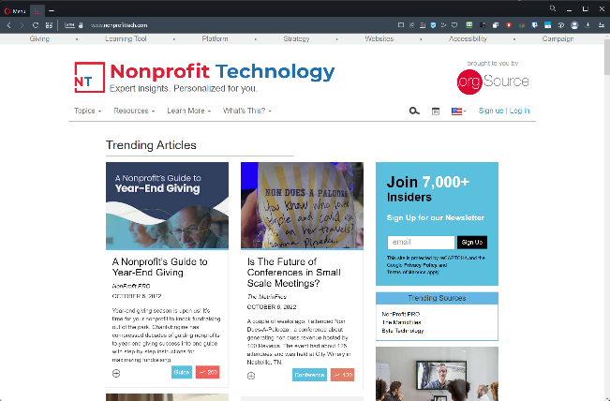
Recommended Online Resources
techsoup.org
techimpact.com
nten.org
nonprofittech.com
nptechforgood.com

Slide 4
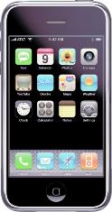
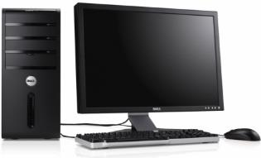
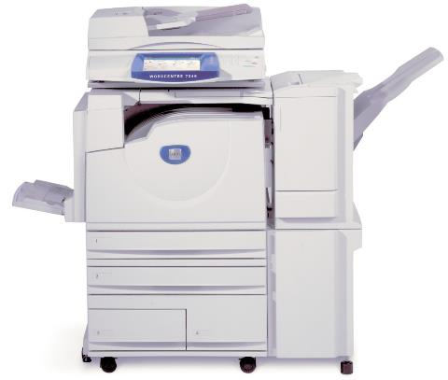
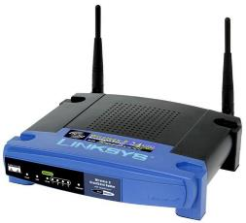
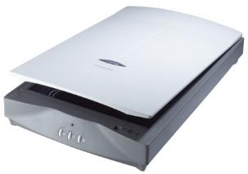
Technology Tools: Hardware

Slide 5








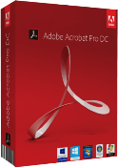

Technology Tools: Software
Notes:
Software is what makes the hardware work such as Windows for your computer, Apple iOS for your iPhone, firmware for the copier or scanner, etc… this software is known as “operating systems”. You can install even more software onto the operating system called “Software Applications” or “apps” like Quickbooks, Microsoft Office, iWork, Adobe Acrobat, Firefox, Facebook and Twitter. Your software may not always “cost you money”. Later, we’ll talk more about software – and specifically – free and open source software.

Slide 6

Tool #1 – Conduct an Inventory
Workstations, Hardware, Equipment
Software
Networks
Databases
Online Presences

Slide 7
Workstations / Hardware / Equipment
Manufacturer
Make
Model
Serial Number
Status
Purchased Date
Warranty
Cost
CPU
RAM
HDD/SSD
NIC
Removable Drives
Monitor
User
Peripherals
Condition

Slide 8
Software
Title
Version / Release
Description
License Info
Type
Status
Purchased Date
Maintenance
Cost
Compatibility

Slide 9
Networks
LAN / WAN
Wiring
Wireless / Wi-Fi
Network speeds
Network protocols
Internet services (ISP)
Hosts (Web, Email)
Firewalls
RAS / VPN
Equipment
Diagrams
Site Plans

Slide 10
Databases
Client/Server
Local
File/Server shares
Online
Access/Passwords

Slide 11
Online Presences
Website(s) / FTP
Domain names
Facebook, Twitter, LinkedIn, Instagram, Pinterest, etc.
Email
Access/Passwords

Slide 12
Recommendations
TechSoup
  Help Desk Services (One-time or subscription)
  Technology Implementation (Free)
TechImpact
  Help Desk Services (One-time or subscription)
  Technology Assessment (Free)
Inventory Software
  Spiceworks
  SysAid Free Edition
  IT Asset Tool
  Spreadsheets

Slide 13



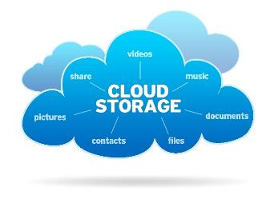



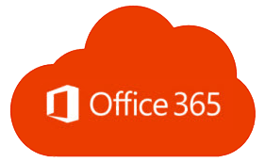

Technology Tools: Cloud

Slide 14
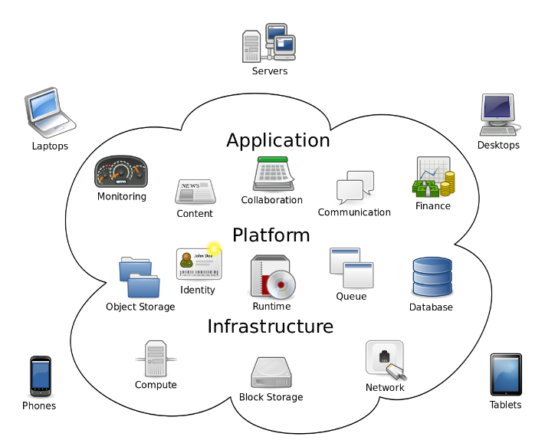
CLOUD COMPUTING

Slide 15
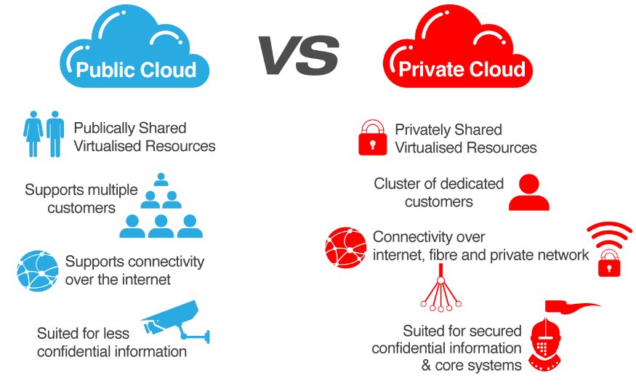
CLOUD OPTIONS

Slide 16
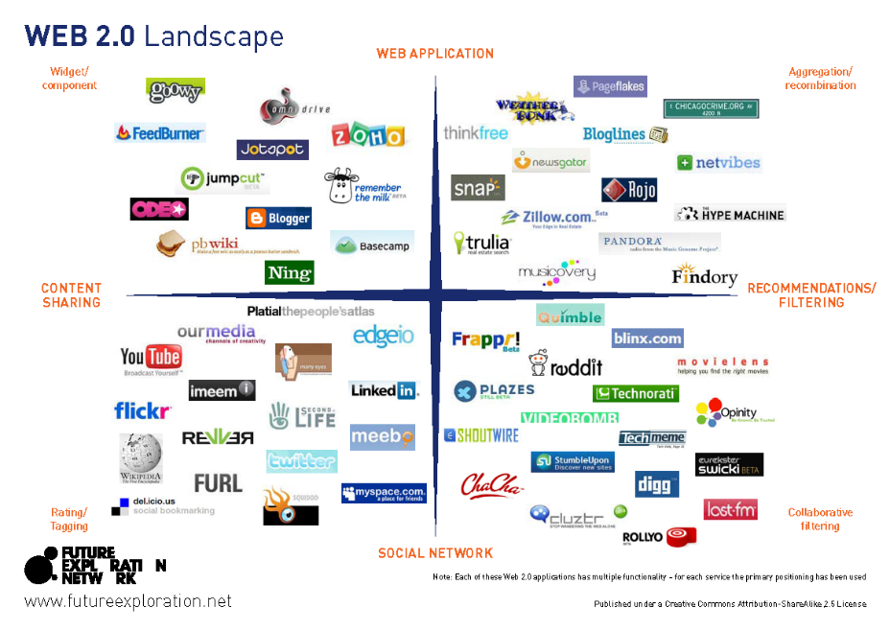

Slide 17
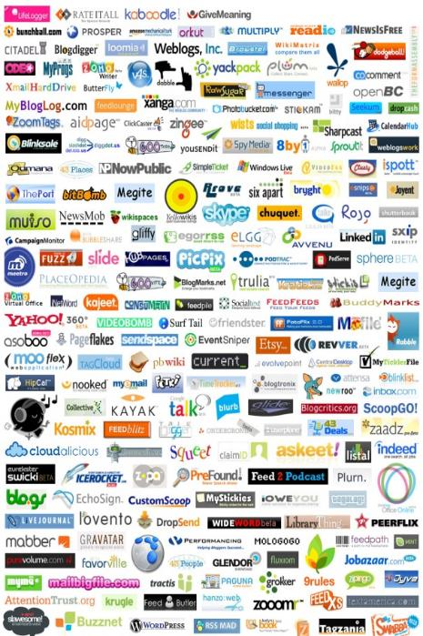
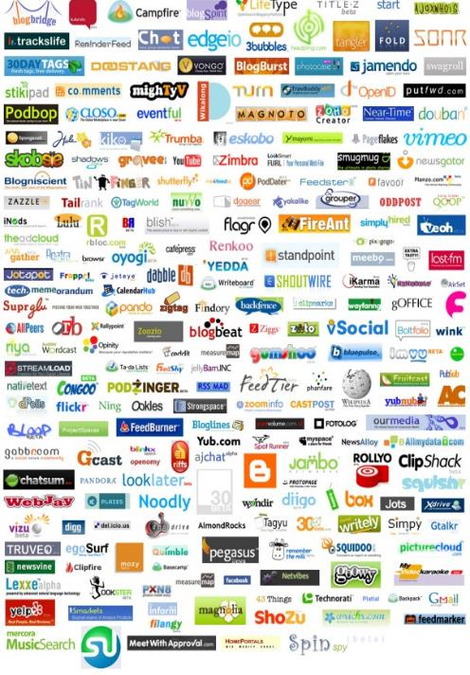

Slide 18











































Which one?

Slide 19
CYBER SECURITY
Identifying, Understanding and Mitigating
the Latest Security Threats to Hit Nonprofits

Slide 20
Top Security Threats
Malvertising
Phishing / Spear Phishing / Whaling
Ransomware
Internal Threats
External Threats

Slide 21
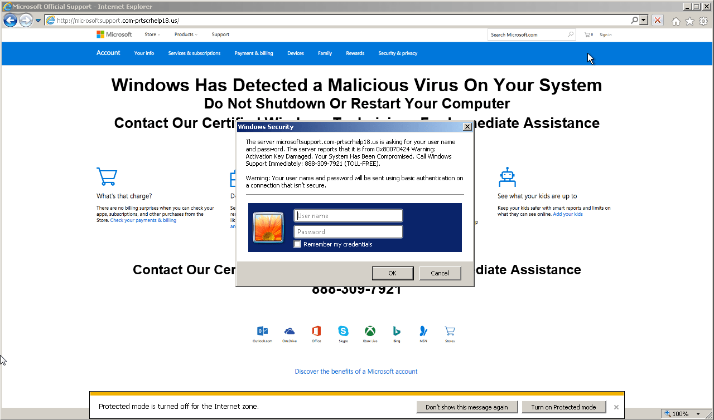
Malvertising

Slide 22
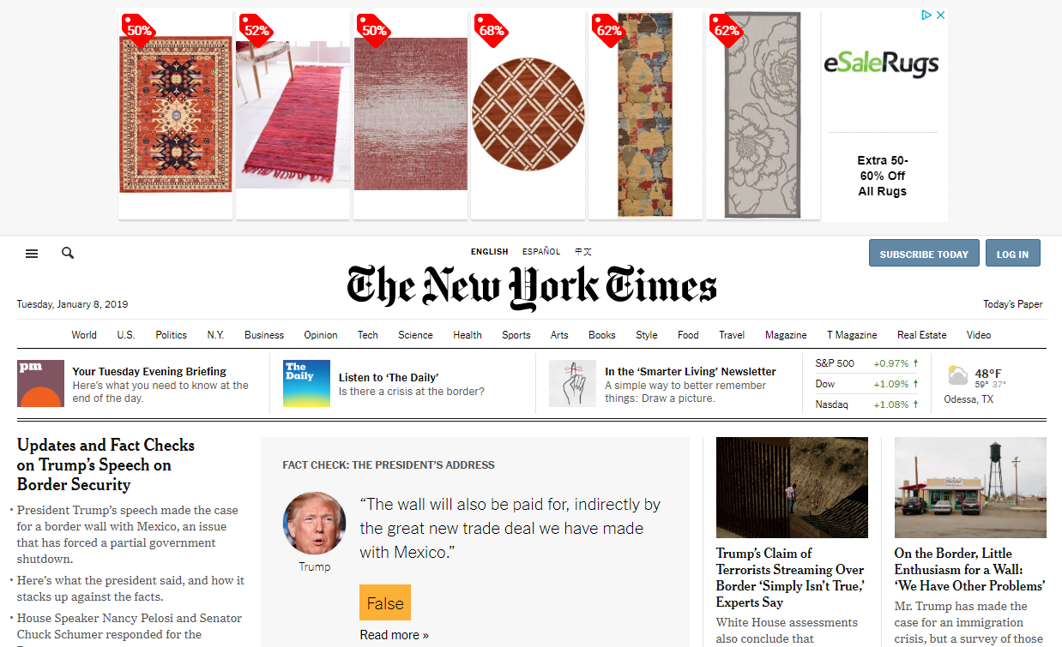
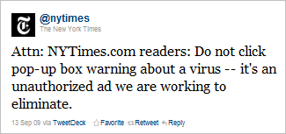
Malvertising

Slide 23

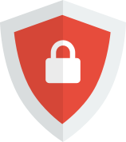



Malvertising
Advertising Blockers (plugins, extensions for browsers)
  AdBlock
  AdBlocker Ultimate
  uBlock Origin
  Ghostery
  AdBlock Plus
  many more

Slide 24






Malvertising
Internet Browsers with built-in blockers
  Opera / Opera Mini / Opera Touch
  Firefox Focus
  Microsoft Edge
  Brave Browser
  Ghostery Privacy Browser
  Slimjet
  and a few others

Slide 25
Malvertising
DNS Web Filters
  OpenDNS
  CleanBrowsing DNS
  SafeDNS
  Norton ConnectSafe
  Comodo Secure DNS
  Quad9
VPN Services
  NordVPN
  ExpressVPN
  BulletVPN
  PrivateInternetAccess
  CyberGhost VPN
  TunnelBear VPN

Slide 26





Malvertising
Applications / Appliances / Hardware
  1Blocker (iOS, Mac)
  AdLock (Windows $22, Android $11)
  Disconnect.me
  Sophos UTM Home*
  clearOS*
* May require additional IT service/support

Slide 27
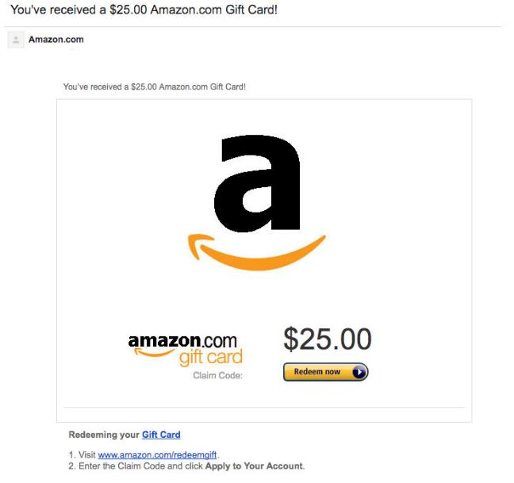
Phishing
(The Lookalike)

Slide 28
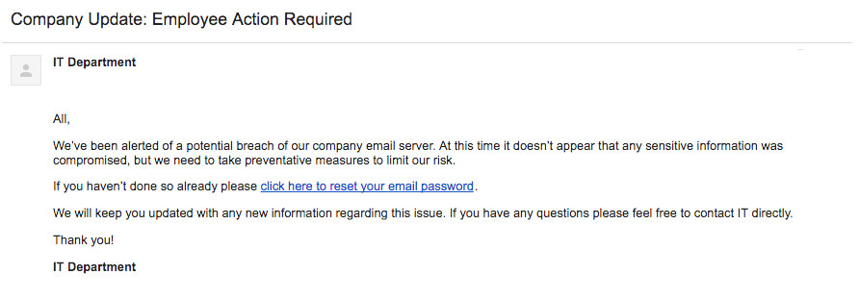
Phishing
(The Internal Request)

Slide 29
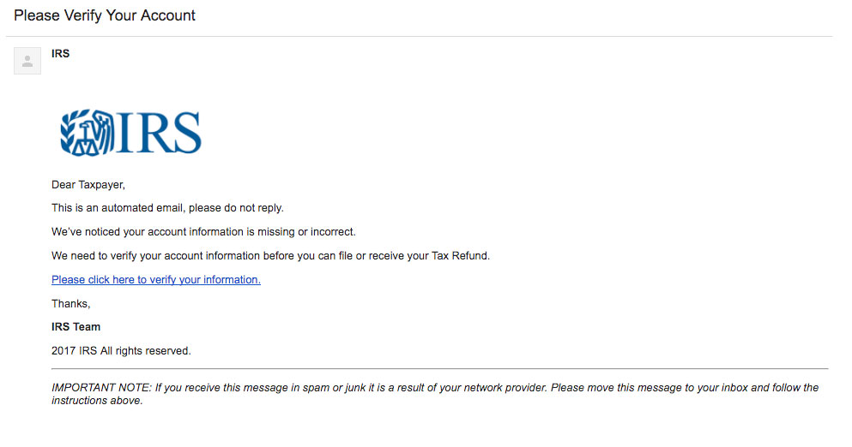
Phishing
(The Government Threat)

Slide 30
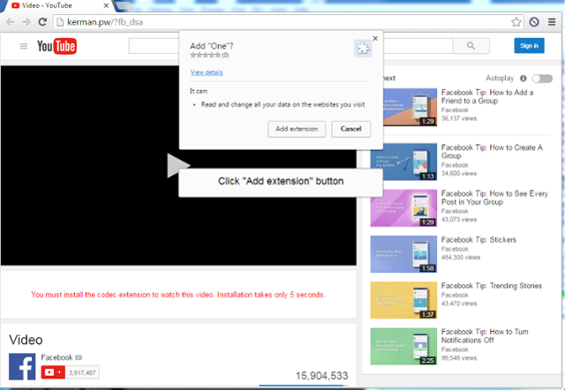
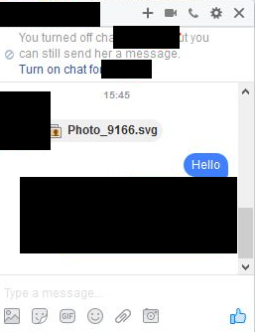
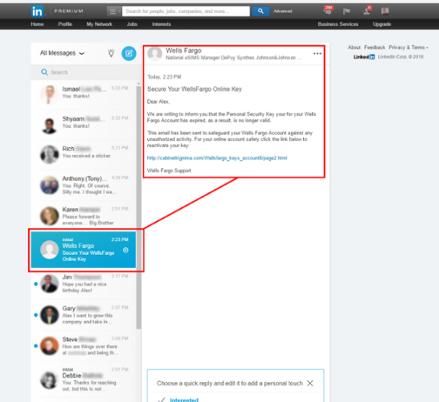
Phishing
(Social Media Exploits)

Slide 31
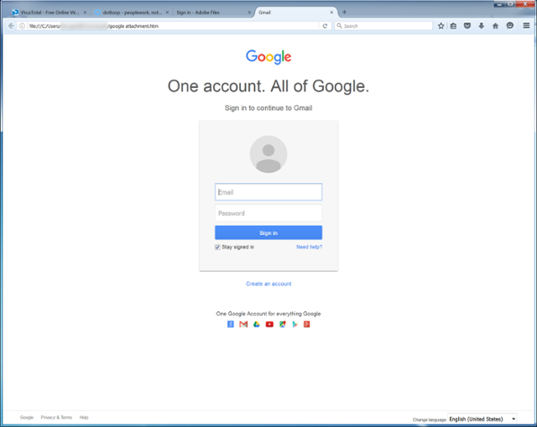
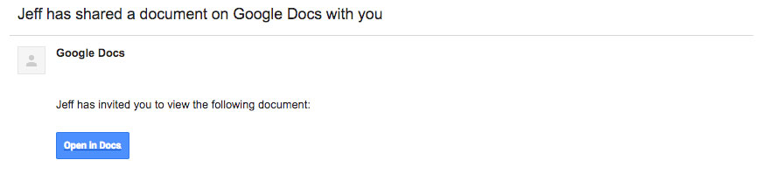
Phishing
(Spoofing Attack)

Slide 32
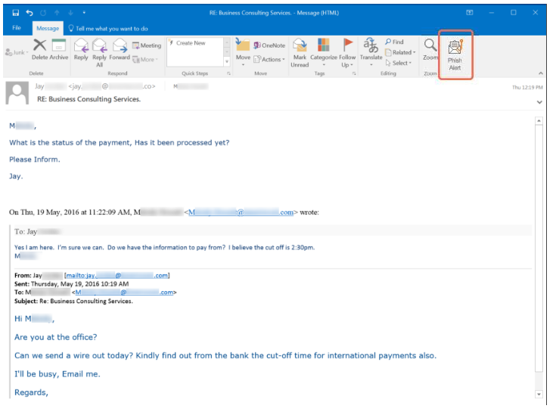
Phishing
(Spear Phishing / Whaling)

Slide 33
Phishing
IE
CHROME
EDGE
FIREFOX
OPERA

Slide 34
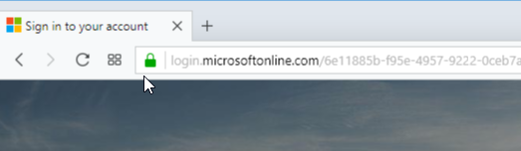
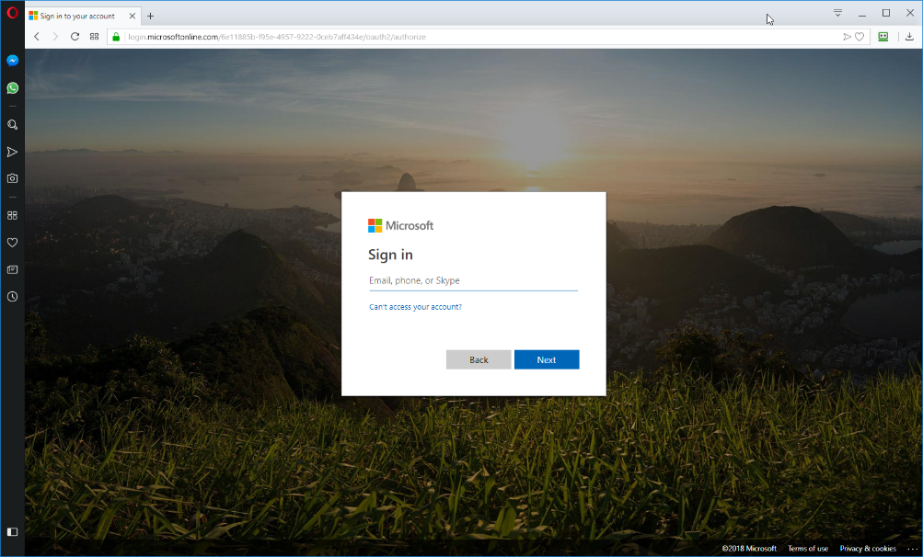
Phishing
SSL/TLS

Slide 35
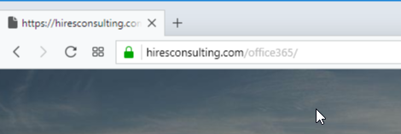
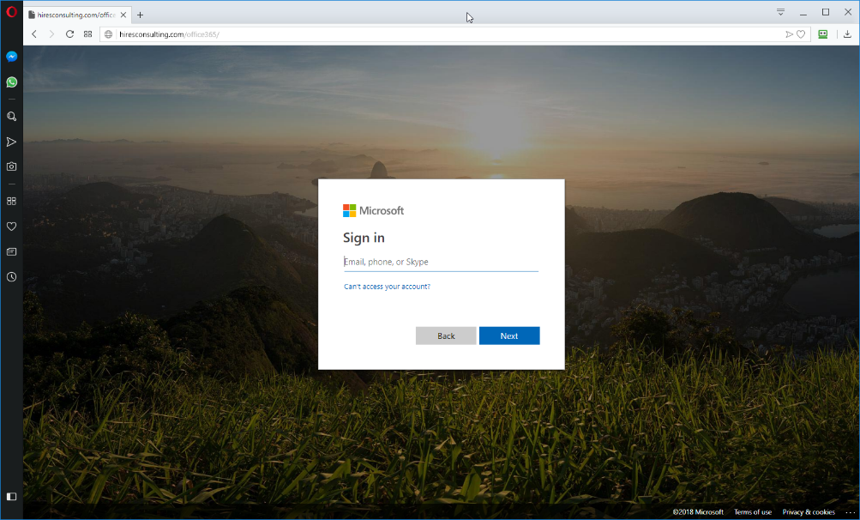
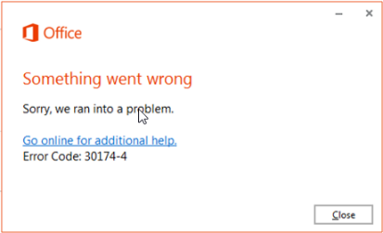
Phishing
SSL/TLS

Slide 36
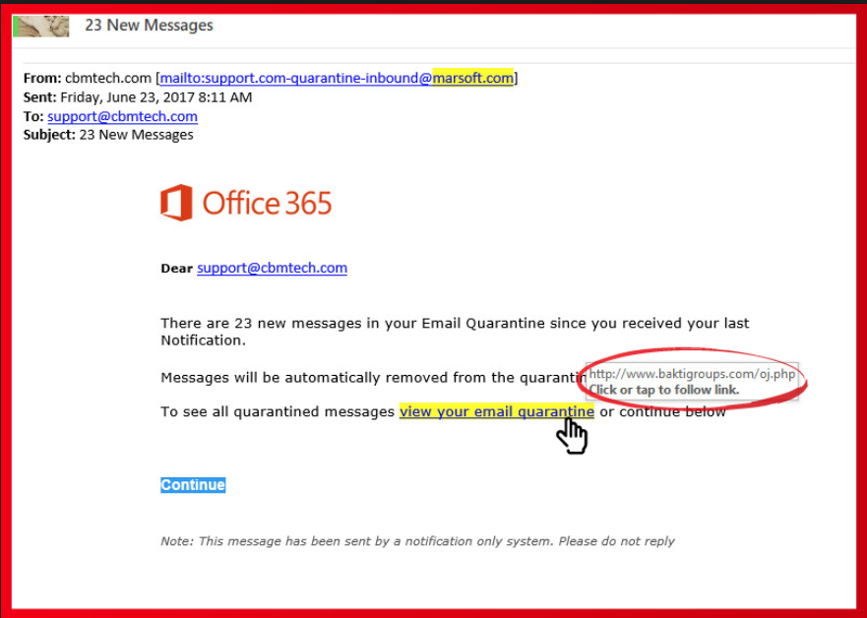
Phishing

Slide 37
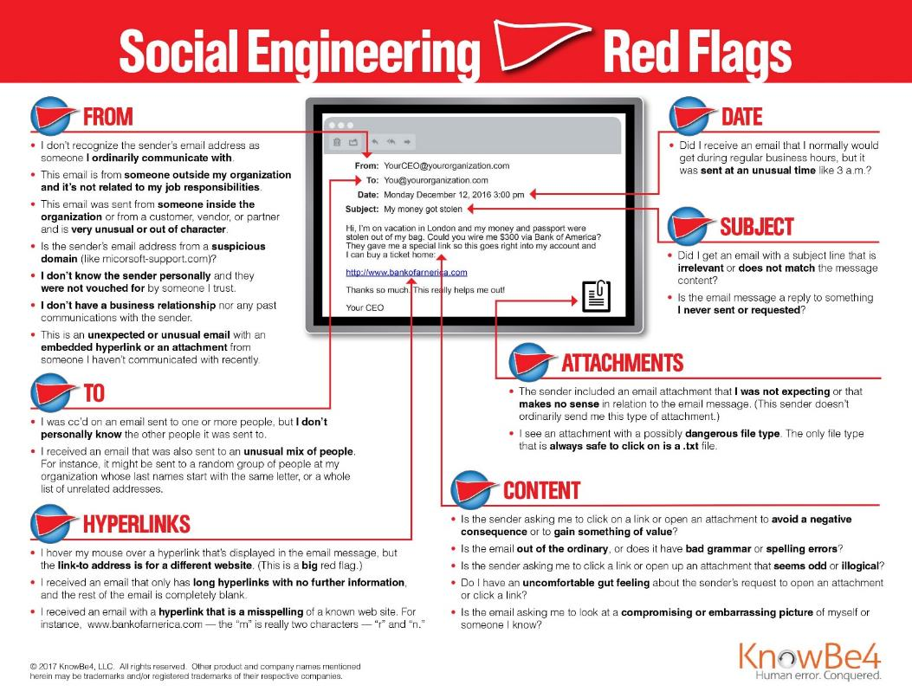
Phishing

Slide 38
Phishing
Two-Factor Authentication
Multi-Factor Authentication
Strong & Unique Passwords for EACH & EVERY LOGIN
Check/Monitor for Breaches
Password Managers
Different/Aliased Email Accounts
Wrong Passwords
Temporary Email Addresses / Hide my Email, Free Accounts

Slide 39
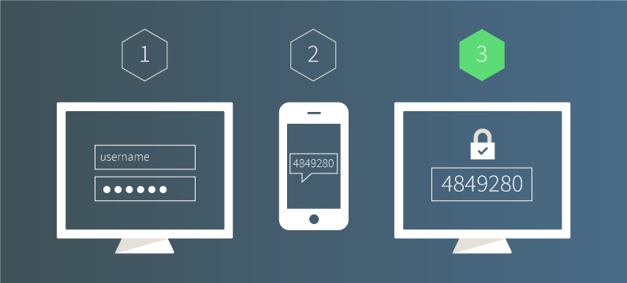
Phishing
Two-Factor Authentication (2FA)
  Usually Password & Text/SMS Codes

Slide 40
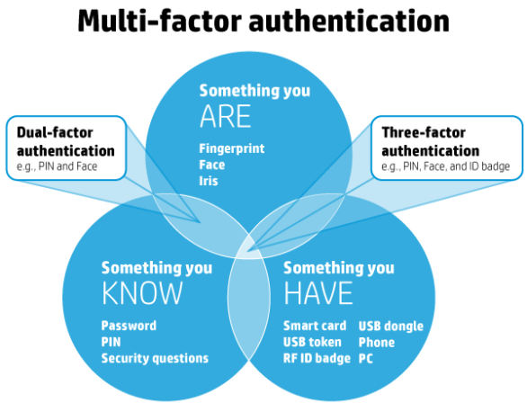
Phishing
Multi-Factor Authentication (MFA)
  Multiple verification methods required

Slide 41
Phishing
Strong & Unique Password for EACH & EVERY LOGIN
  https://howsecureismypassword.net
  https://lastpass.com/howsecure.php
  https://password.kaspersky.com/
  https://passwordsgenerator.net/
  https://www.lastpass.com/password-generator/
  https://www.roboform.com/password-generator

Slide 42
Phishing
Strong & Unique Phrases for EACH & EVERY LOGIN
  https://bitwarden.com/password-generator/
  https://passphrase-generator.com
  https://useapassphrase.com
  https://goodpassphrase.com
  https://getapassphrase.com

Slide 43
Phishing
Check/Monitor for Account Breaches
  https://haveibeenpwned.com
  https://www.dehashed.com/
  https://monitor.firefox.com
  https://www.creditkarma.com/id-monitoring
  https://wallethub.com/free-credit-monitoring/

Slide 44
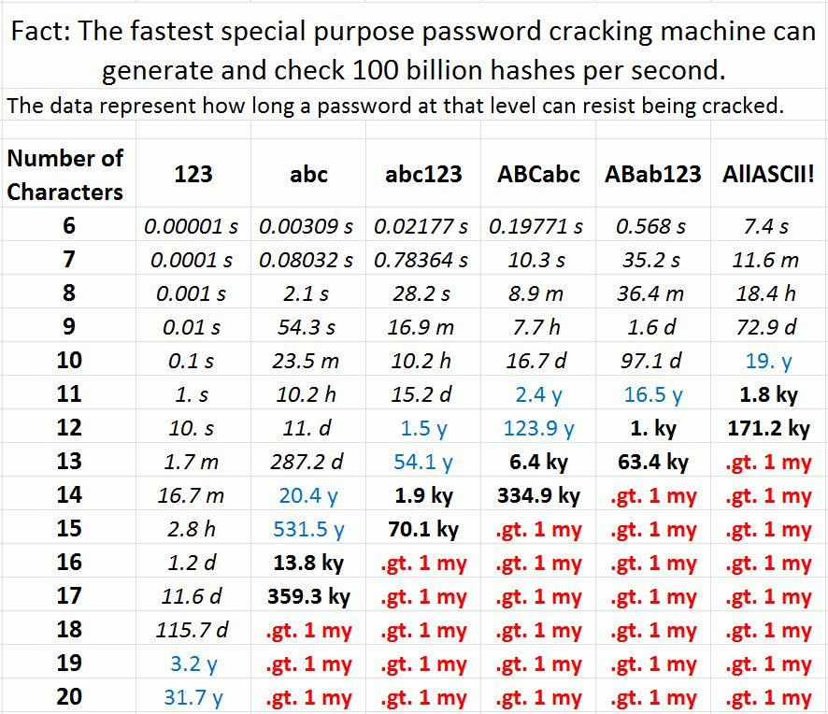
Phishing

Slide 45
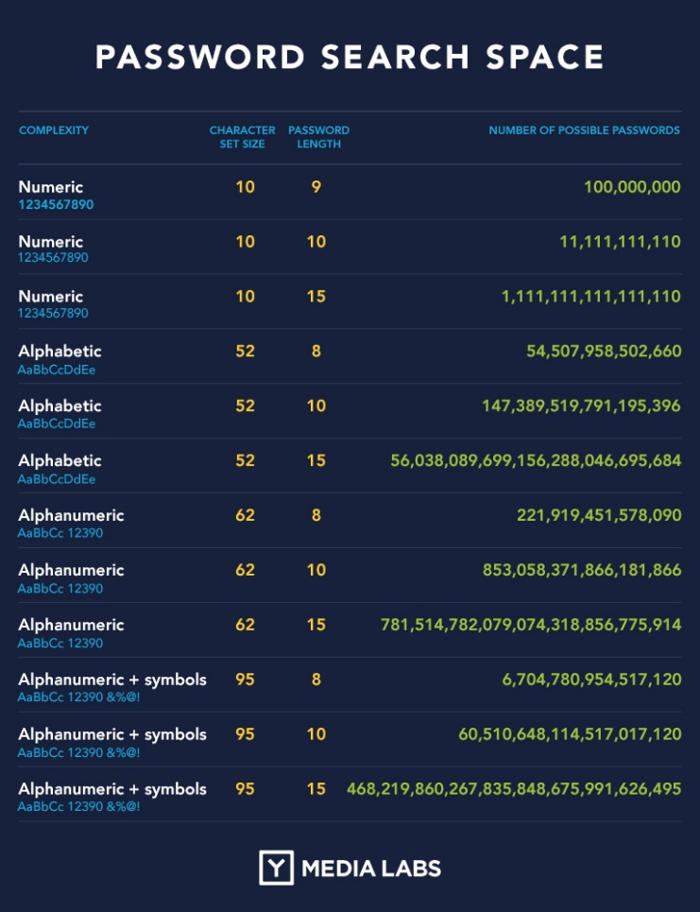
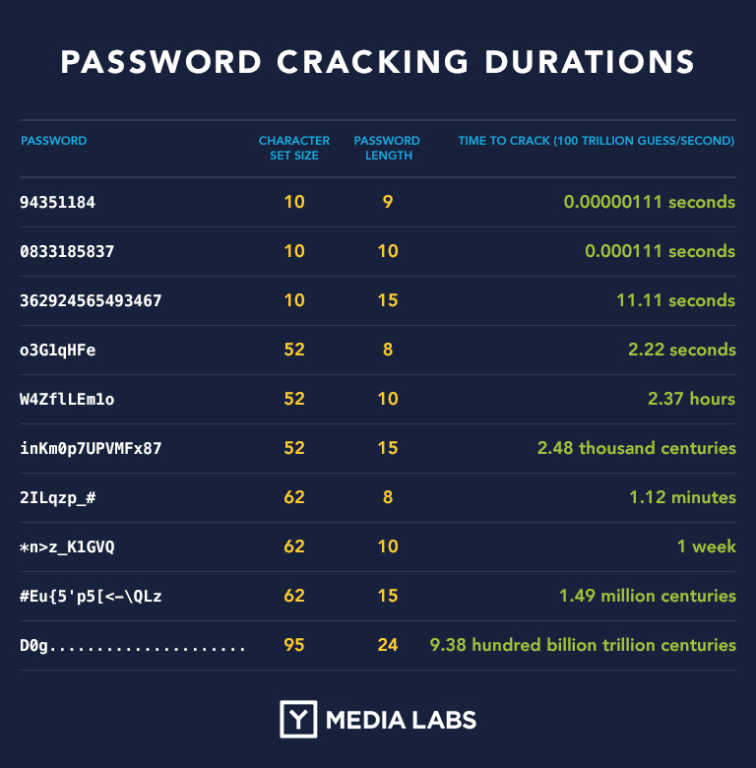
Phishing

Slide 46



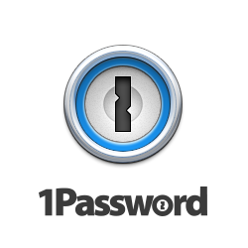


Phishing
Password Managers
  1Password
  Bitwarden
  Dashlane
  Keepass
  Lastpass
  Roboform

Slide 47
Phishing
Different / Shared / Aliased Email Accounts / Profiles
  Generic / Shared Mailboxes
    info@mydomain.org, admin@mydomain.org,
    media@mydomain.org, accounts@mydomain.org
  Aliased Email Accounts
    Primary email: garyhires@mydomain.org
    Alias email: it@mydomain.org, network@mydomain.org

Slide 48




Phishing
Different/Browsers Profiles
  Setup and utilize “browser profiles” for specific “internet tasks” within single “browser”
    Firefox, Chrome, Edge, Opera, Brave, Safari
  Install and utilize different “browsers” for specific “internet tasks”

Slide 49
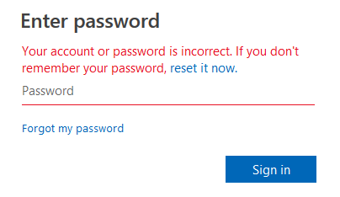
Phishing
Wrong Passwords
  Simply enter an intentionally INCORRECT/BAD password
  The “real” website should return with an “invalid account, username or password” type response.

Slide 50
Phishing
Temporary Email Addresses
  Use free services like tempail.com, tempmail.mail, emailtemp.org, minuteinbox.com
Hide my Email
  Apple iCloud+ subscribers
Free Generic Junk Email Accounts
  Gmail, Hotmail, Yahoo, Outlook, iCloud, Proton

Slide 51
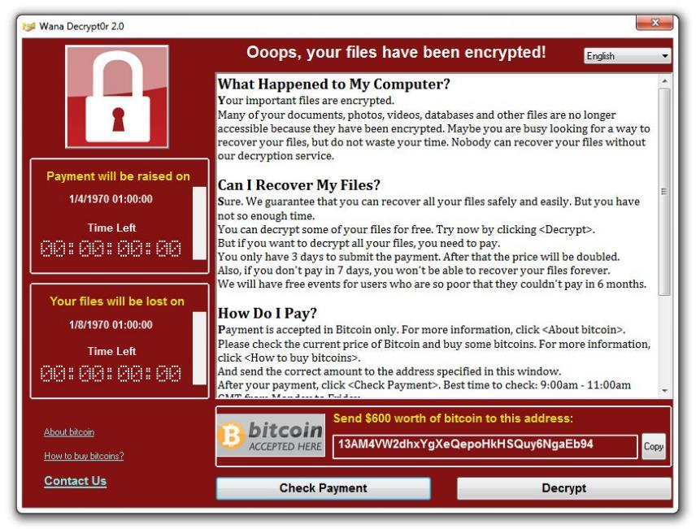
Ransomware

Slide 52
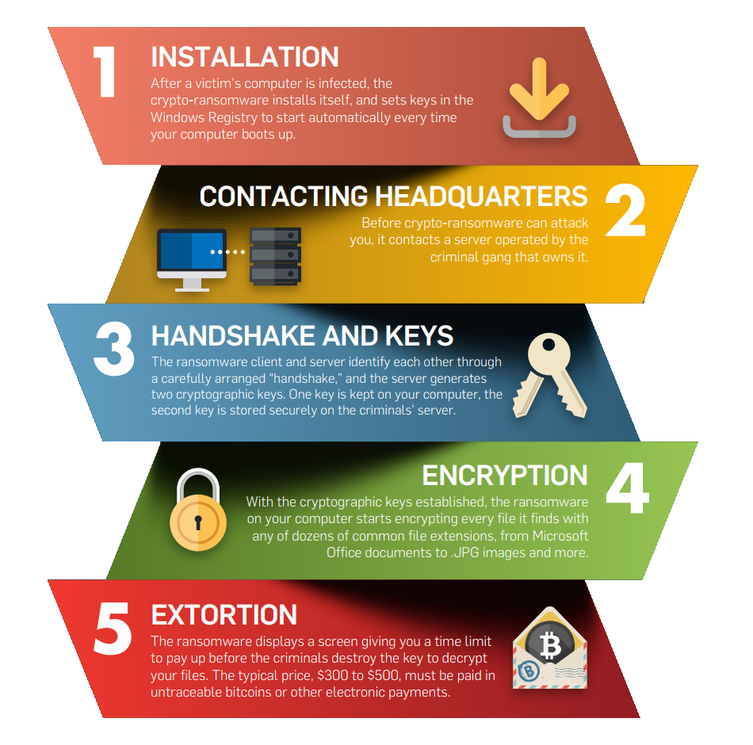
Ransomware

Slide 53
Ransomware
Education
Backups
GFS Retention Policies
Remove local administrative rights from daily use account
Be wary of any email attachments

Slide 54
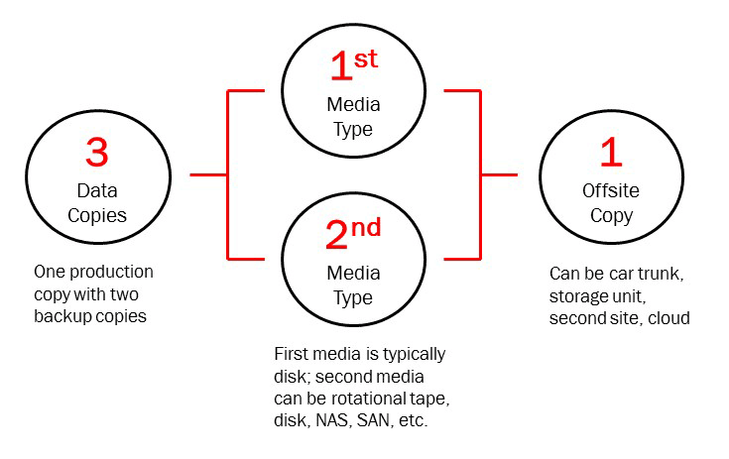
Ransomware
Backups

Slide 55
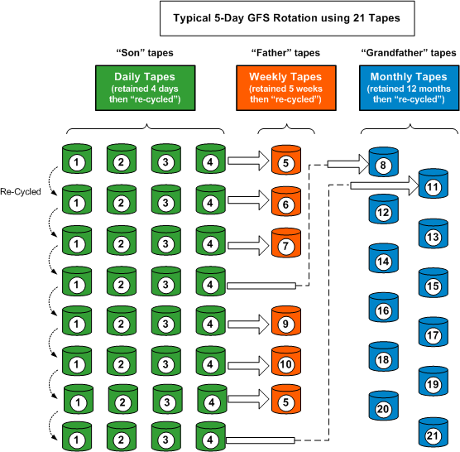

Ransomware
GFS Retention Policies

Slide 56


Ransomware
Remove local administrative rights
  Use Standard User rather than Administrator

Slide 57


Ransomware
Elevate permissions to Administrator only when necessary

Slide 58
Internal Threats
Employees
  Insider malice
  Poor Password Practices
  Weak Access Policies
  Unsafe Downloads
  Unprotected Data and Email

Slide 59
Internal Threats
Software / Systems
  Unsecured Software
  Unsecured Devices
  Unsecured Network / Wi-Fi
  Bad Access Practices

Slide 60
Internal Threats
Devices / Internet-of-Things (IoT)
  Employee’s BYOD – Bring your own device
  Employee Online Access, VPN, Remote Access/Connectivity
Automation/“Connected” Devices
  Software/Firmware Outdated/Unpatched
Websites, Remote Access Gateways, VPN, Servers
  Outdated/Unpatched
  Unmanaged and Unmonitored

Slide 61
Internal Threats
Education, Education, Education
IT Service/Support/Consultants
Conditional Access (Filtering, Blocking)
Privileged Access
Updated/Patched Software and Firmware
Managed/Monitored Servers, Software and Devices
Intentional Increased Security Measures

Slide 62
External Threats
Employees
  BYOD – Bring your own device
  Online Access, VPN, Remote Access/Connectivity
  Severed, Malicious Intentions
Websites, Remote Access Gateways, VPN, Servers
  Outdated/Unpatched
  Unmanaged and Unmonitored

Slide 63
External Threats
Education, Education, Education
IT Service/Support/Consultants
Conditional Access (Filtering, Blocking)
Privileged Access
Updated/Patched Software and Firmware
Managed/Monitored Servers, Software and Devices
Intentional Increased Security Measures

Slide 64

Questions & Answers

Slide 65

Tool #2 – Research
Hardware
  Amazon, BestBuy, Newegg, TigerDirect, Techie
Software
  Online Reviews, Google Search
Cloud (Apps)
  AlternativeTo, Osalt, Sourceforge
  Capterra.com, g2.com, Trustpilot.com
  TrustRadius.com

Slide 66
Types of Software / Apps
Commercial
Freemium
Free Open Source Software (FOSS)

Slide 67

alternativeto.net

Slide 68

osalt.com

Slide 69

sourceforge.net

Slide 70

capterra.com

Slide 71

g2.com

Slide 72

trustradius.com

Slide 73

Tool #3 – “Office” Productivity Suite
Microsoft 365 for Nonprofits
Google Workplace for Nonprofits
LibreOffice, OpenOffice, OnlyOffice

Slide 74

Microsoft 365 Business Premium for Nonprofits
(Free, $3.00, $5.50, $9 or $22.50 per user/month)

Slide 75

Microsoft 365 Business
(Free for first 10 users, $5.00 per user/month for additional users)

Slide 76


Microsoft Azure Donation
($3500 in Credits)

Slide 77

Google for Nonprofits
(Free, $3.00, $5.04, 70% Discount for Nonprofits)

Slide 78



LibreOffice, OpenOffice, etc.

Slide 79


AWS for Nonprofits
($175 TechSoup Admin Fee = $2,000 AWS Credits)

Slide 80

Tool #4 – Get a NAS
Networked Attached Storage (NAS)
  Additional Storage Space
  Easier Collaboration, Less Mess
  Your own “Private Cloud”
  Automatic Data Backups
  Fast Configuration with Low Complications
  Lots of Apps available

Slide 81






Network Attached Storage
Synology, Qnap, Drobo,
Seagate, Western Digital, Netgear

Slide 82











Server / NAS Applications
Apache, Asterisk, Drupal, Joomla, MySQL, PHP, Python, Tomcat, vTiger, Wordpress

Slide 83

Tool #5 – Security (Online, Devices, etc.)
  Secure your devices
  Always use HTTPS if possible
  Public Wi-Fi – Just Say NO
  Use Password Managers
  Two-Factor Authentication

Slide 84





Password Managers
Bitwarden, LastPass, RoboForm, Dashlane, 1Password, KeePass*

Slide 85
Questions & Answers

Slide 86
Contact Information
Midland Shared Spaces
3500 N A St, Ste 2200
Midland, TX 79705
(432) 685-0400 main
ghires@midlandss.org
https://midlandss.org
Hires Consulting (copy of this presentation)
http://hiresconsulting.com

