Slide 1
CYBER SECURITY
Identifying, Understanding and Mitigating
the Latest Security Threats to Hit Nonprofits

Slide 2
Top Security Threats
Malvertising
Phishing / Spear Phishing / Whaling
Ransomware
Internal Threats
External Threats
Crypto-Jacking

Slide 3
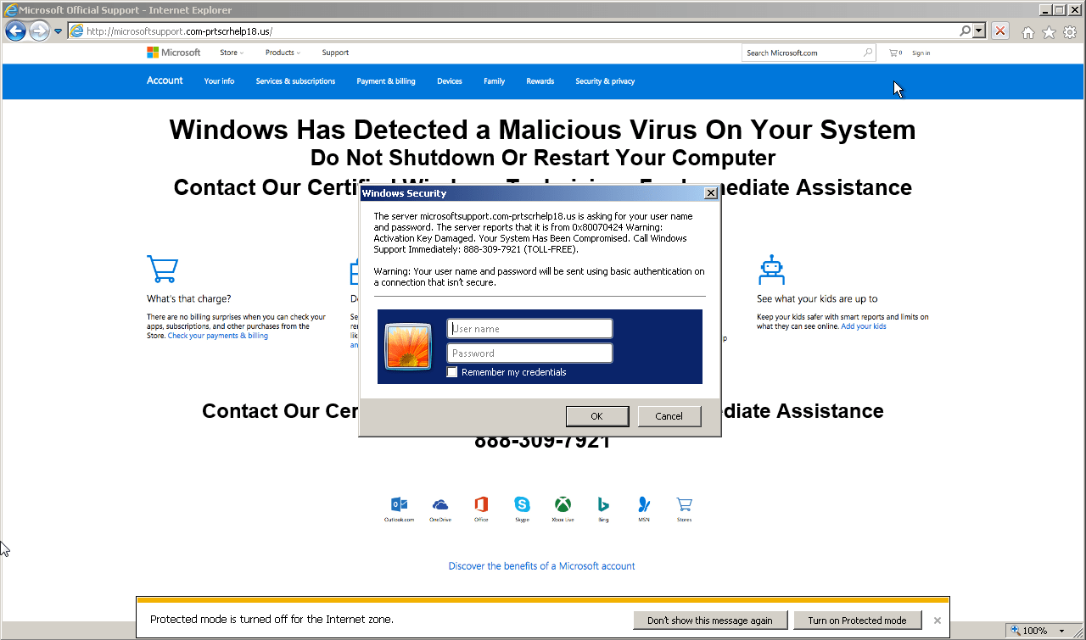
Malvertising

Slide 4
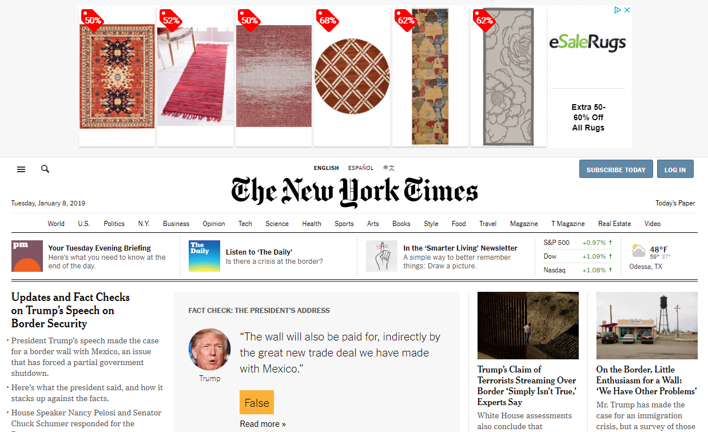
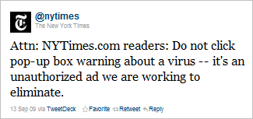
Malvertising

Slide 5

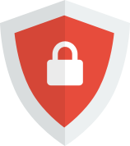



Malvertising
Advertising Blockers (plugins, extensions for browsers)
  AdBlock
  AdBlocker Ultimate
  uBlock Origin
  Ghostery
  AdBlock Plus
  many more

Slide 6






Malvertising
Internet Browsers with built-in blockers
  Opera / Opera Mini / Opera Touch
  Firefox Focus
  Microsoft Edge
  Brave Browser
  Ghostery Privacy Browser
  Slimjet
  and a few others

Slide 7
Malvertising
DNS Web Filters
  OpenDNS
  CleanBrowsing DNS
  SafeDNS
  Norton ConnectSafe
  Comodo Secure DNS
  Quad9
VPN Services
  NordVPN
  ExpressVPN
  BulletVPN
  PrivateInternetAccess
  CyberGhost VPN
  TunnelBear VPN

Slide 8





Malvertising
Applications / Appliances / Hardware
  1Blocker (iOS, Mac)
  AdLock (Windows $22, Android $11)
  Disconnect.me
  Sophos UTM Home*
  clearOS*
* May require additional IT service/support

Slide 9
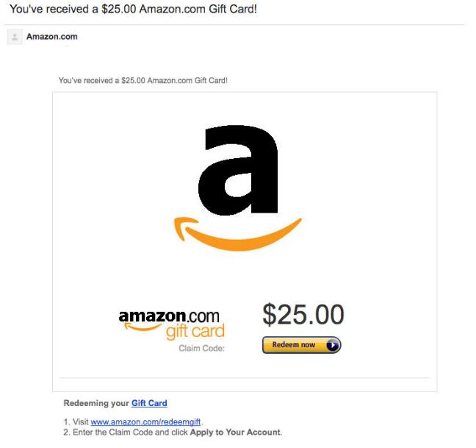
Phishing
(The Lookalike)

Slide 10
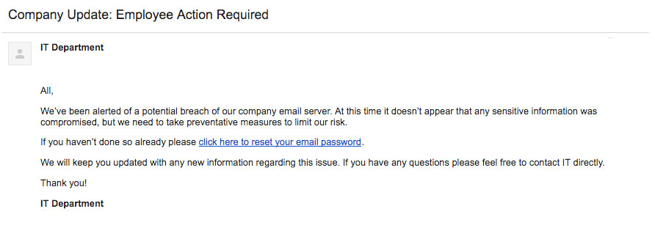
Phishing
(The Internal Request)

Slide 11
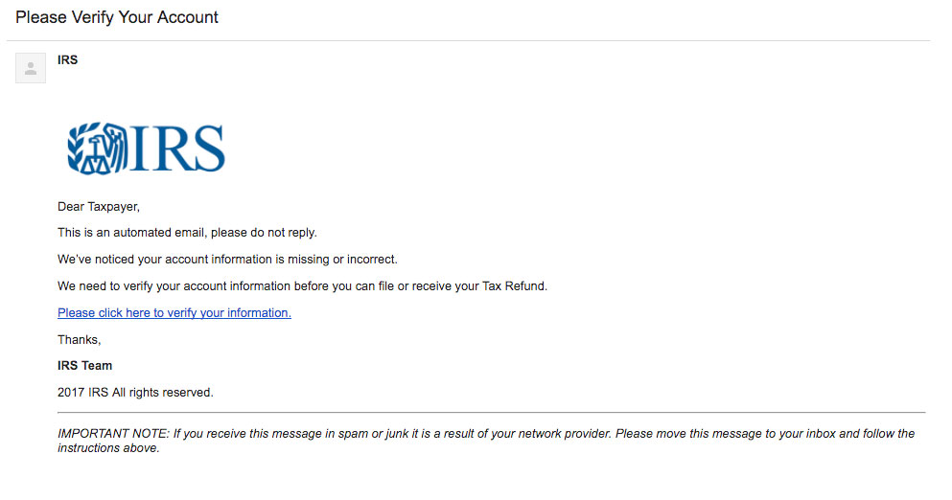
Phishing
(The Government Threat)

Slide 12
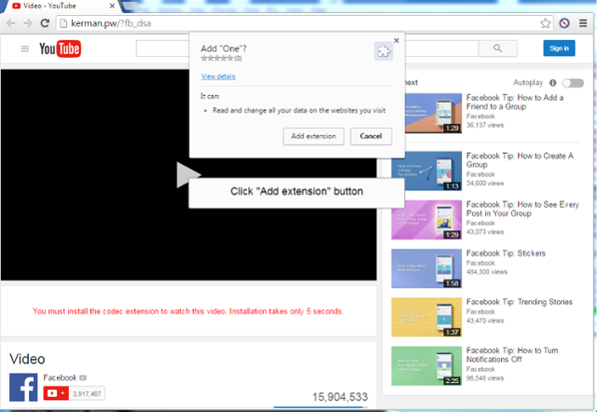
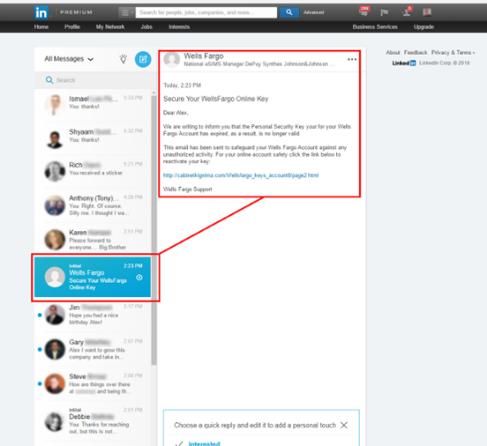
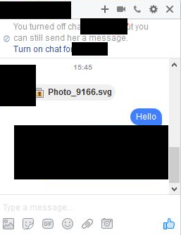
Phishing
(Social Media Exploits)

Slide 13
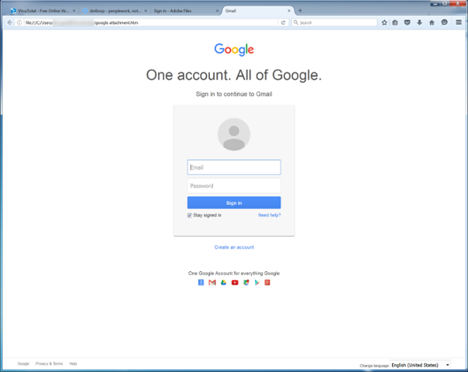
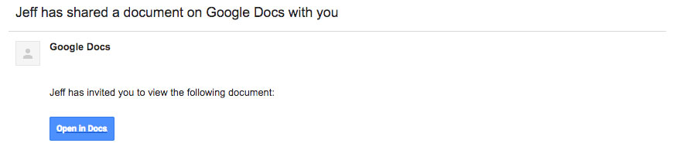
Phishing
(Spoofing Attack)

Slide 14
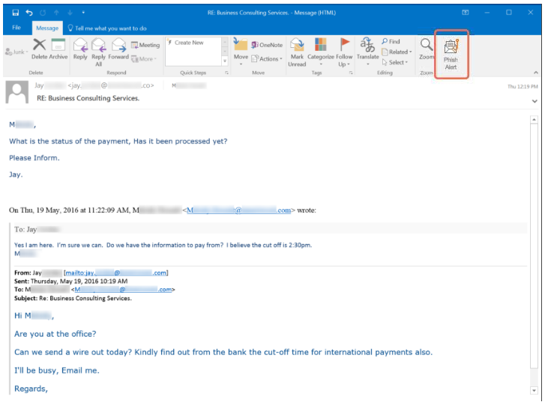
Phishing
(Spear Phishing / Whaling)

Slide 15
Phishing
IE
CHROME
EDGE
FIREFOX
OPERA

Slide 16
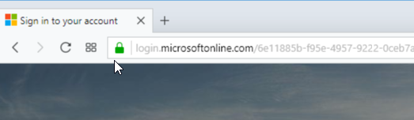
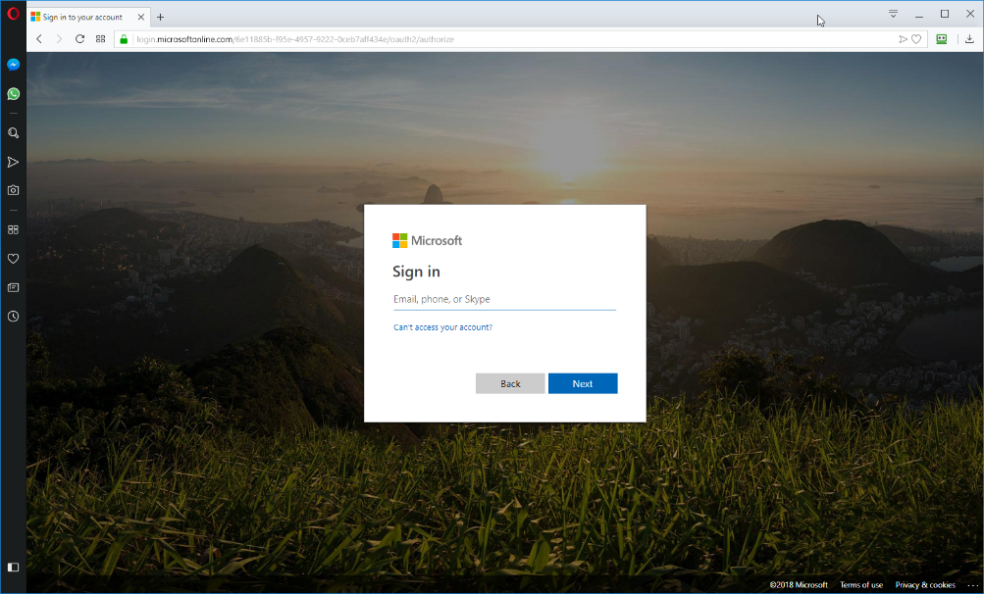
Phishing
SSL/TLS

Slide 17
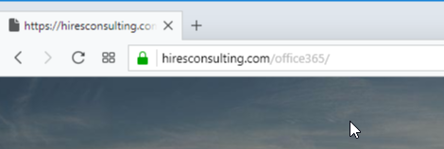
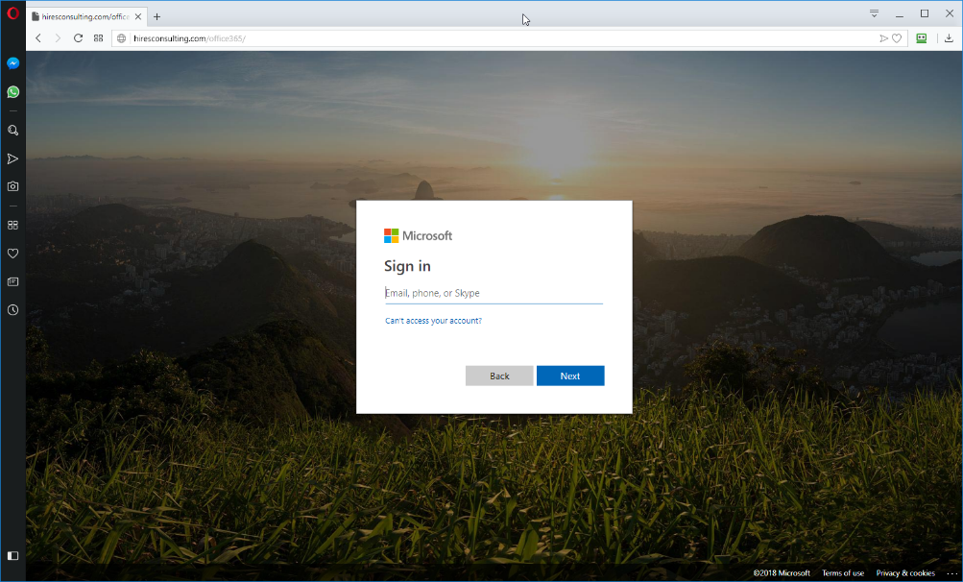
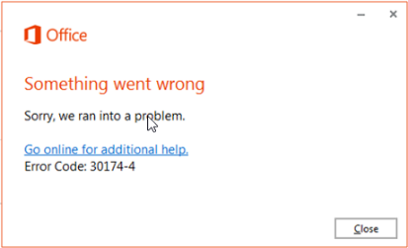
Phishing
SSL/TLS

Slide 18
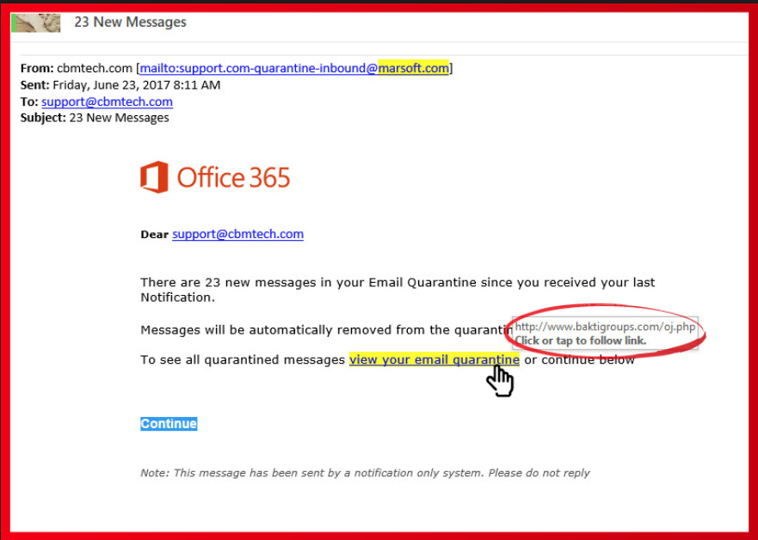
Phishing

Slide 19
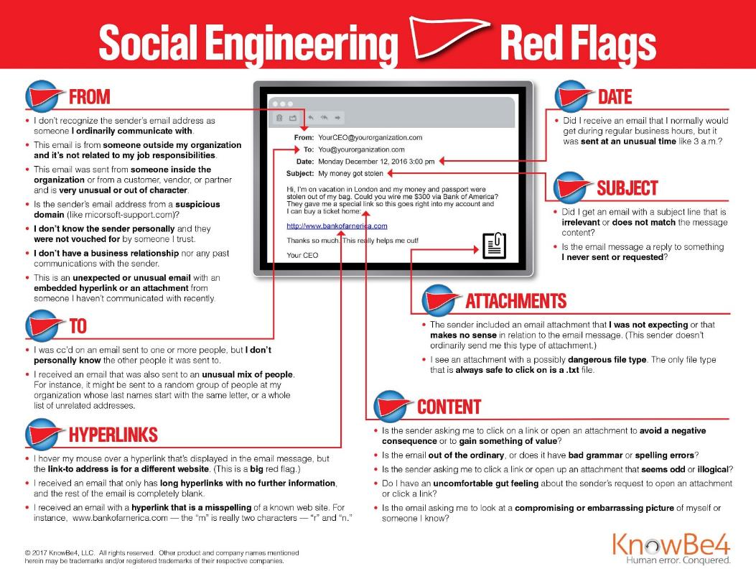
Phishing

Slide 20
Phishing
Two-Factor Authentication
Multi-Factor Authentication
Strong & Unique Passwords for EACH & EVERY LOGIN
Check/Monitor for Breaches
Password Managers
Different/Aliased Email Accounts
Wrong Passwords
Temporary Email Addresses / Hide my Email, Free Accounts

Slide 21
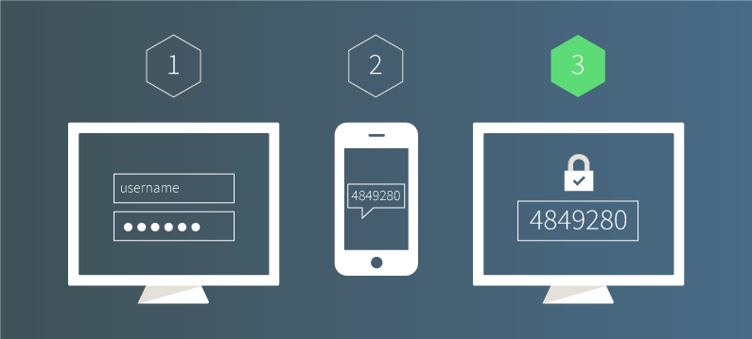
Phishing
Two-Factor Authentication (2FA)
  Usually Password & Text/SMS Codes

Slide 22
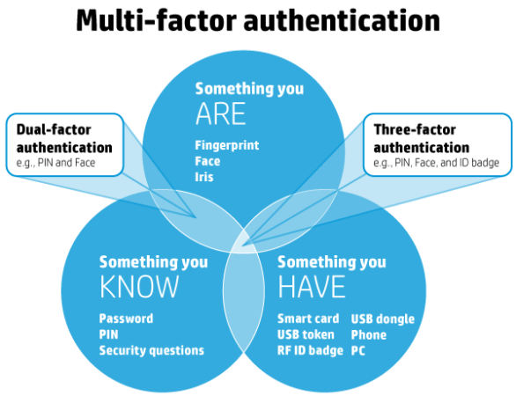
Phishing
Multi-Factor Authentication (MFA)
  Multiple verification methods required

Slide 23
Phishing
Strong & Unique Password for EACH & EVERY LOGIN
  https://howsecureismypassword.net
  https://lastpass.com/howsecure.php
  https://password.kaspersky.com/
  https://passwordsgenerator.net/
  https://www.lastpass.com/password-generator/
  https://www.roboform.com/password-generator

Slide 24
Phishing
Strong & Unique Phrases for EACH & EVERY LOGIN
  https://bitwarden.com/password-generator/
  https://passphrase-generator.com
  https://useapassphrase.com
  https://goodpassphrase.com
  https://getapassphrase.com

Slide 25
Phishing
Check/Monitor for Account Breaches
  https://haveibeenpwned.com
  https://www.dehashed.com/
  https://monitor.firefox.com
  https://www.creditkarma.com/id-monitoring
  https://wallethub.com/free-credit-monitoring/

Slide 26
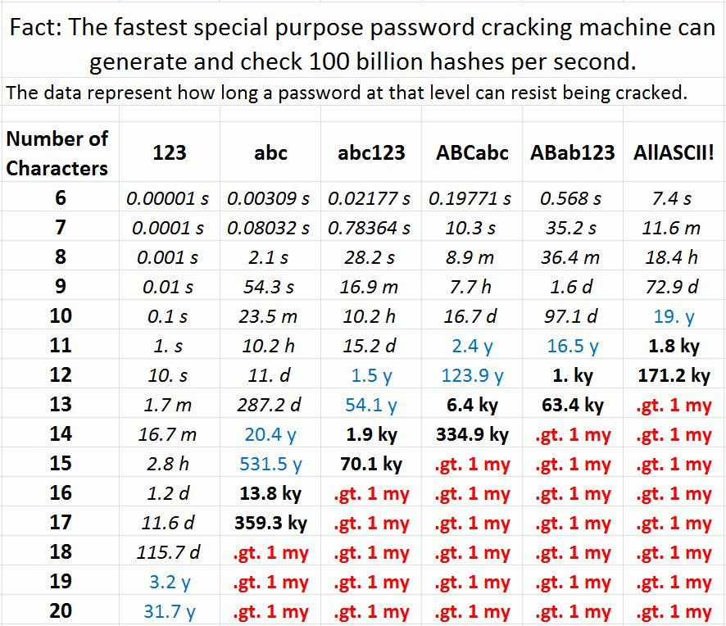
Phishing

Slide 27
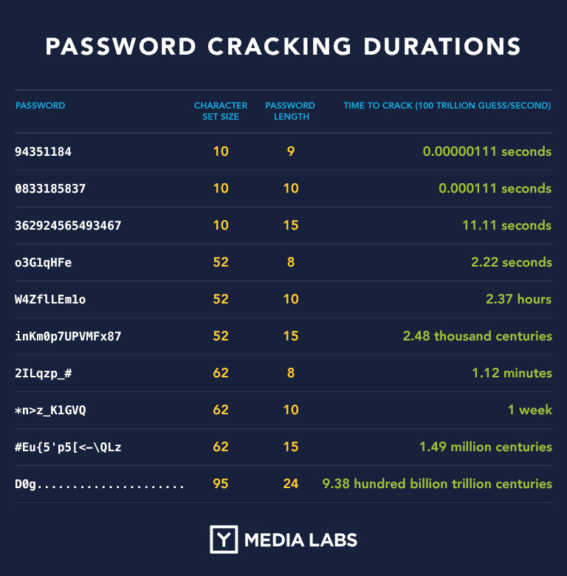
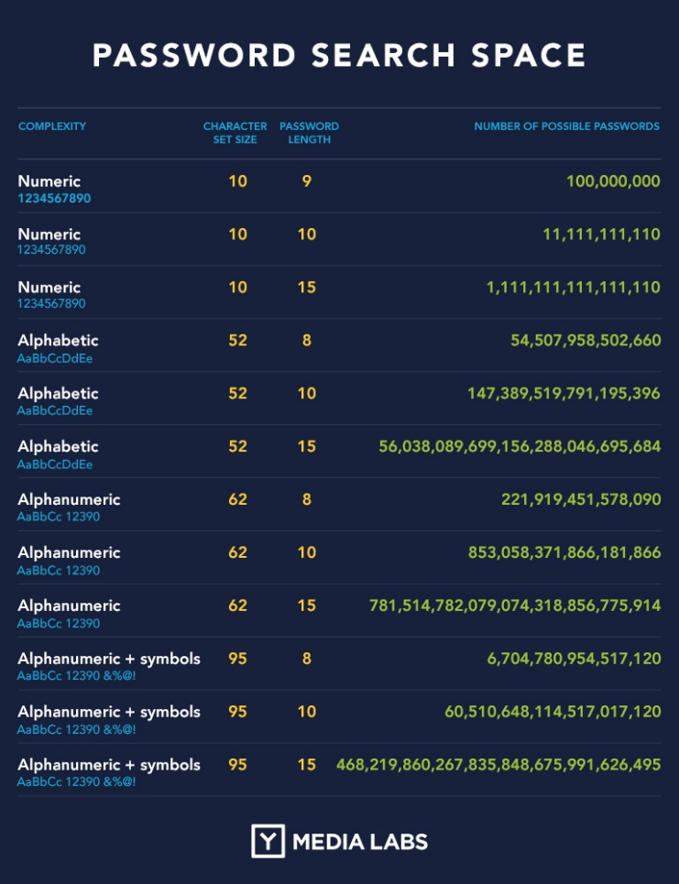
Phishing

Slide 28



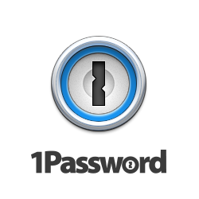
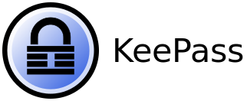

Phishing
Password Managers
  1Password
  Bitwarden
  Dashlane
  Keepass
  Lastpass
  Roboform

Slide 29
Phishing
Different / Shared / Aliased Email Accounts / Profiles
  Generic / Shared Mailboxes
    info@mydomain.org, admin@mydomain.org,
    media@mydomain.org, accounts@mydomain.org
  Aliased Email Accounts
    Primary email: garyhires@mydomain.org
    Alias email: it@mydomain.org, network@mydomain.org

Slide 30




Phishing
Different/Browsers Profiles
  Setup and utilize “browser profiles” for specific “internet tasks” within single “browser”
    Firefox, Chrome, Edge, Opera, Brave, Safari
  Install and utilize different “browsers” for specific “internet tasks”

Slide 31
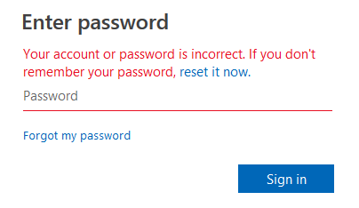
Phishing
Wrong Passwords
  Simply enter an intentionally INCORRECT/BAD password
  The “real” website should return with an “invalid account, username or password” type response.

Slide 32
Phishing
Temporary Email Addresses
  Use free services like tempail.com, tempmail.mail, emailtemp.org, minuteinbox.com
Hide my Email
  Apple iCloud+ subscribers
Free Generic Junk Email Accounts
  Gmail, Hotmail, Yahoo, Outlook, iCloud, Proton

Slide 33
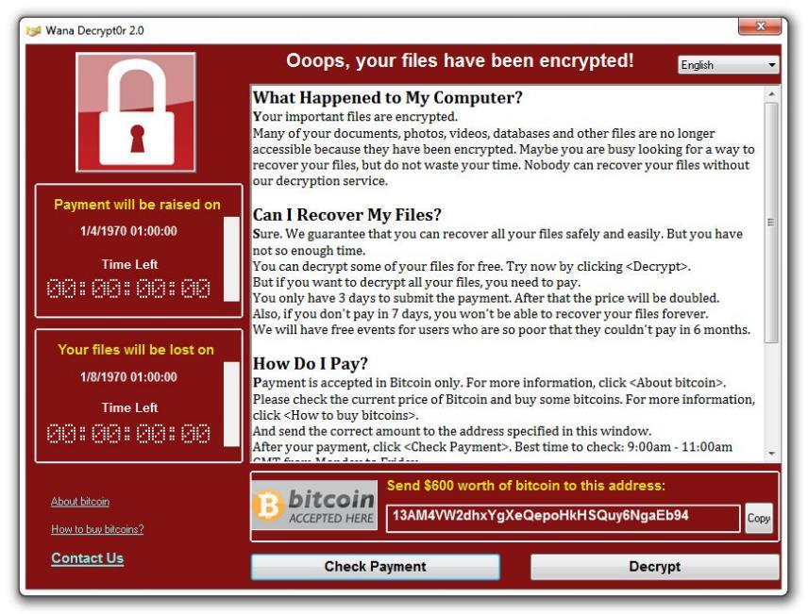
Ransomware

Slide 34
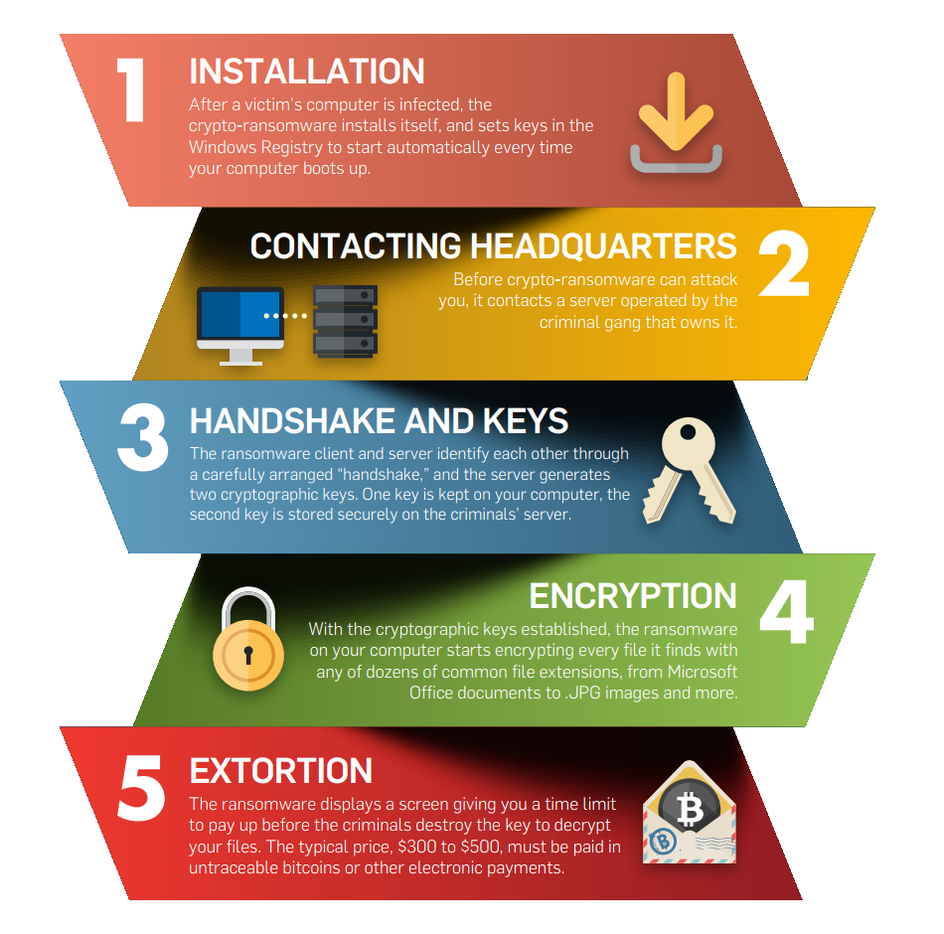
Ransomware

Slide 35
Ransomware
Education
Backups
GFS Retention Policies
Remove local administrative rights from daily use account
Be wary of any email attachments

Slide 36
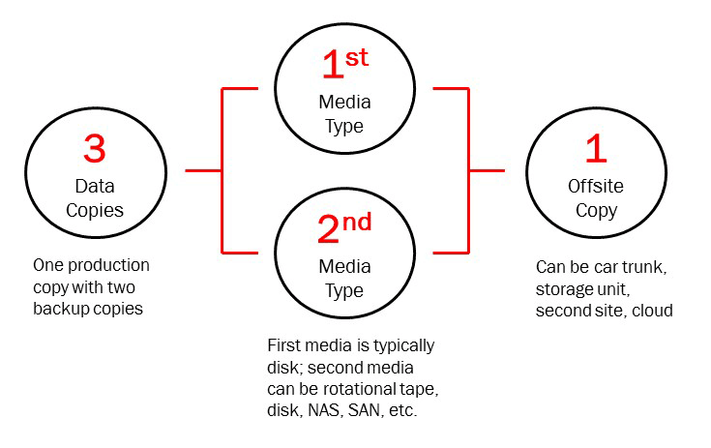
Ransomware
Backups

Slide 37
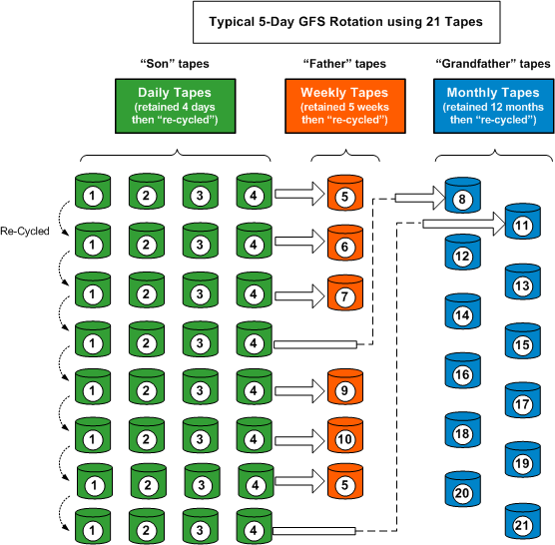
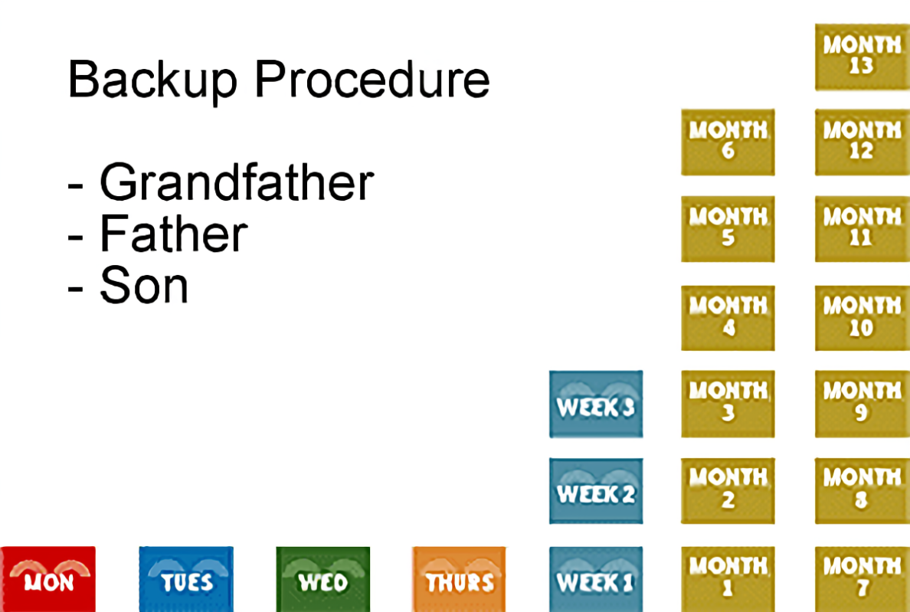
Ransomware
GFS Retention Policies

Slide 38
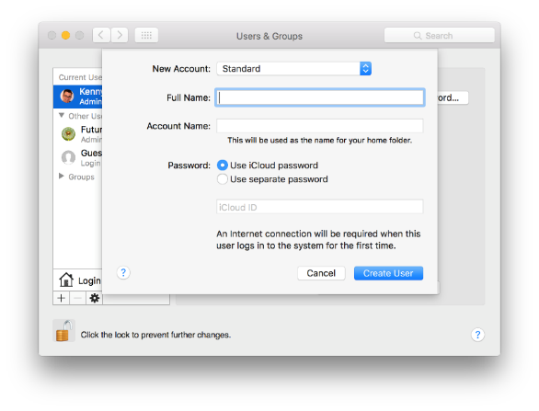
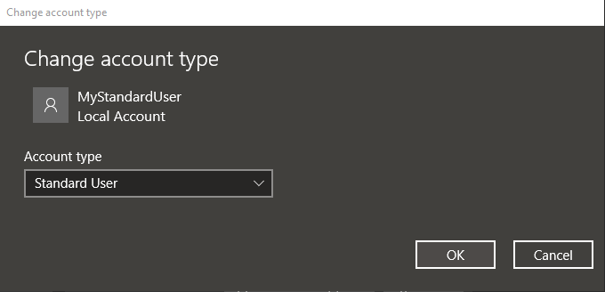
Ransomware
Remove local administrative rights
  Use Standard User rather than Administrator

Slide 39
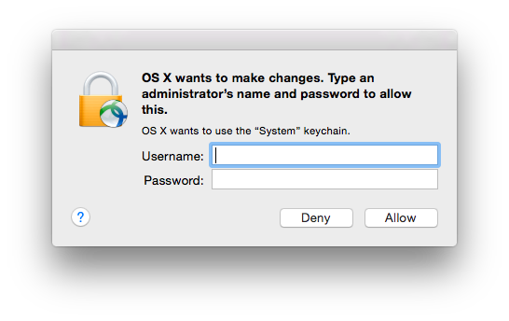
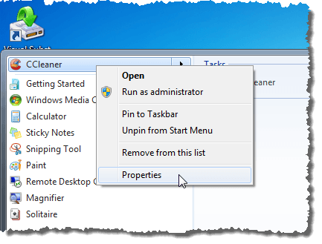
Ransomware
Elevate permissions to Administrator only when necessary

Slide 40
Internal Threats
Employees
  Insider malice
  Poor Password Practices
  Weak Access Policies
  Unsafe Downloads
  Unprotected Data and Email

Slide 41
Internal Threats
Software / Systems
  Unsecured Software
  Unsecured Devices
  Unsecured Network / Wi-Fi
  Bad Access Practices

Slide 42
Internal Threats
Devices / Internet-of-Things (IoT)
  Employee’s BYOD – Bring your own device
  Employee Online Access, VPN, Remote Access/Connectivity
Automation/“Connected” Devices
  Software/Firmware Outdated/Unpatched
Websites, Remote Access Gateways, VPN, Servers
  Outdated/Unpatched
  Unmanaged and Unmonitored

Slide 43
Internal Threats
Education, Education, Education
IT Service/Support/Consultants
Conditional Access (Filtering, Blocking)
Privileged Access
Updated/Patched Software and Firmware
Managed/Monitored Servers, Software and Devices
Intentional Increased Security Measures

Slide 44
External Threats
Employees
  BYOD – Bring your own device
  Online Access, VPN, Remote Access/Connectivity
  Severed, Malicious Intentions
Websites, Remote Access Gateways, VPN, Servers
  Outdated/Unpatched
  Unmanaged and Unmonitored

Slide 45
External Threats
Education, Education, Education
IT Service/Support/Consultants
Conditional Access (Filtering, Blocking)
Privileged Access
Updated/Patched Software and Firmware
Managed/Monitored Servers, Software and Devices
Intentional Increased Security Measures

Slide 46
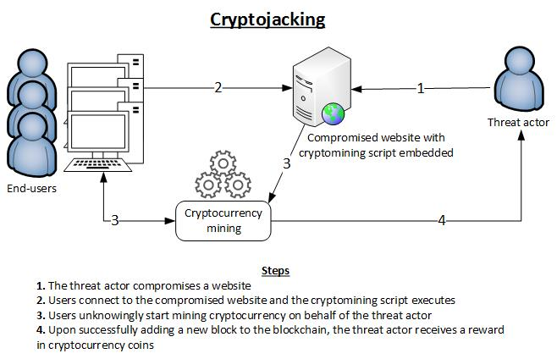
Cryptojacking

Slide 47
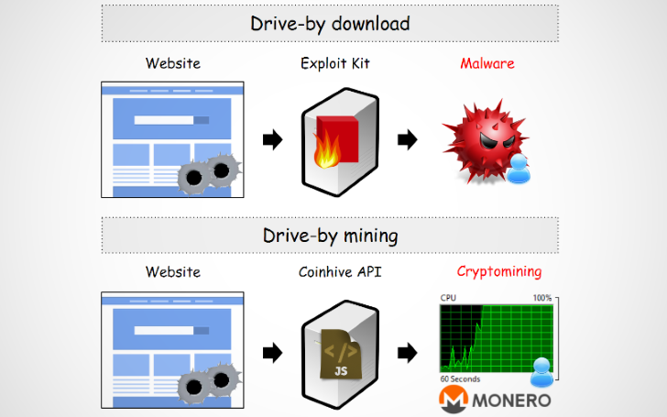
Cryptojacking

Slide 48
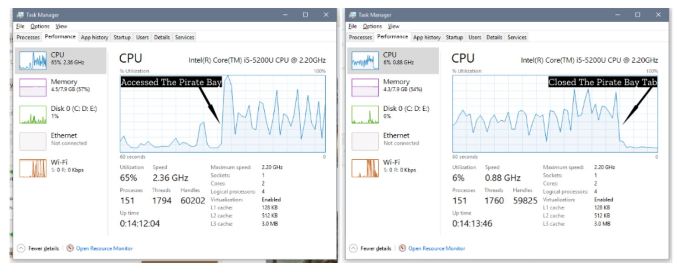
Cryptojacking

Slide 49
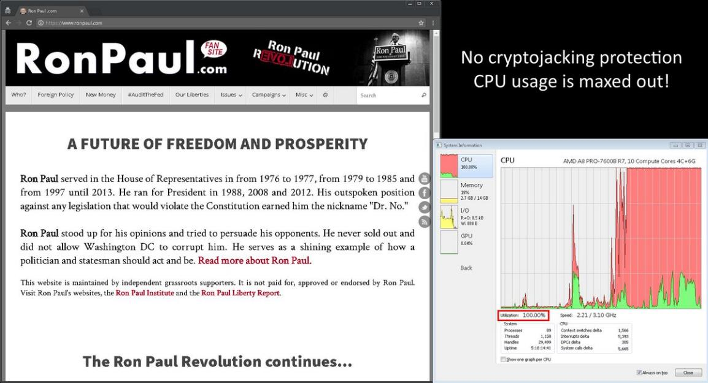
Cryptojacking

Slide 50
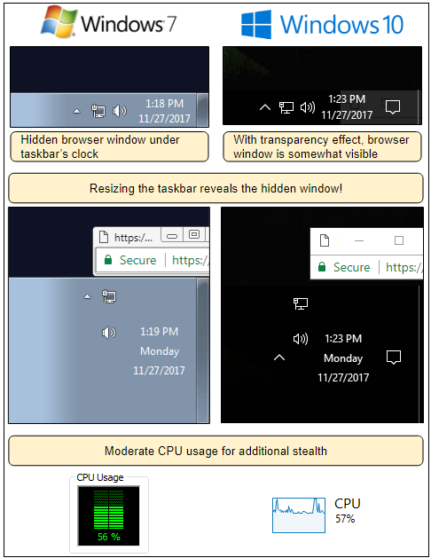
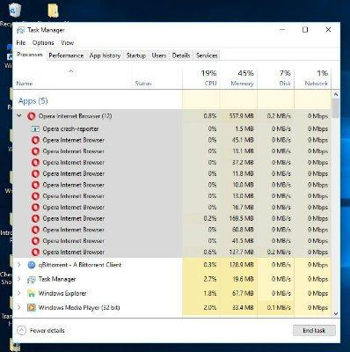
Cryptojacking

Slide 51
Cryptojacking
Use the Task Manager (Windows) or Activity Monitor (Mac OS X)
Disable JavaScript in the browser
Browser extensions like “No Coin”, “Miner Blocker”, “CoinBlocker” are available for most browsers.
Opera has it enabled already.
Install third-party malware detection and anti-virus software
Update and patch software

Slide 52
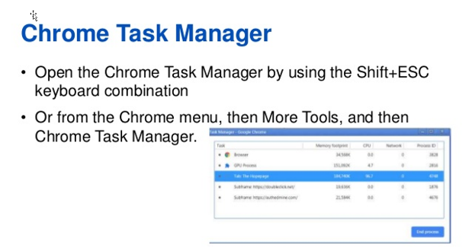
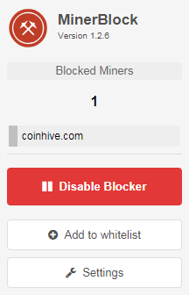
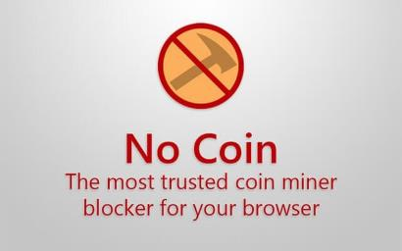
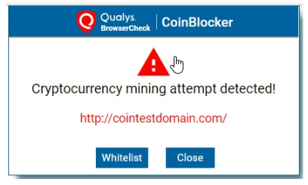
Cryptojacking

Slide 53
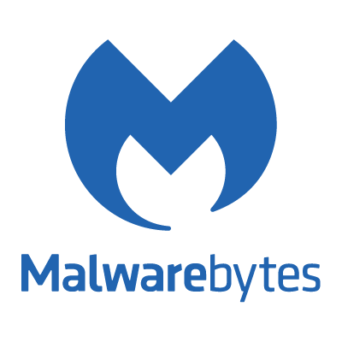



Cryptojacking
Anti-Malware, Anti-Spyware, Anti-Spamware
  https://www.malwarebytes.com/
  http://www.safer-networking.org/private/
  https://superantispyware.com/
  https://zemana.com

Slide 54

Questions & Answers

Slide 55
Contact Information
Midland Shared Spaces (MSS)
3500 N A St, Ste 1100
Midland, TX 79705
(432) 685-0400 main
ghires@midlandss.org
https://midlandss.org
Hires Consulting (website for this presentation)
http://hiresconsulting.com

