Slide 1
Technology
Tools in your Technology Plan
October 11, 2019

Slide 2







Recommended Books

Slide 3
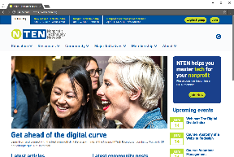
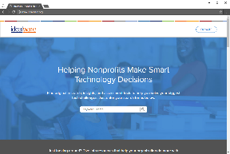
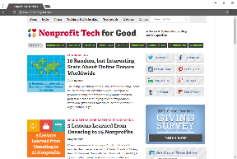
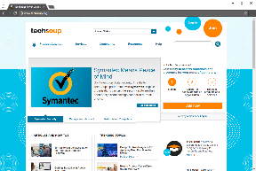
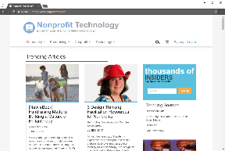
Recommended Online Resources
techsoup.org
nten.org
idealware.org
nonprofittech.com
nptechforgood.com

Slide 4
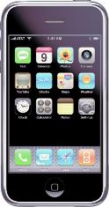
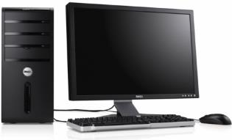
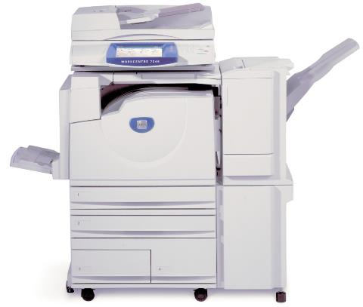
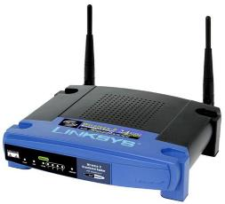
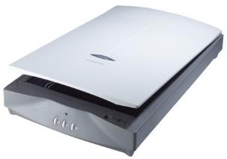
Technology Tools: Hardware

Slide 5

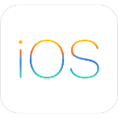






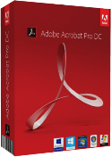

Technology Tools: Software
Notes:
Software is what makes the hardware work such as Windows for your computer, Apple iOS for your iPhone, firmware for the copier or scanner, etc… this software is known as “operating systems”. You can install even more software onto the operating system called “Software Applications” or “apps” like Quickbooks, Microsoft Office, iWork, Adobe Acrobat, Firefox, Facebook and Twitter. Your software may not always “cost you money”. Later, we’ll talk more about software – and specifically – free and open source software.

Slide 6

Tool #1 – Conduct an Inventory
Workstations/Hardware/Equipment
Software
Networks
Databases
Online Presences

Slide 7
Workstations / Hardware / Equipment
Manufacturer
Make
Model
Serial Number
Status
Purchased Date
Warranty
Cost
CPU
RAM
HD
NIC
Removable Drives
Monitor
User
Peripherals
Condition

Slide 8
Software
Title
Version / Release
Description
License Info
Type
Status
Purchased Date
Maintenance
Cost
Compatibility

Slide 9
Networks
LAN / WAN
Wiring
Wireless / Wi-Fi
Network speeds
Network protocols
Internet services (ISP)
Hosts (Web, Email)
Firewalls
RAS / VPN
Equipment
Diagrams
Site Plans

Slide 10
Databases
Client/Server
Local
File/Server shares
Online
Access/Passwords

Slide 11
Online Presences
Website(s) / FTP
Domain names
Facebook/Twitter/LinkedIn/Pinterest, etc.
Email
Access/Passwords

Slide 12
Recommendations
TechSoup
  Help Desk Services (One-time or subscription)
  Technology Implementation (Free)
Inventory Software
  Spiceworks
  SysAid Free Edition
  IT Asset Tool
  Spreadsheets

Slide 13



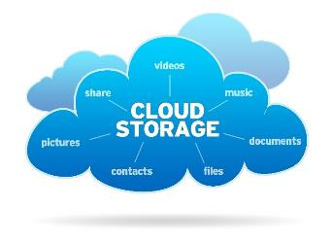



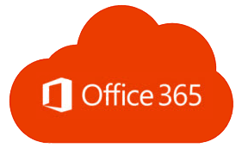

Technology Tools: Cloud

Slide 14
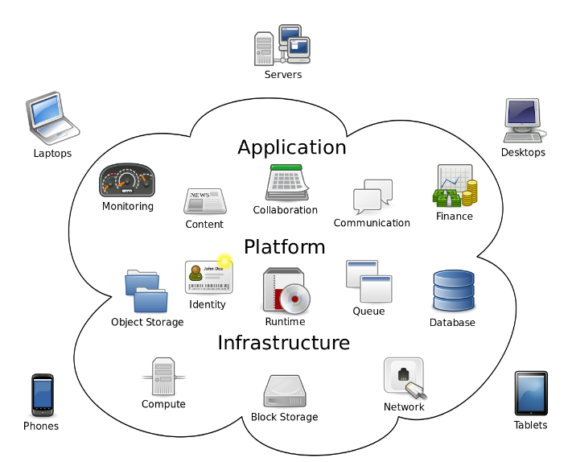
CLOUD COMPUTING

Slide 15
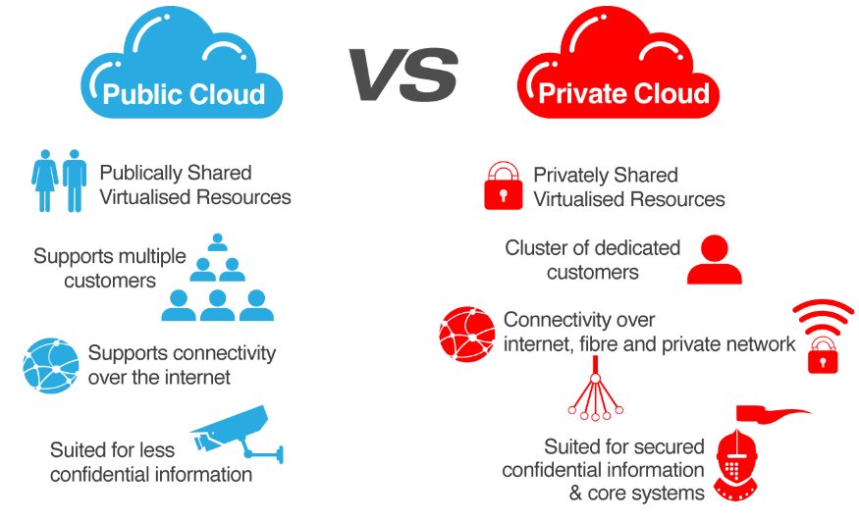
CLOUD OPTIONS

Slide 16
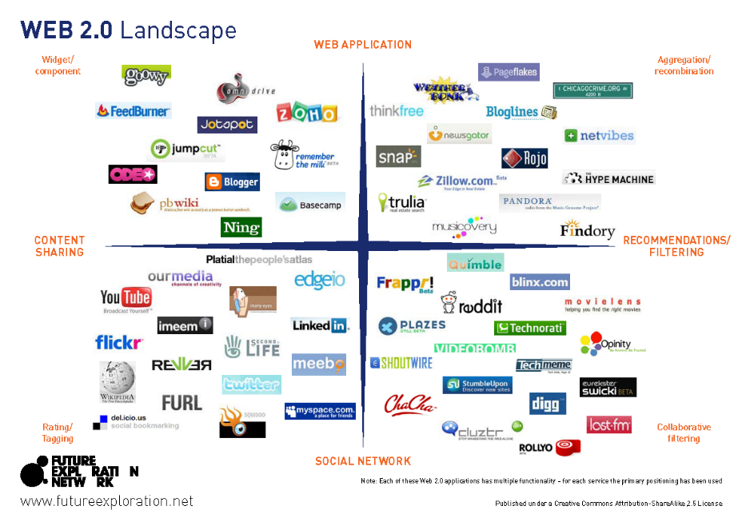

Slide 17
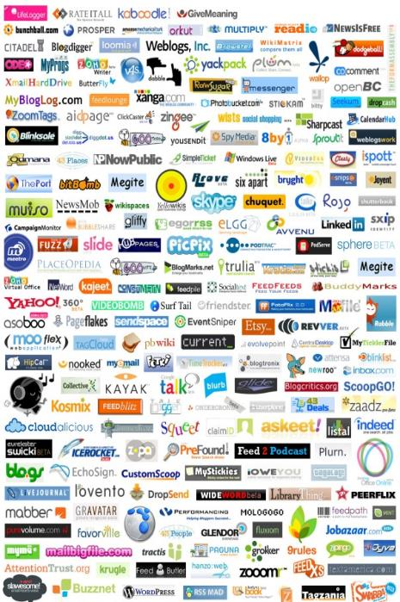
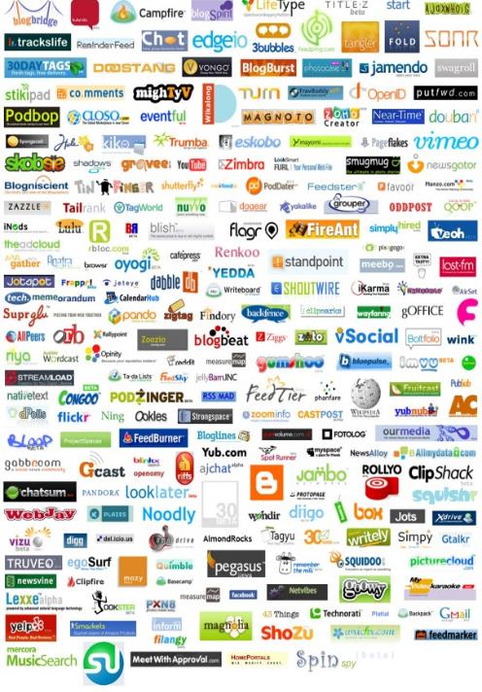

Slide 18











































Which one?

Slide 19
Browsers – Secured (Lock)
CHROME
EDGE
FIREFOX
IE
OPERA

Slide 20
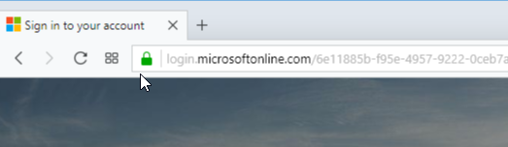
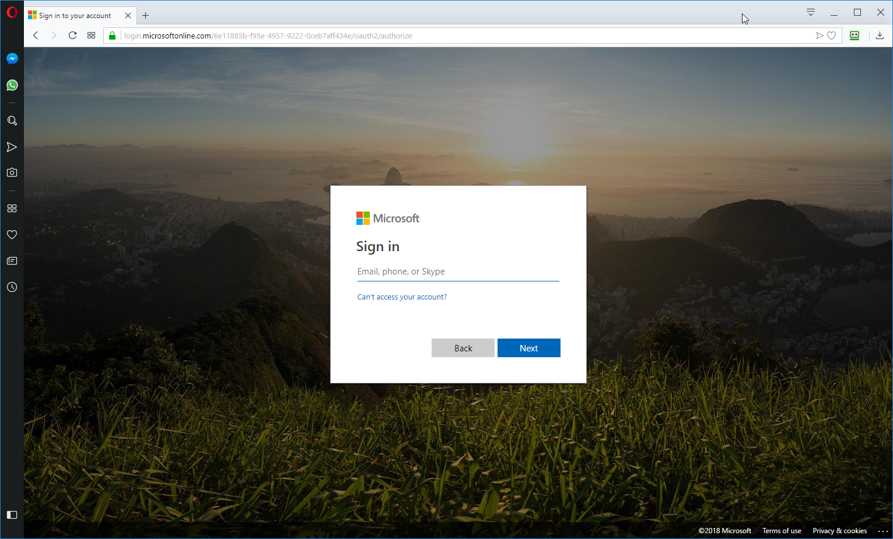
HTTPS - Phishing

Slide 21
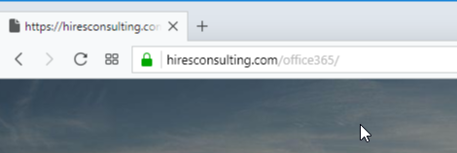
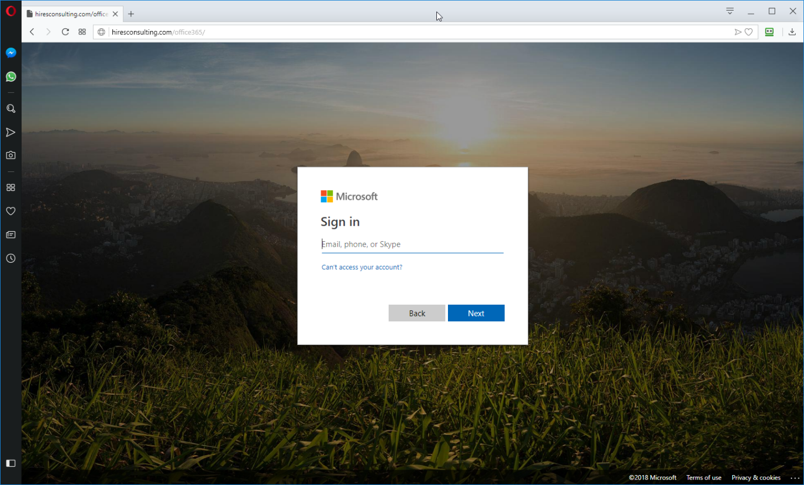
HTTPS - Phishing

Slide 22

Tool #2 – Research
Hardware
  Amazon, BestBuy, Newegg, TigerDirect, Techie
Software
  Online Reviews, Google Search,
Cloud (Apps)
  AlternativeTo, Osalt, Sourceforge

Slide 23
Types of Software / Apps
Commercial
Freemium
Free Open Source Software (FOSS)

Slide 24
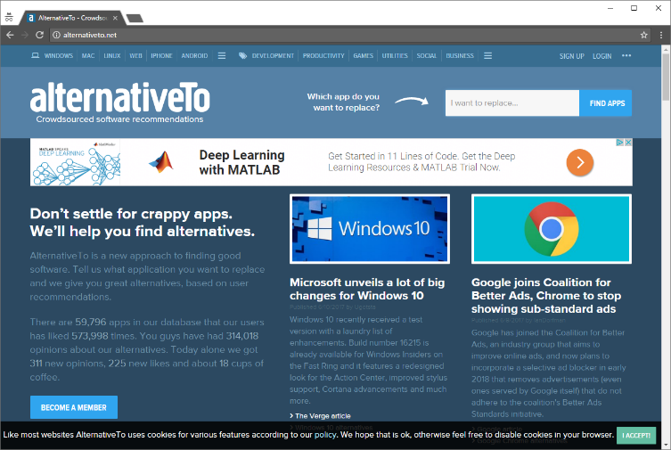
alternativeto.net

Slide 25
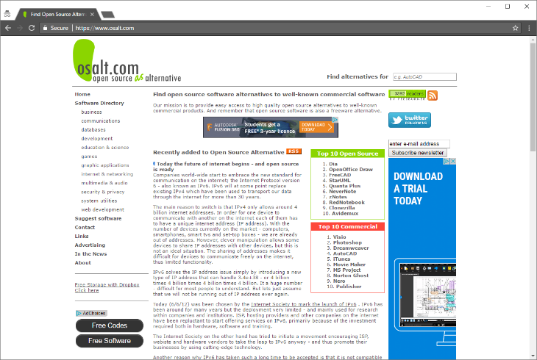
osalt.com

Slide 26
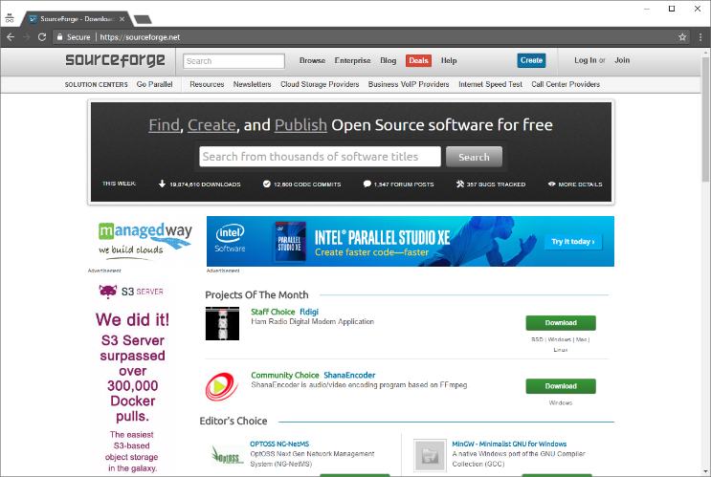
sourceforge.net

Slide 27

Tool #3 – “Office” Productivity Suite
Microsoft Office 365 for Nonprofits
Google G-Suite for Nonprofits
LibreOffice, OpenOffice, OnlyOffice

Slide 28
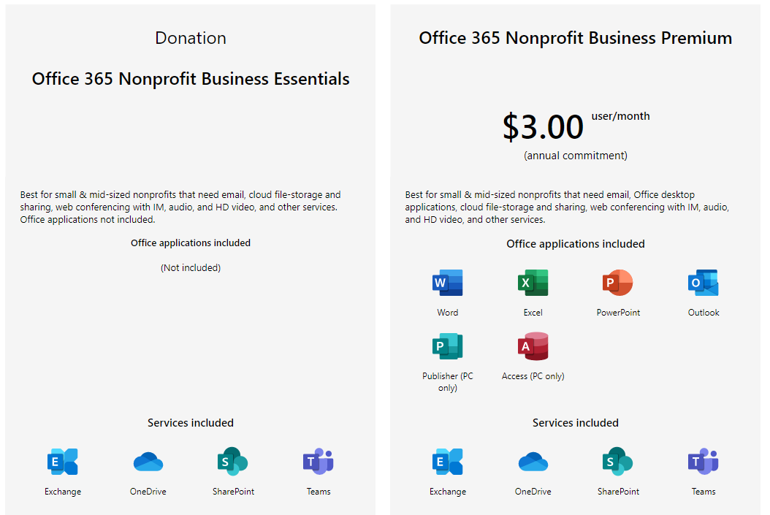
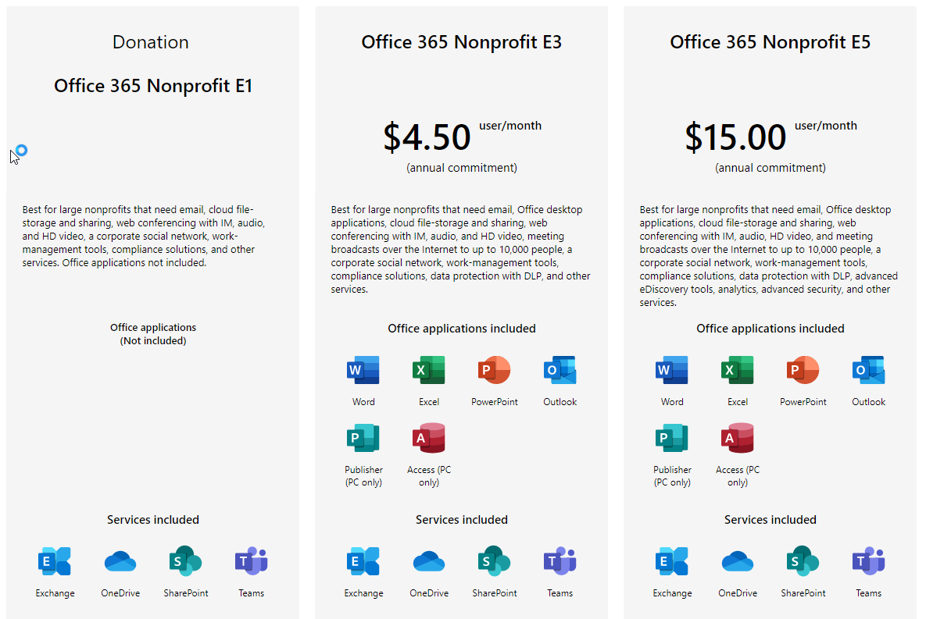
Office365 for Nonprofits
(Free, $3.00, $4.50 or $15 per user/month)

Slide 29
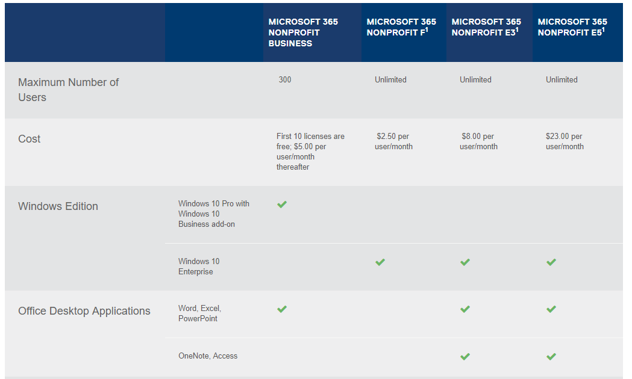
Microsoft 365 Business
(Free for first 10 users, $5.00 per user/month for additional users)

Slide 30
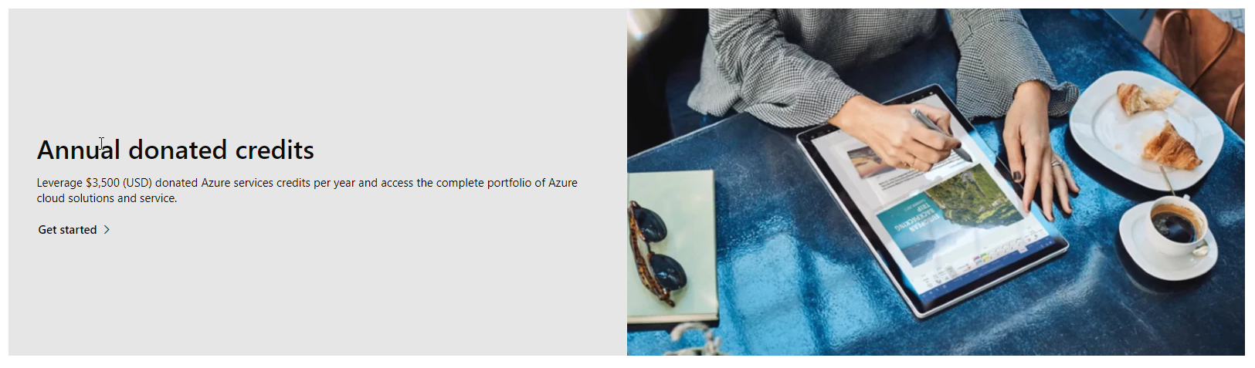
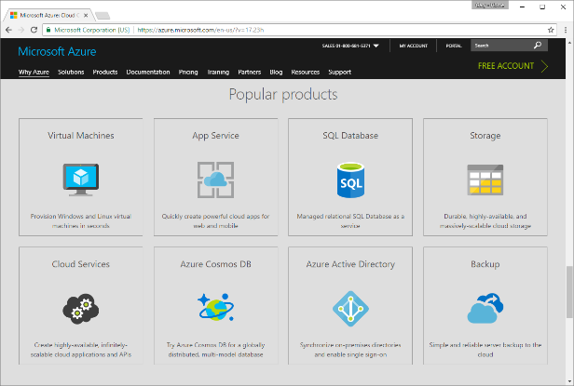
Microsoft Azure Donation
($3500 in Credits)

Slide 31
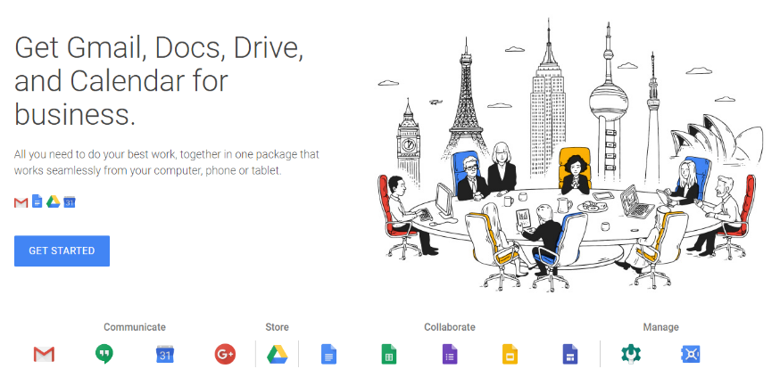
Google Apps for Nonprofits
(Free for Nonprofits)

Slide 32
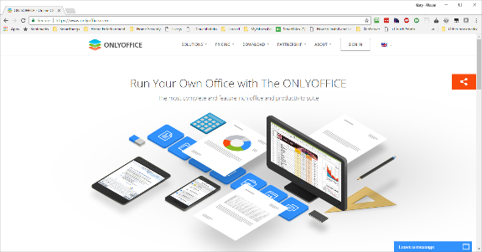
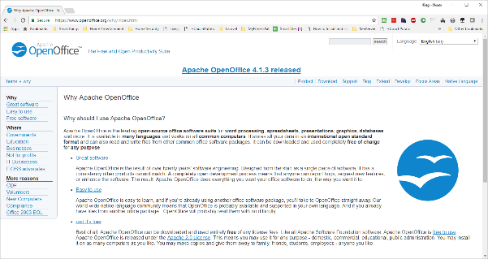
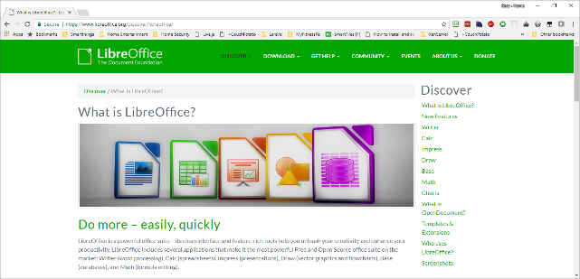
LibreOffice, OpenOffice, etc.

Slide 33
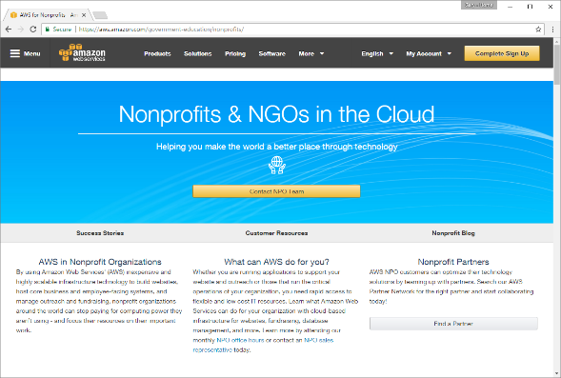
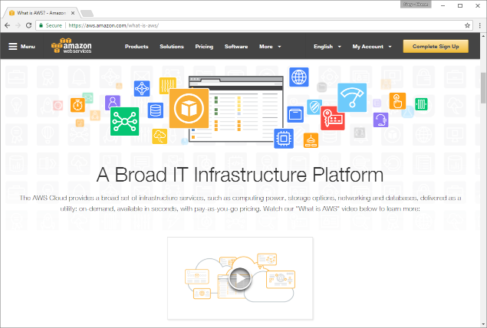
AWS for Nonprofits
($175 TechSoup Admin Fee = $2,000 AWS Credits)

Slide 34
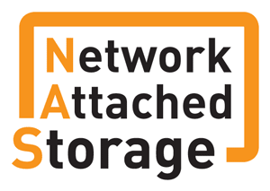
Tool #4 – Get a NAS
Networked Attached Storage (NAS)
  Additional Storage Space
  Easier Collaboration, Less Mess
  Your own “Private Cloud”
  Automatic Data Backups
  Fast Configuration with Low Complications
  Lots of Apps available

Slide 35
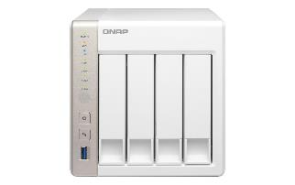
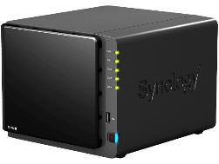
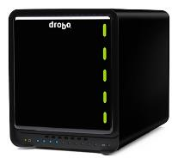
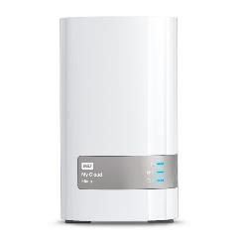
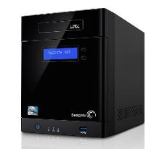
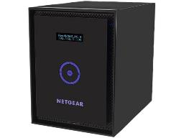
Network Attached Storage
Qnap, Synology, Drobo,
Seagate, Western Digital, Netgear

Slide 36











Server / NAS Applications
Apache, Asterisk, Drupal, Joomla, MySQL, PHP, Python, Tomcat, vTiger, Wordpress

Slide 37

Tool #5 – Security (Online, Devices, etc.)
  Secure your devices
  Always use HTTPS if possible
  Public Wi-Fi – Just Say NO
  Use Password Managers
  Two-Factor Authentication

Slide 38
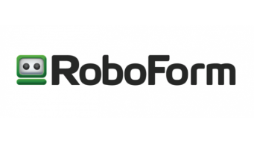


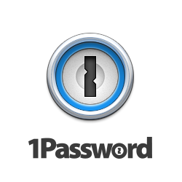

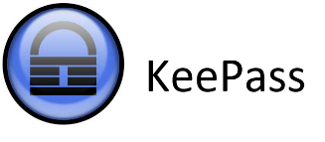
Password Managers
Password Boss, LastPass, RoboForm, Dashlane, 1Password, KeePass*

Slide 39
Questions & Answers

Slide 40
Contact Information
Midland Shared Spaces
3500 N A St, Ste 1100
Midland, TX 79705
(432) 685-0400 main
ghires@midlandss.org
https://midlandss.org
Hires Consulting (copy of this presentation)
http://hiresconsulting.com

