Slide 1
Technology
Inventory, Assessment & Needs

Slide 2




Recommended Books

Slide 3
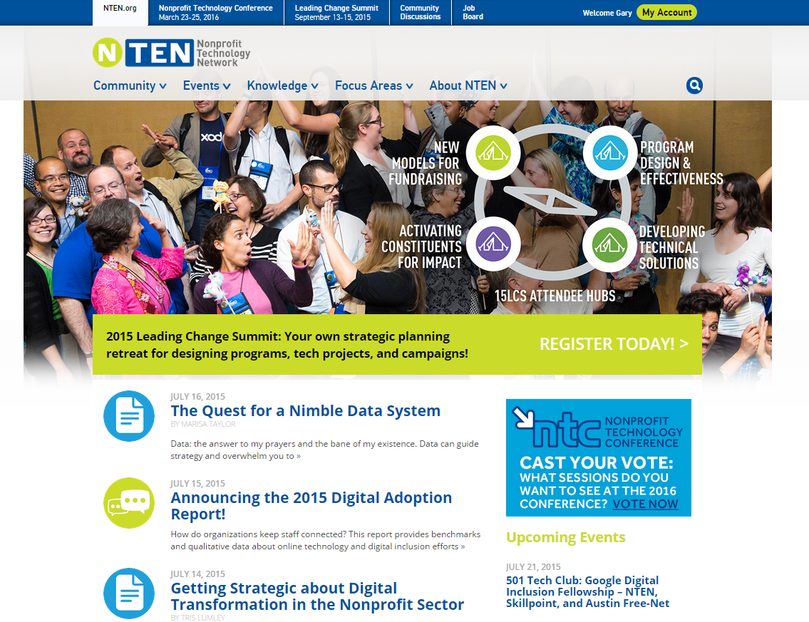
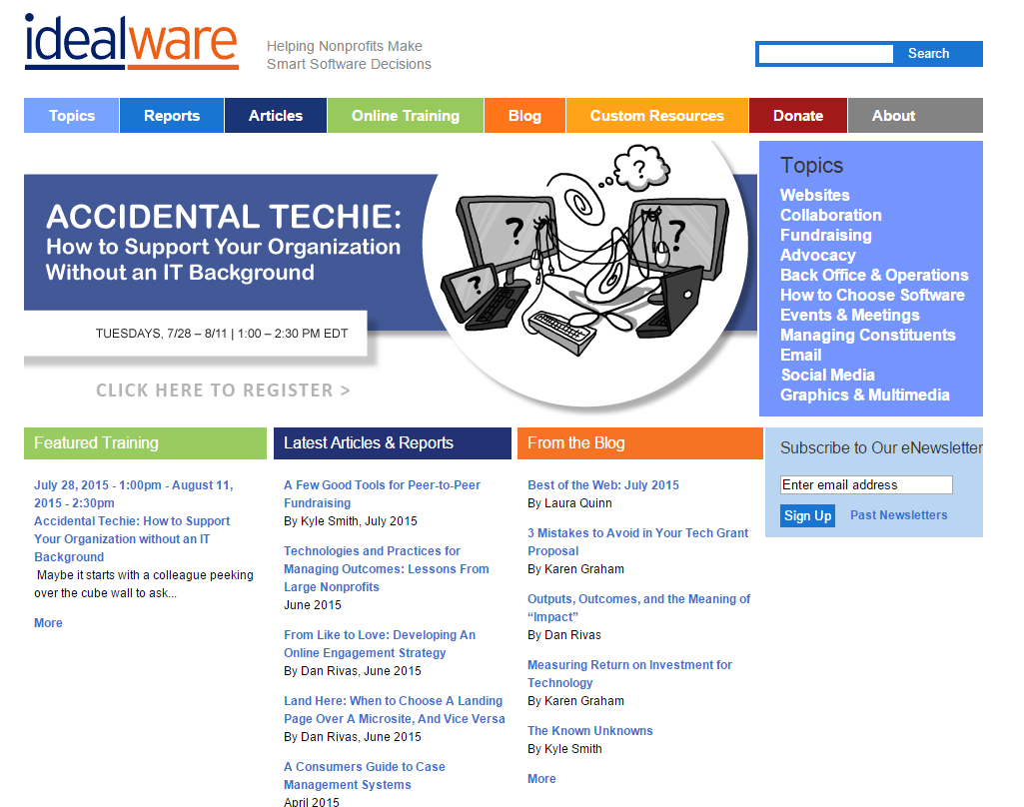

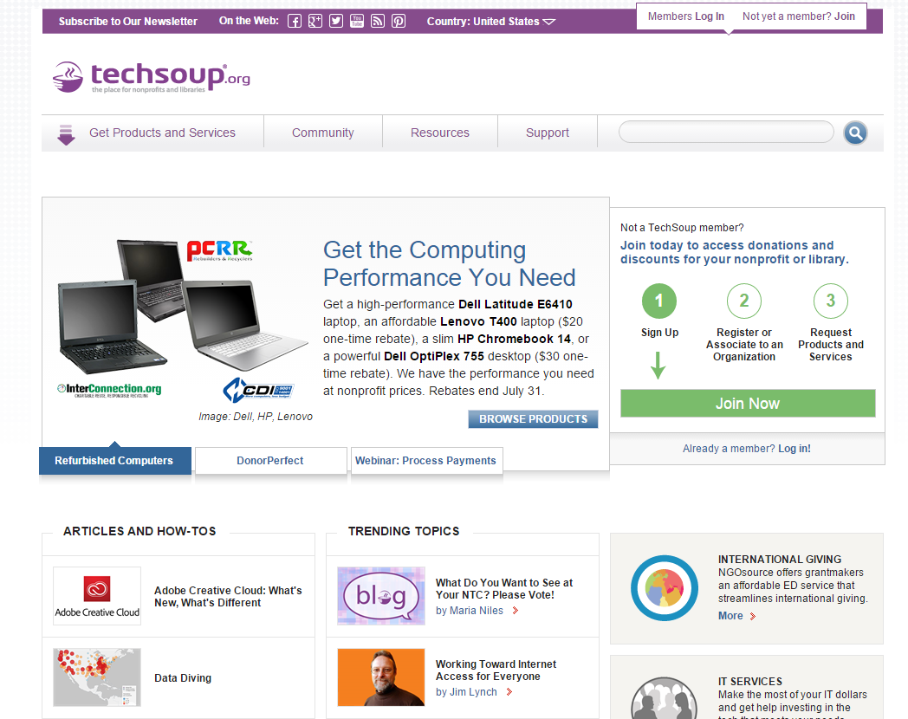
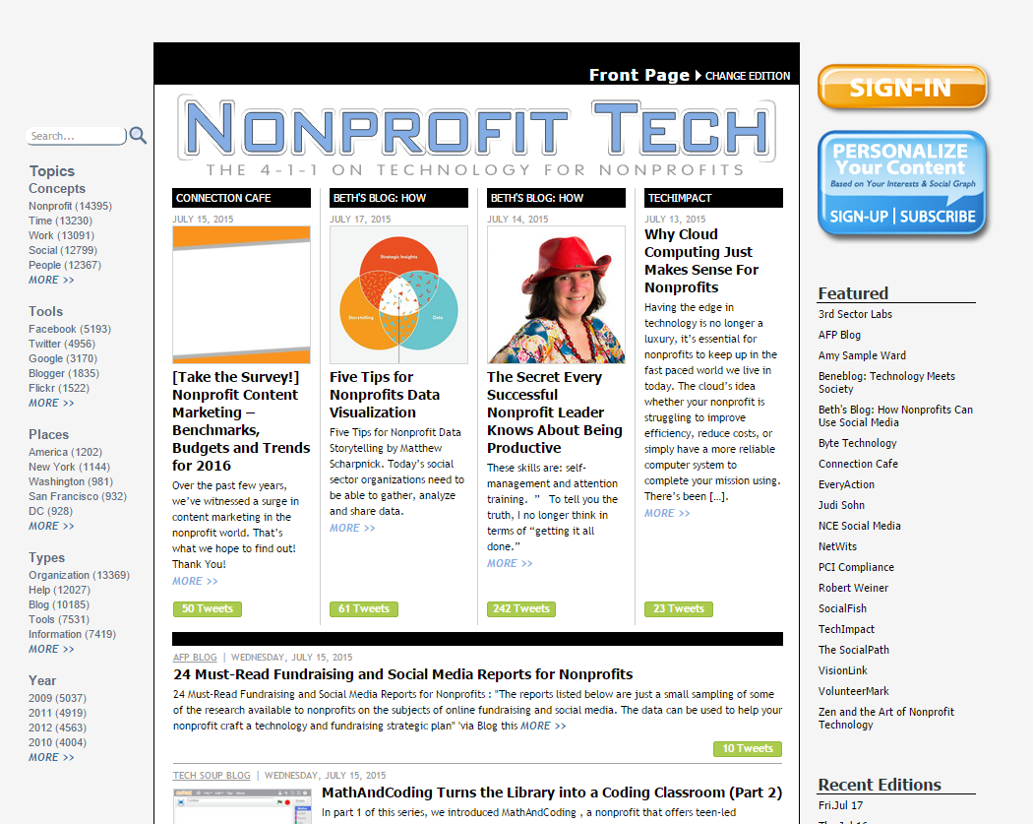
Recommended Online Resources
techsoup.org
nten.org
idealware.org
nonprofittech.org
nptechforgood.org

Slide 4
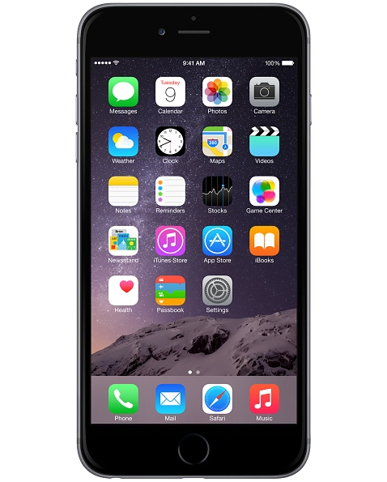
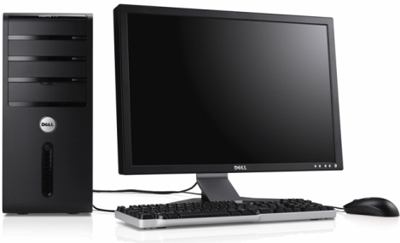
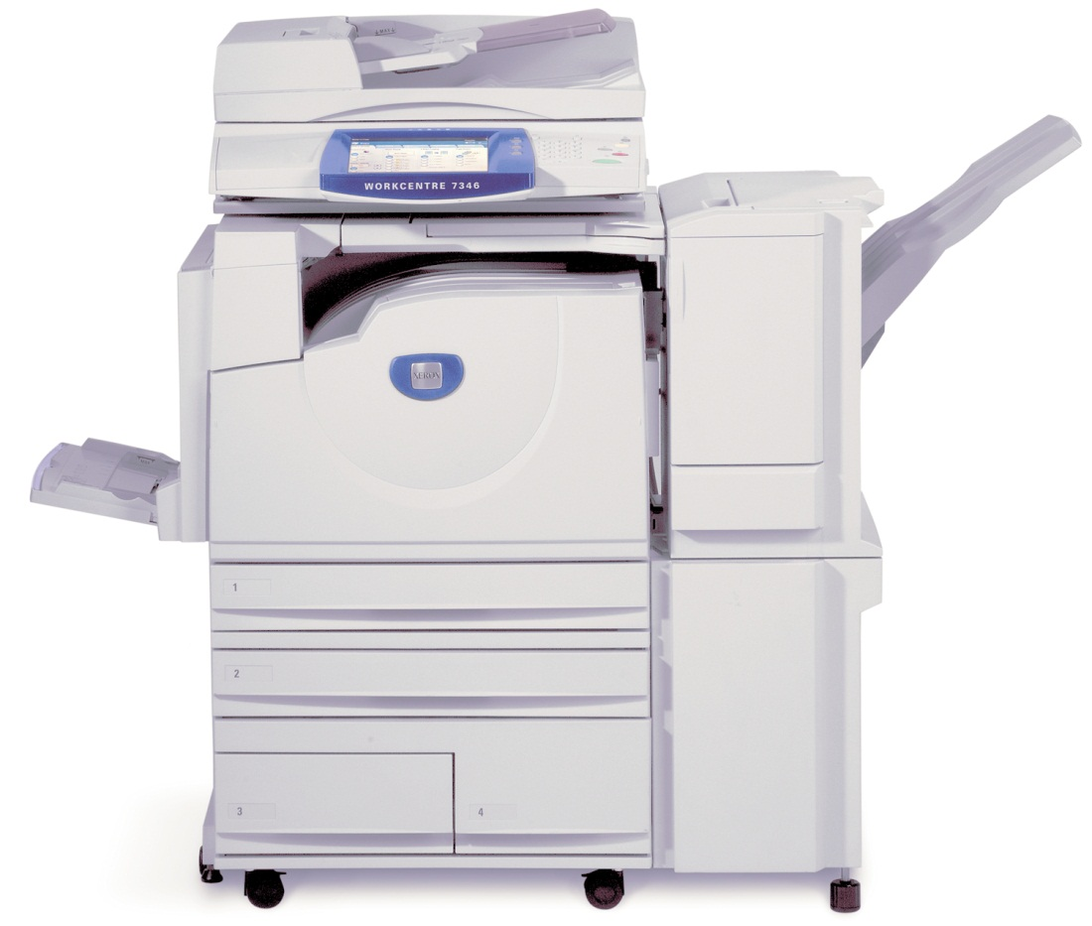
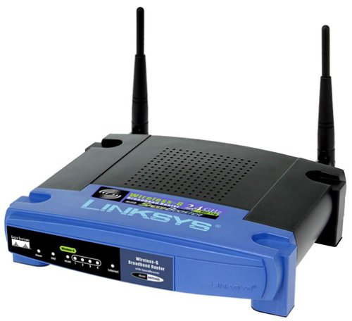
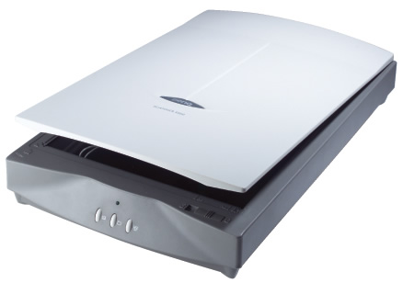
Technology Tools: Hardware

Slide 5








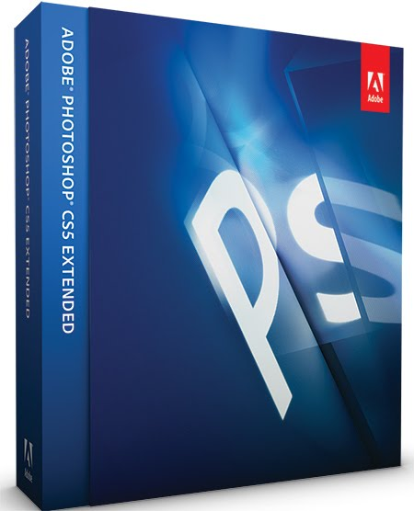

Technology Tools: Software

Slide 6



Where are we now?
Conduct an Inventory
Assessing & Supporting Users
Data Protection & Disaster Recovery

Slide 7
Conduct an Inventory
Workstations/Hardware/Equipment
Software
Networks
Databases
Online Presences

Slide 8
Workstations / Hardware / Equipment
Manufacturer
Make
Model
Serial Number
Status
Purchased Date
Warranty
Cost
CPU
RAM
HD
NIC
Removable Drives
Monitor
User
Peripherals
Condition

Slide 9
Software
Title
Version / Release
Description
License Info
Type
Status
Purchased Date
Maintenance
Cost
Compatibility

Slide 10
Networks
LAN / WAN
Wiring
Wireless / Wi-Fi
Network speeds
Network protocols
Internet services (ISP)
Hosts (Web, Email)
Firewalls
RAS / VPN
Equipment
Diagrams
Site Plans

Slide 11
Databases
Client/Server
Local
File/Server shares
Online
Access/Passwords

Slide 12
Online Presences
Website(s) / FTP
Domain names
Facebook/Twitter/LinkedIn
Email
Access/Passwords

Slide 13

Assessing & Supporting Users
User personalities
User support system
Training

Slide 14
User Personalities
Savvy User
Willing User
Resistant User
Off-site User

Slide 15
User Support System
FAQs / “How-to” Guides
Peer support
Help Desk
Consultant / Vendor Support

Slide 16
Training
One-to-One
Small group
CBT
  e-Learning
  Online videos / tutorials

Slide 17
Data Protection & Disaster Recovery
Virus / Spyware / Malware Protection
Software Maintenance
Backup / Restore Systems
Security
Technology Policies

Slide 18
Virus / Spyware Protection
Anti-Virus Software
Anti-Malware
Anti-Adware
Anti-Spyware
RansomeWare*

Slide 19
Software Maintenance
Windows / Apple Updates
  Critical & Security Updates
  Recommended Updates
  Optional Updates
  Hardware / Driver Updates
Software Updates / Patches

Slide 20
Backup / Restore Systems
Backup methods
  Optical Media (CDs, DVDs, BDs)
  Tape
  External Drives (Hard drives, Flash)
  Online
Best Practices
  3-2-1 (3 copies, 2 types of media, 1 off-site)
  Rotate media & keep off-site
  Schedule & automate
  Test your backup regularly

Slide 21
Security
Physical location – “lock it up”
Unauthorized access via network ports
Unneeded services – Servers & Workstations
Alternative web browsers
Encrypted start-up / logins / passwords
VPNs
Wireless security

Slide 22
Technology Policies
User Guidelines
Acceptable Use Policy
  Computer use
  Other technologies / equipment
  MDM (Mobile Device Management)
  Personal property
  Passwords
  Privacy
  Consequences

Slide 23
FAQs
What kind of computer should I purchase?
  Mac or PC?
  New, Used or Refurbished?
  Laptop, Desktop or Tablet
What’s the best processor?
How much memory should I have?
32-bit or 64-bit?
Best way to perform backups?

Slide 24
Recommendations
Idealware
  “Accidental Techie” Webinar
  On-Demand Tactical Technology Planning
TechSoup
  Donated Software from Adobe, Microsoft, Intuit
  Refurbished hardware products
Inventory Software
  Spiceworks
  SysAid Free Edition
  IT Asset Tool

Slide 25
Questions & Answers

