Slide 1
Technology
WTRPD 2017
Web 2.0, Apps & the Cloud

Slide 2







Recommended Books

Slide 3
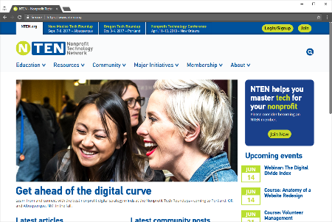
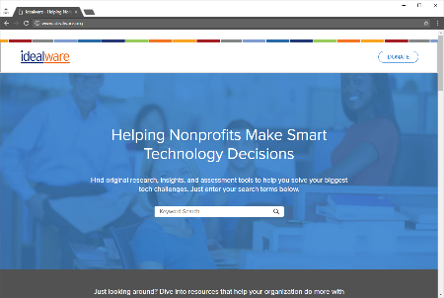
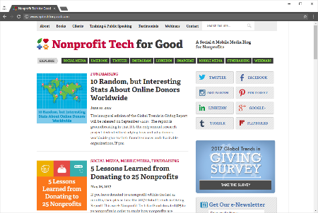
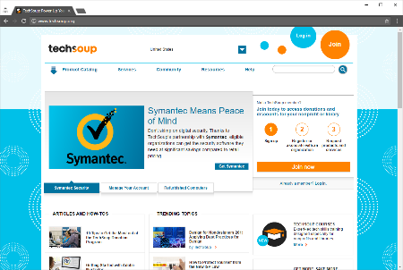
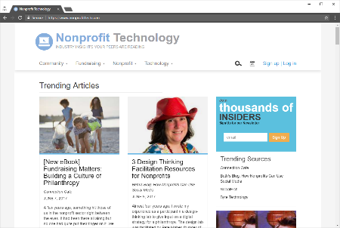
Recommended Online Resources
techsoup.org
nten.org
idealware.org
nonprofittech.com
nptechforgood.com

Slide 4

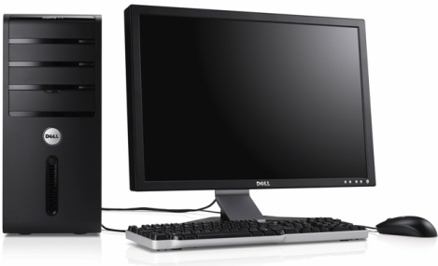
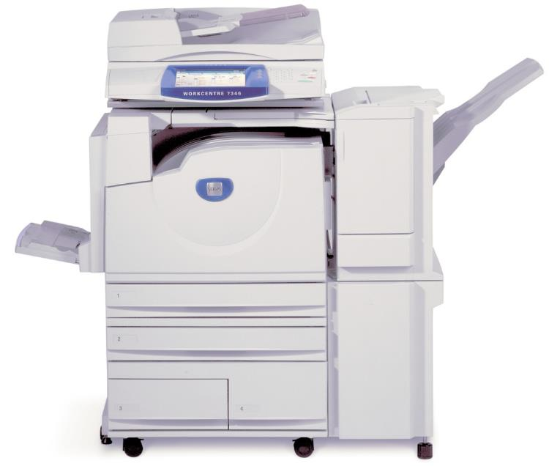
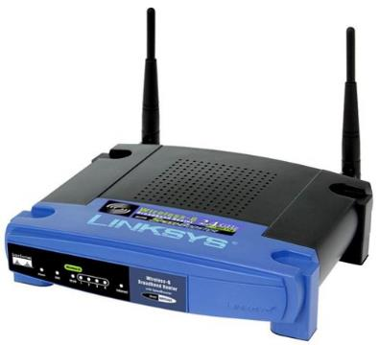
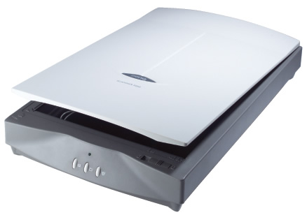
Technology Tools: Hardware

Slide 5








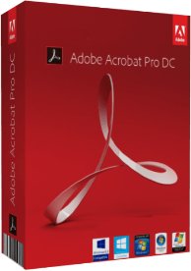

Technology Tools: Software

Slide 6
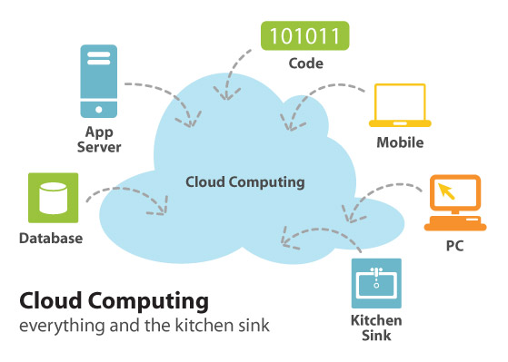

Future of Computing

Slide 7
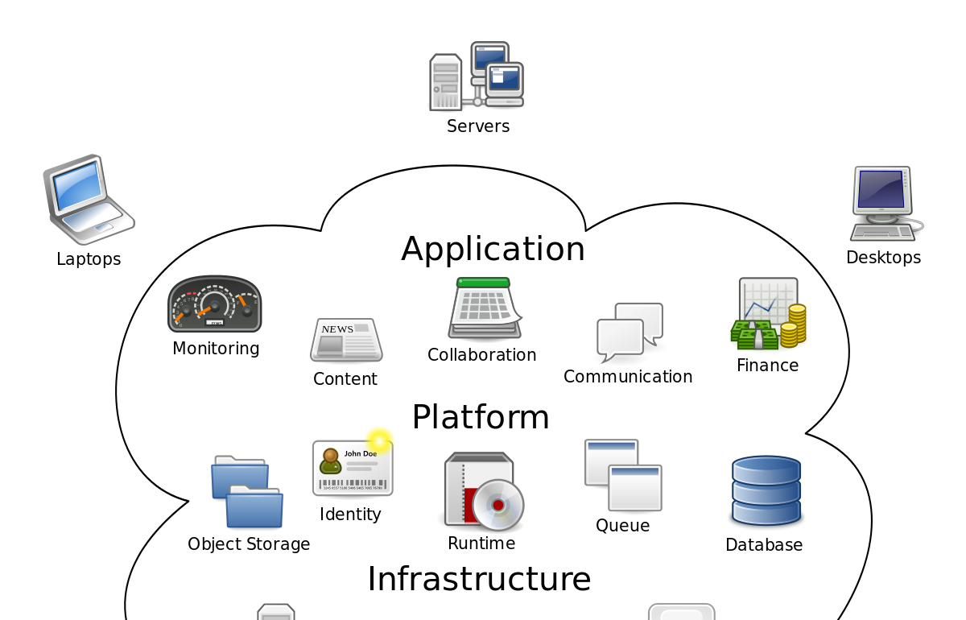
CLOUD COMPUTING

Slide 8
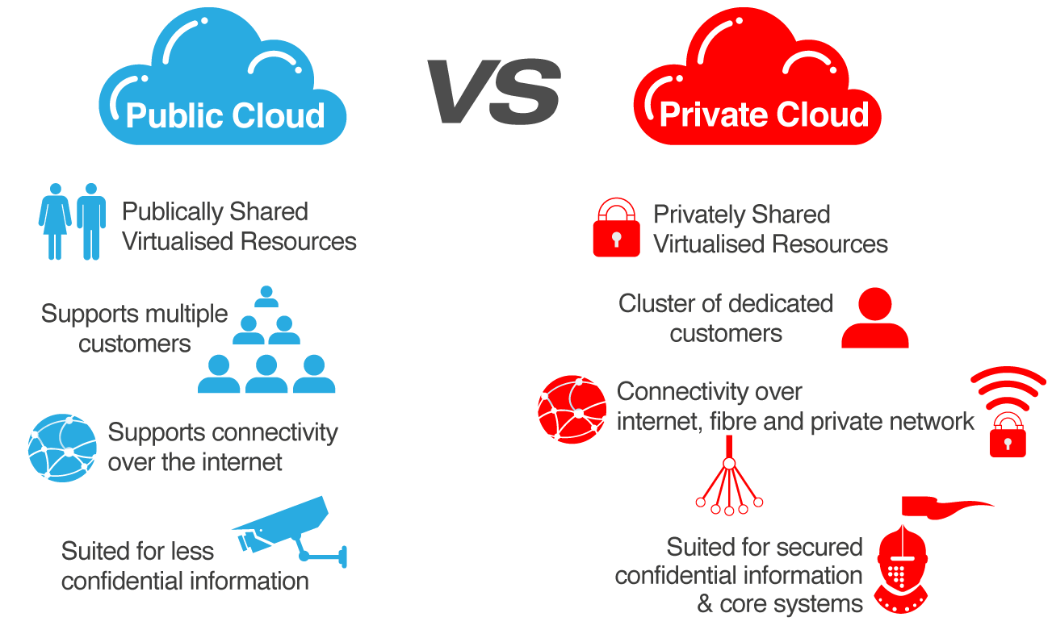
CLOUD OPTIONS

Slide 9
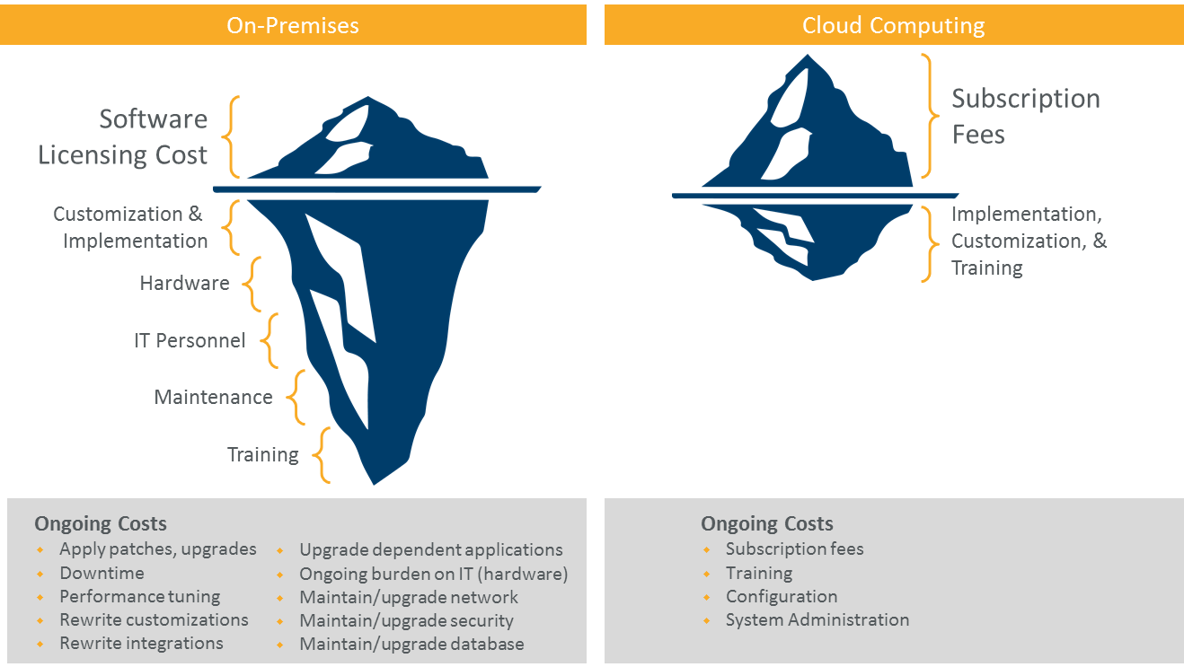
PUBLIC CLOUD BENEFITS

Slide 10
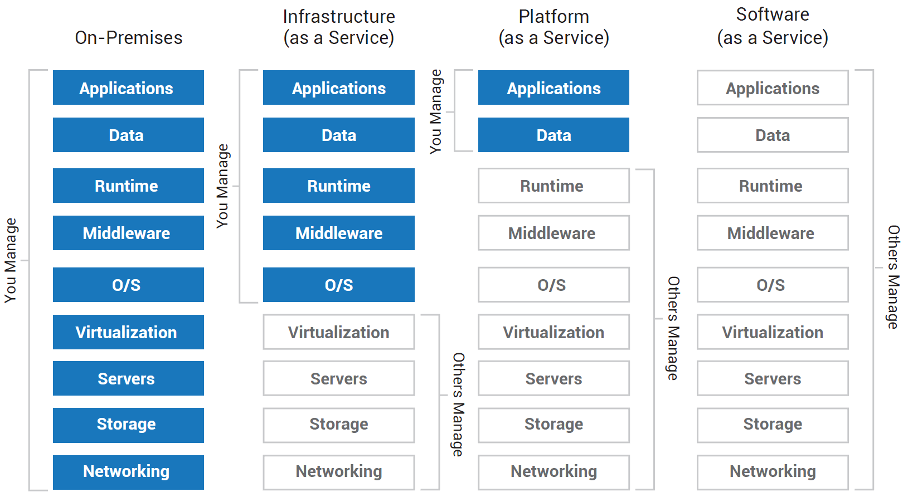
AS A SERVICE

Slide 11
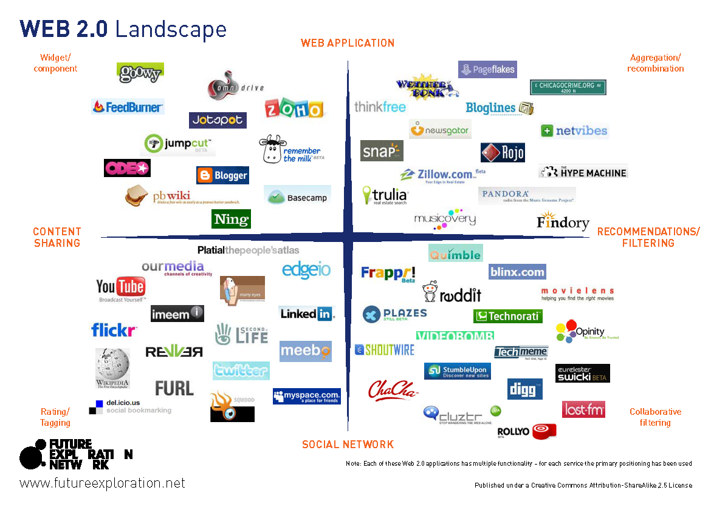

Slide 12
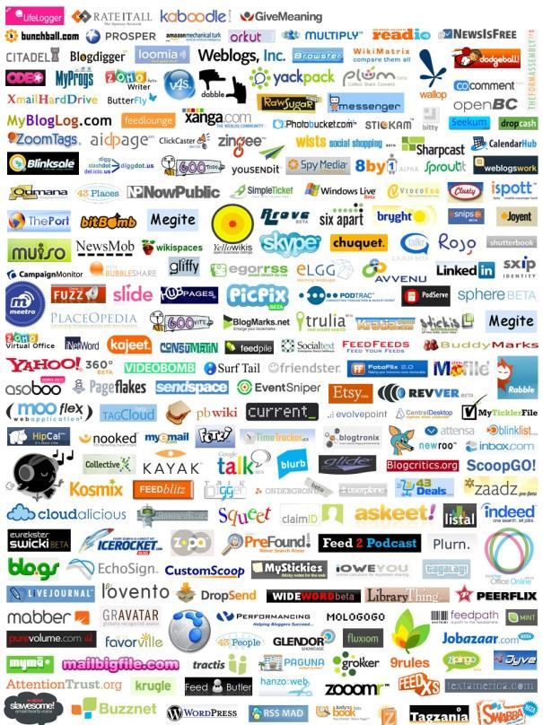
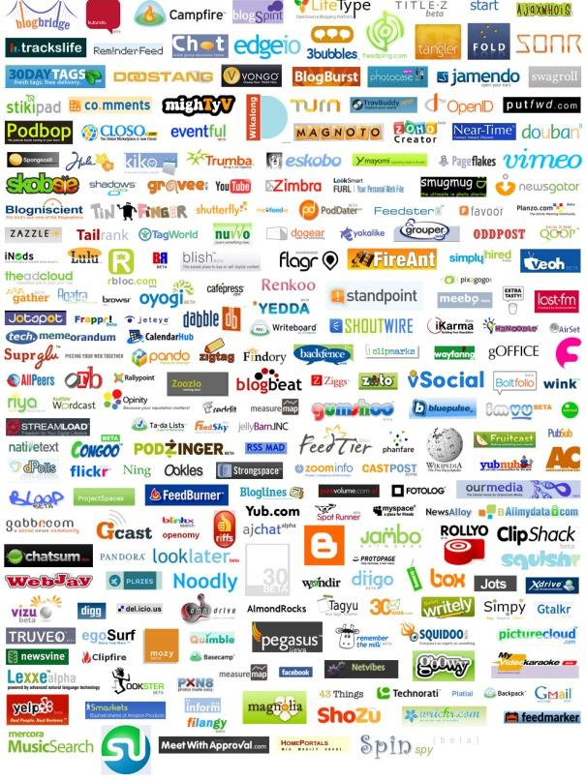

Slide 13











































Which one?

Slide 14
Technology Impact
“Information technology and telecommunications hardware, software and services turns out to be a powerful driver of growth, having an impact on worker productivity three to five times that of non-IT capital (e.g., buildings and machines).”
Atkinson, Robert D., and McKay, Andrew S. Digital Prosperity: Understanding the Economic Benefits of the Information Technology Revolution. The Information Technology and Innovation Foundation, 2007.

Slide 15
Browsers – Secured (Lock)
CHROME
EDGE
FIREFOX
IE
OPERA

Slide 16
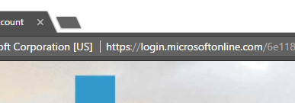
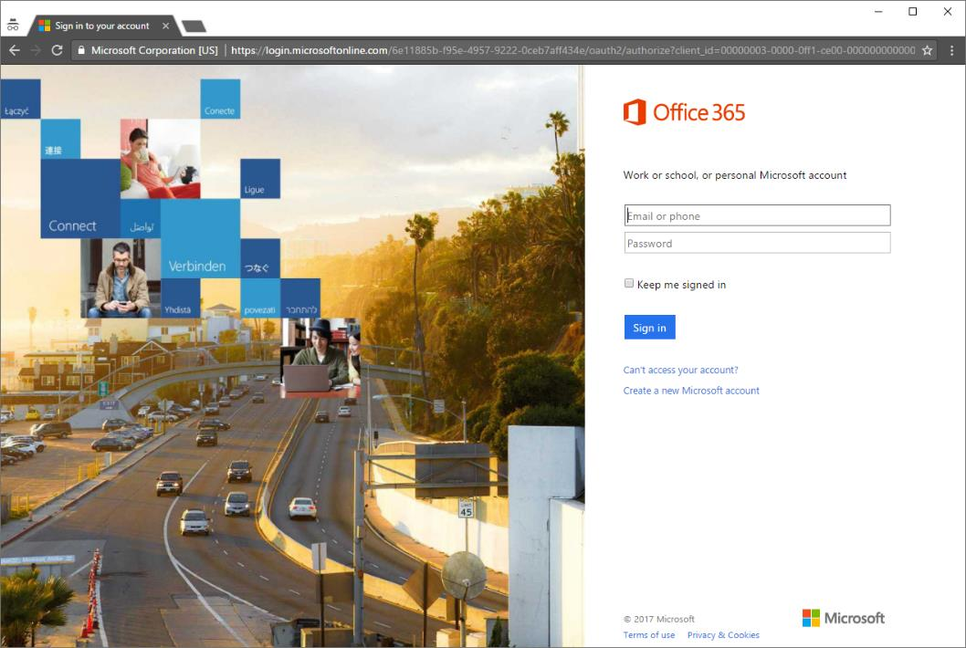
HTTPS - Phishing

Slide 17
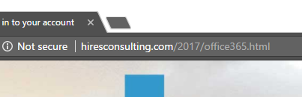

HTTPS - Phishing

Slide 18
Productivity Tools - Desktop
Commercial
Freemium
Free Open Source Software (FOSS)

Slide 19
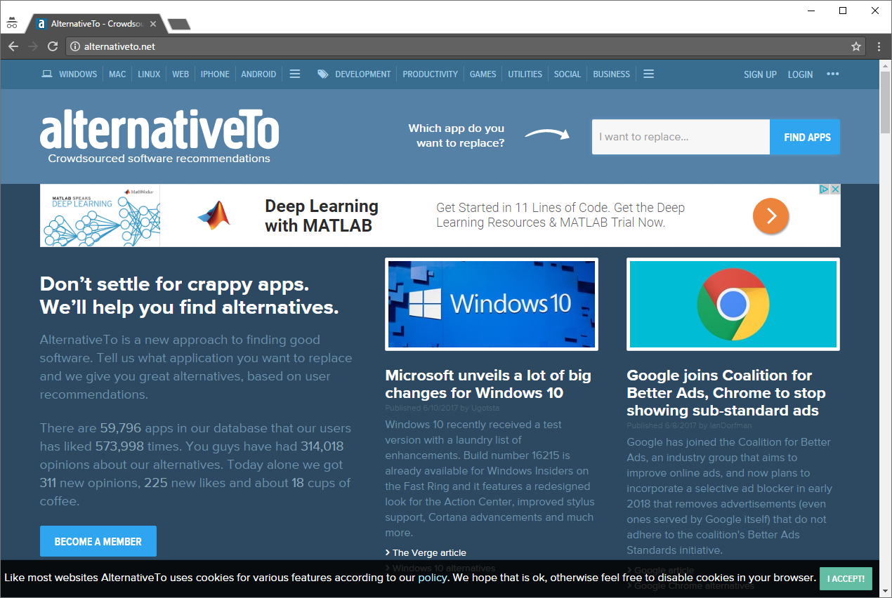
alternativeto.net

Slide 20
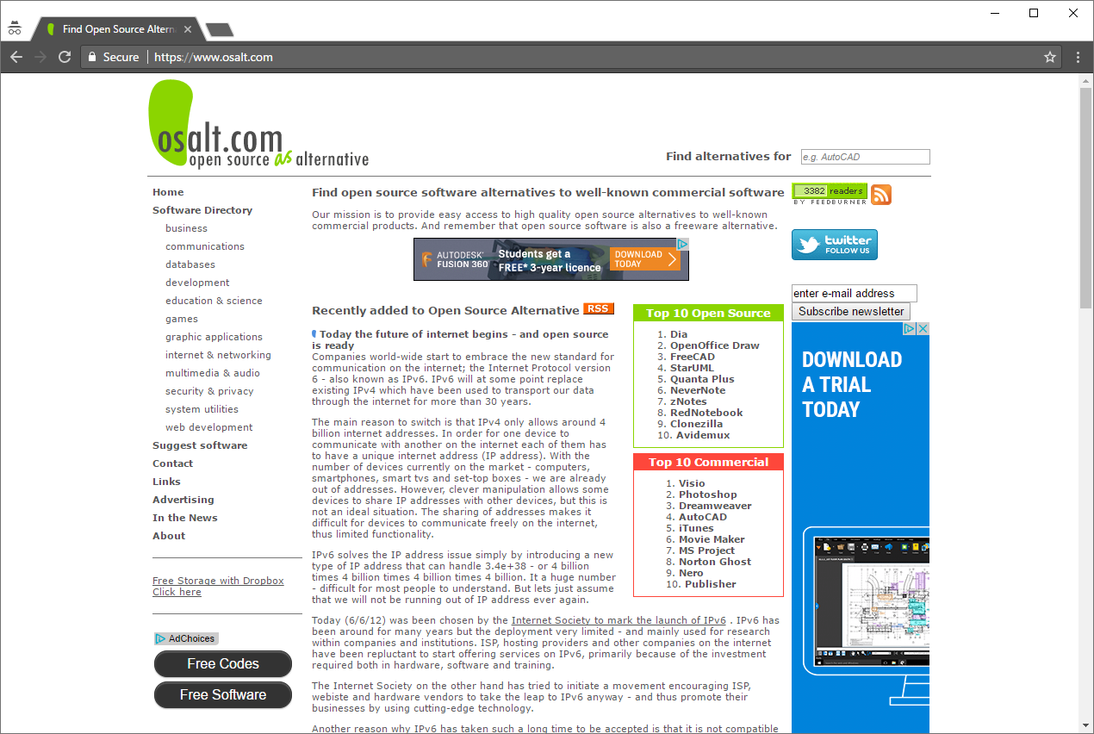
osalt.com

Slide 21
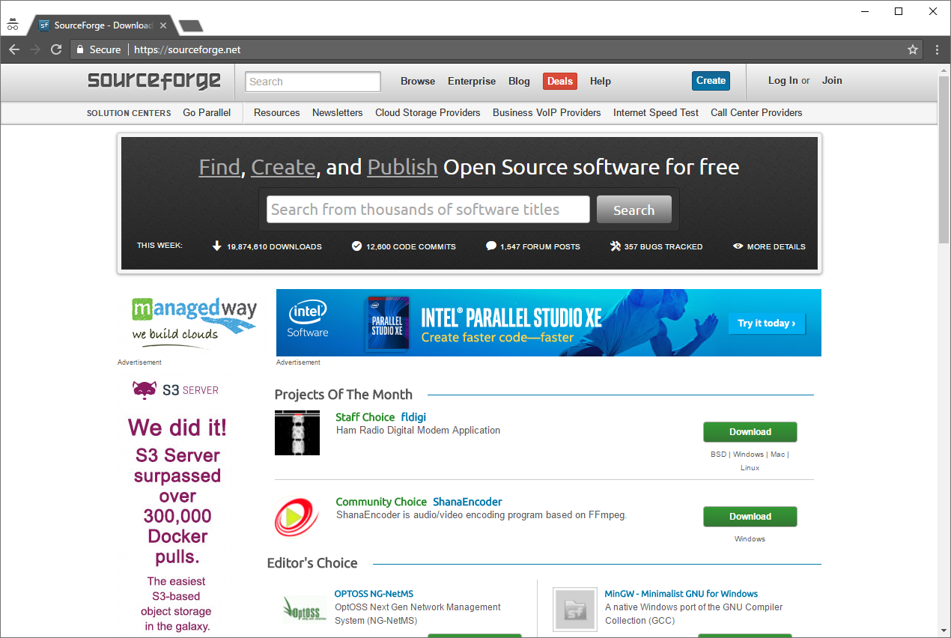
sourceforge.net

Slide 22
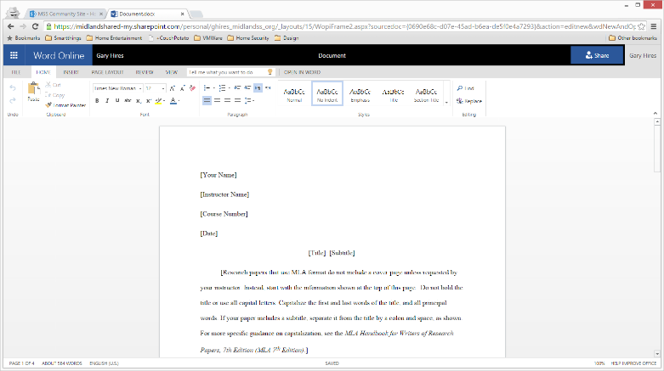
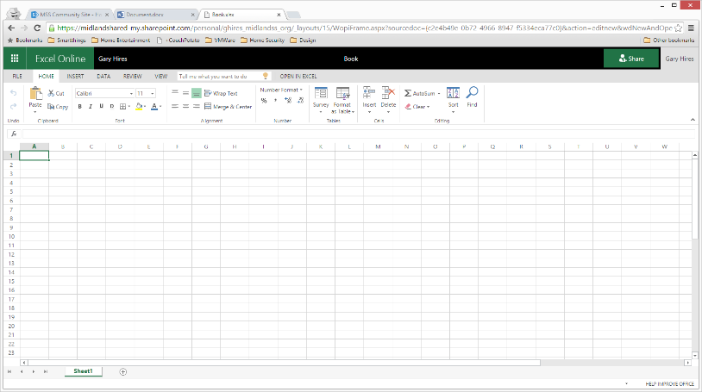
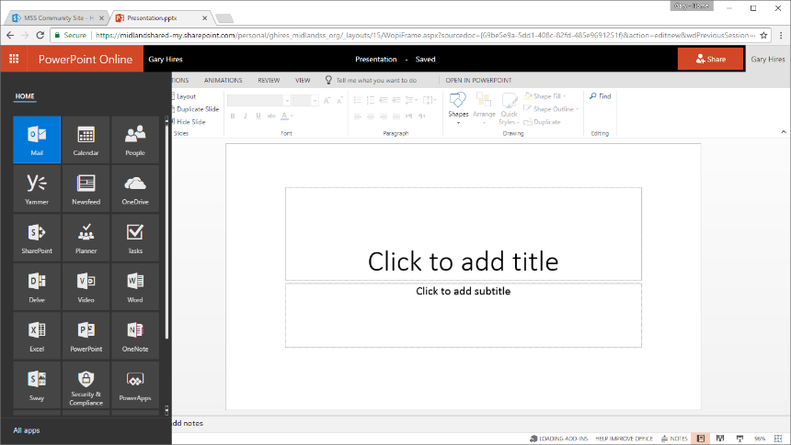
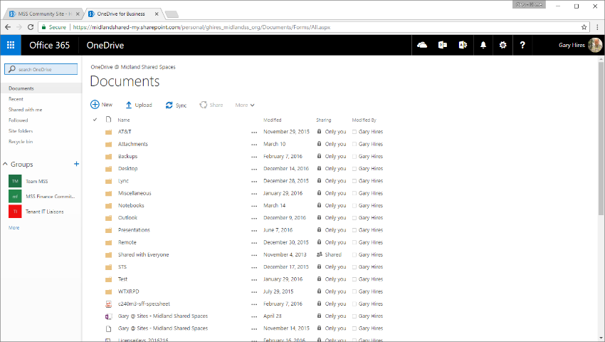
Microsoft Office365
(Free, $2.00, $4.50 or $10 per user/month)

Slide 23
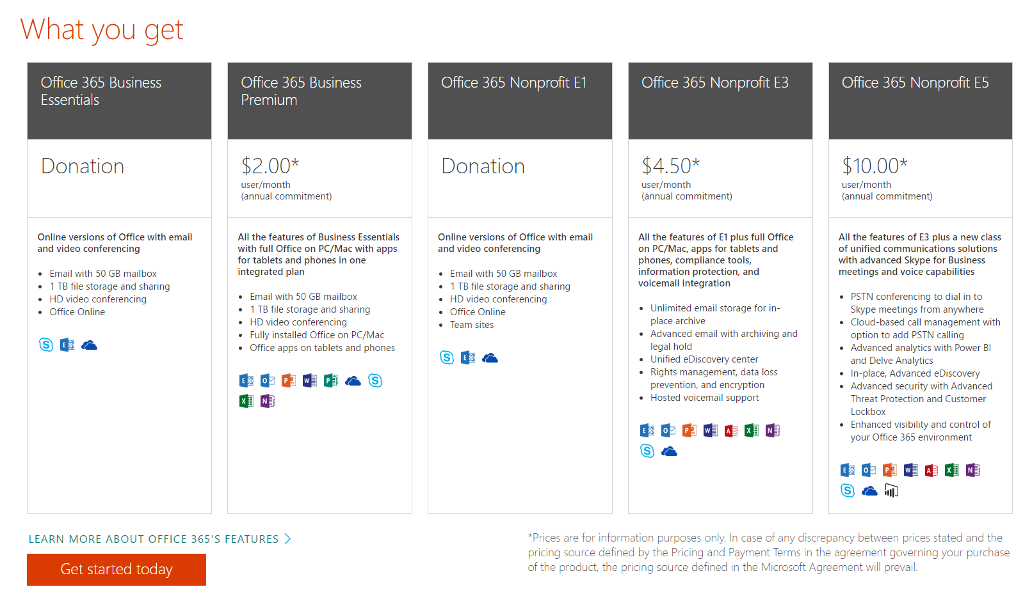
Microsoft Office365
(Free, $2.00, $4.50 or $10 per user/month)

Slide 24
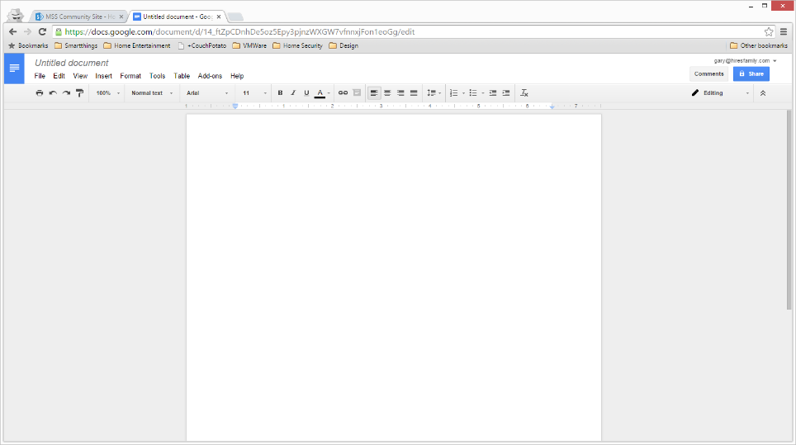
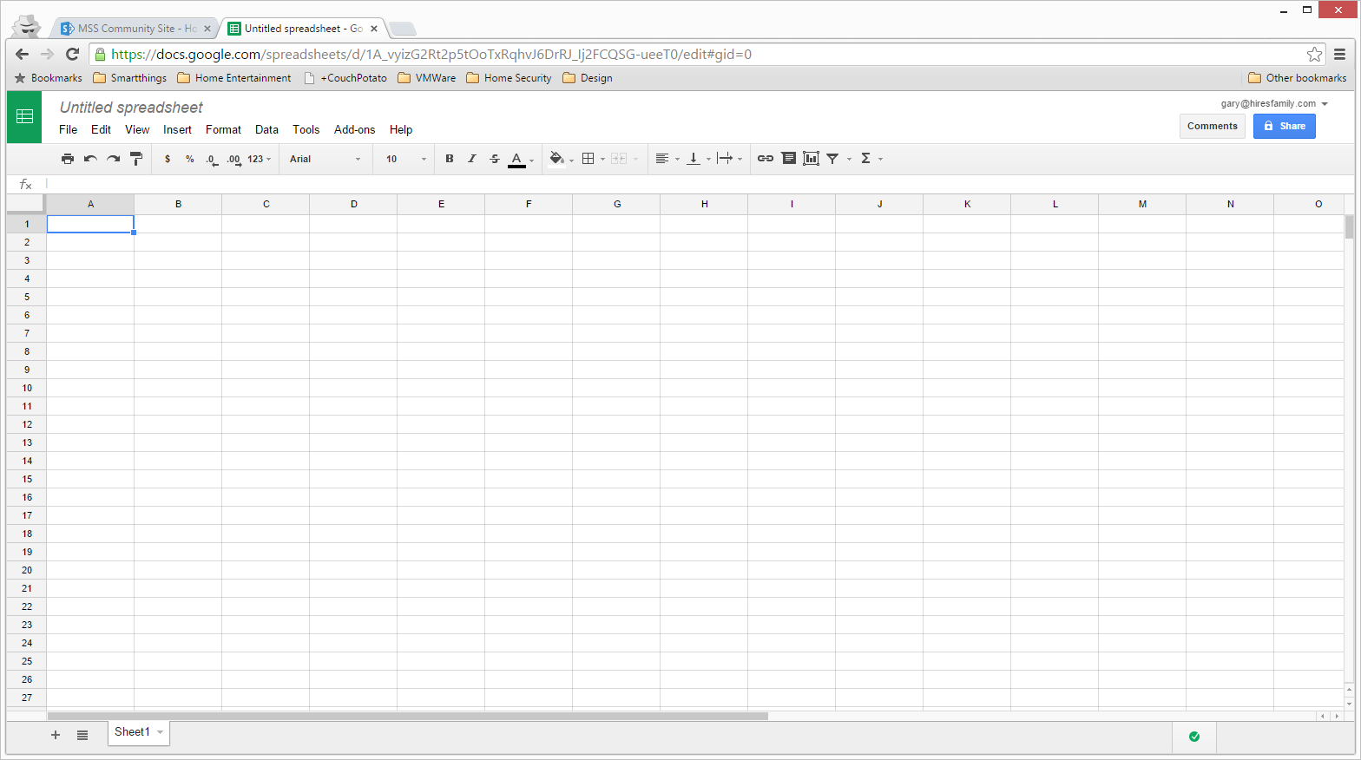
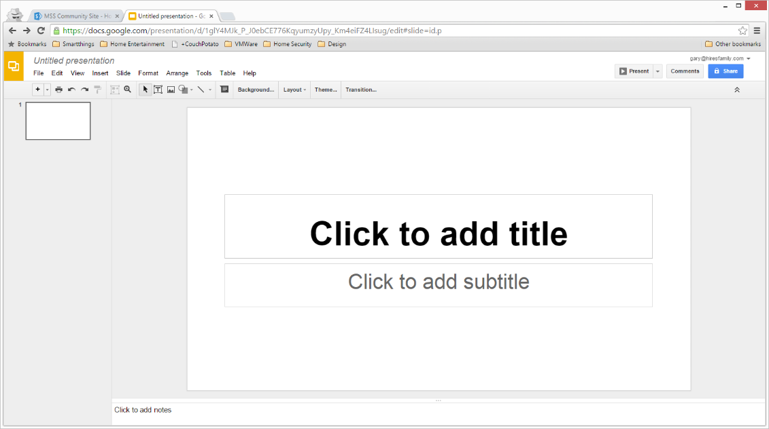
Google Apps for Nonprofits
(Free for Nonprofits)

Slide 25
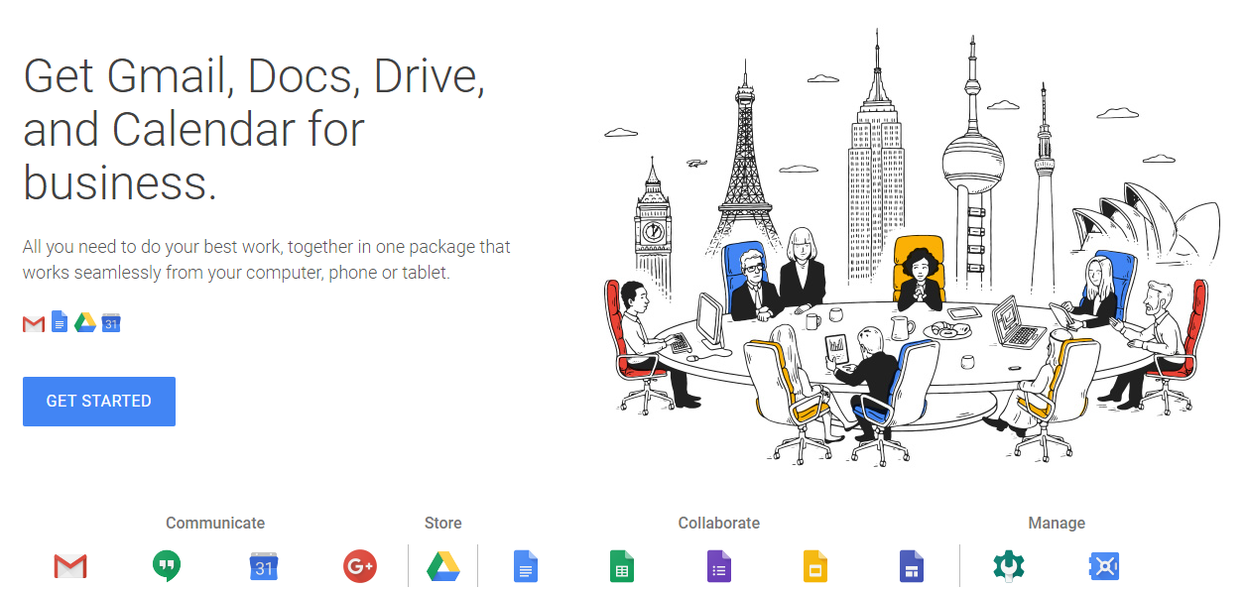
Google Apps for Nonprofits
(Free for Nonprofits)

Slide 26
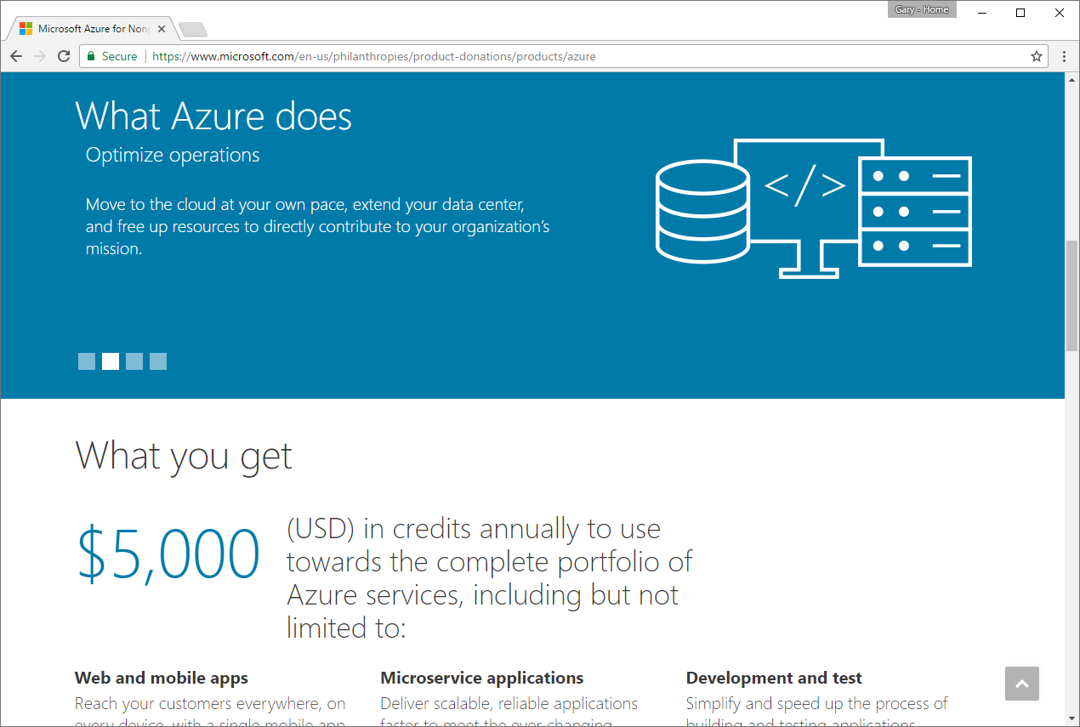
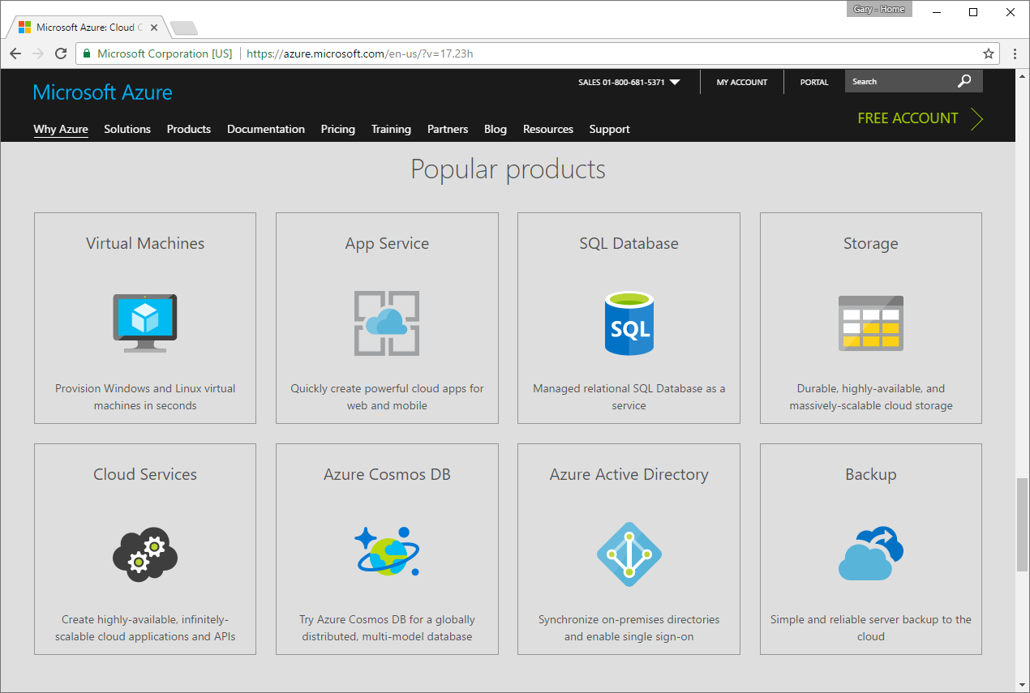
Microsoft Azure Donation
($5000 in Credits)

Slide 27
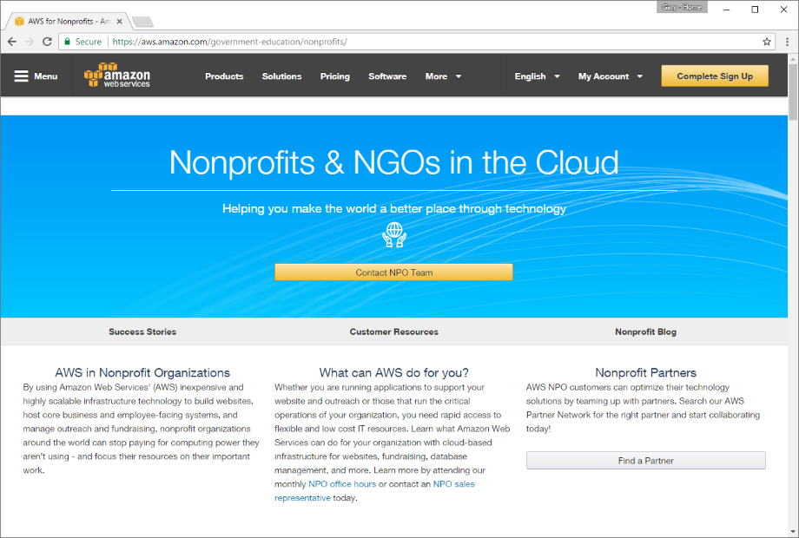
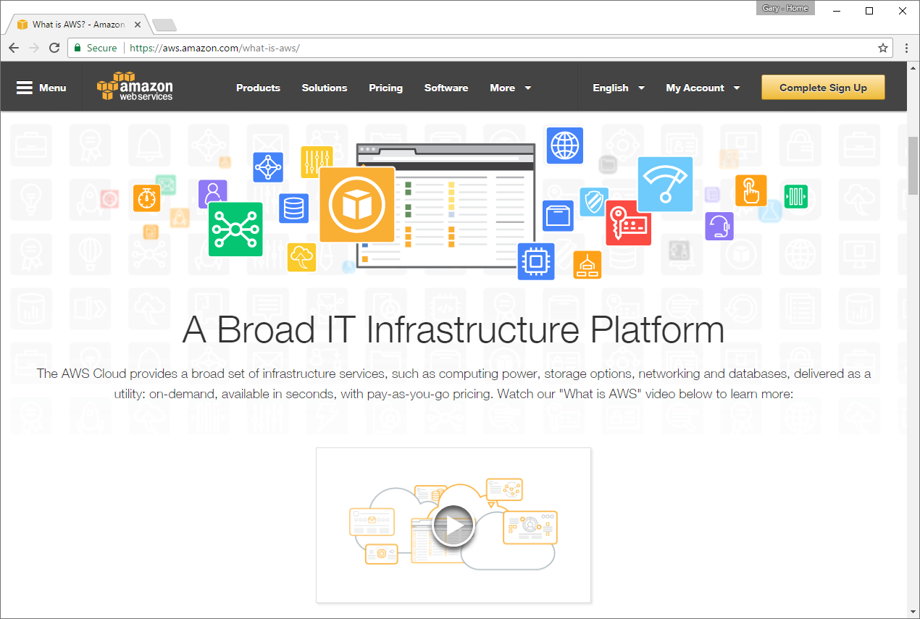
AWS for Nonprofits
($175 TechSoup Admin Fee = $2,000 AWS Credits)

Slide 28





PDF Creation
Adobe Acrobat
(Techsoup: $55)
CutePDF
PDF Creator
PDF Converter (Online)

Slide 29



Office Productivity Suite
Microsoft Office
(TechSoup: $40)
OpenOffice
LibreOffice

Slide 30
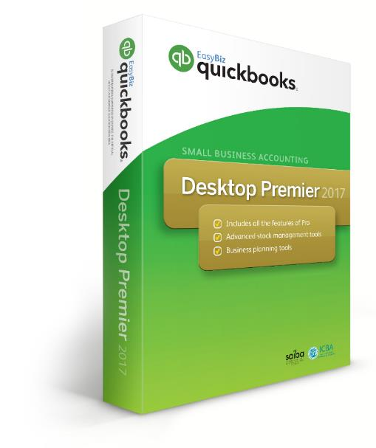


Financial & Accounting
QuickBooks 2015
(TechSoup: $50)
PostBooks
GnuCash

Slide 31



Picture Editing
Adobe Photoshop
(TechSoup: $27 – Photoshop Elements)
GIMP
Pixlr Editor (Online)

Slide 32





Computer Aided Design
AutoCAD
(TechSoup: $99 – AutoDesk Suite)
NanoCad, Google SketchUp
FreeCAD, DraftSight

Slide 33
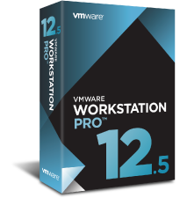

Virtual Machines
VMWare Workstation
(JourneyEd: $149.00)
Oracle VirtualBox

Slide 34
Productivity Tools - Hardware
Servers
Networked Attached Storage (NAS)

Slide 35





Server Operating Systems
Windows Server
(TechSoup: $58)
Linux Servers

Slide 36



Server Business Operating Systems
Windows 2016 Essentials
(TechSoup: $38.00)
Linux Servers
ClearOS, Zentyal

Slide 37

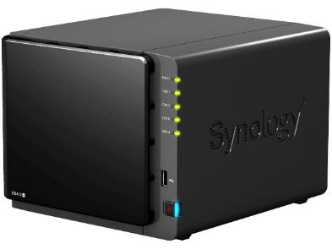
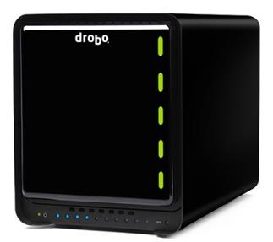
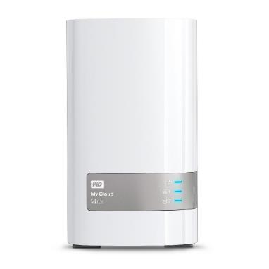
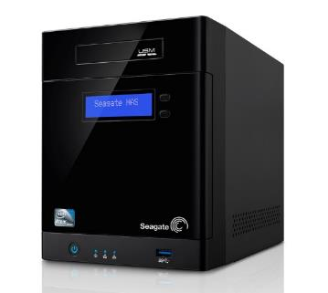
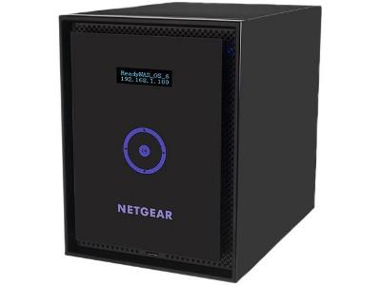
Network Attached Storage
Qnap, Synology, Drobo,
Seagate, Western Digital, Netgear

Slide 38











Server / NAS Applications
Apache, Asterisk, Drupal, Joomla, MySQL, PHP, Python, Tomcat, vTiger, Wordpress

Slide 39
Productivity Tools - Web
Web 2.0
  Hosted
  Software as a Service (SaaS)
  Platform as a Service (PaaS)
  Infrastructure as a Service (Iaas)
Social Bookmarking & Networking

Slide 40



Blogs
Wordpress
Blogger, Tumblr

Slide 41



Office Suite
Google Docs, Office 365, Zoho Office

Slide 42
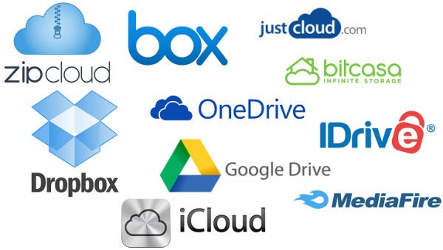
Storage
OneDrive, Google Drive, Dropbox, Box, iDrive, iCloud, Box, ZipCloud

Slide 43






Note Taking
Apple Notes, Google Keep, Microsoft OneNote,
Simplenote, Zoho Notebook

Slide 44








Photo Editing
Photoshop.com, Google Photos, Picasa, Pixlr.com
Later.com, Giphy.com

Slide 45
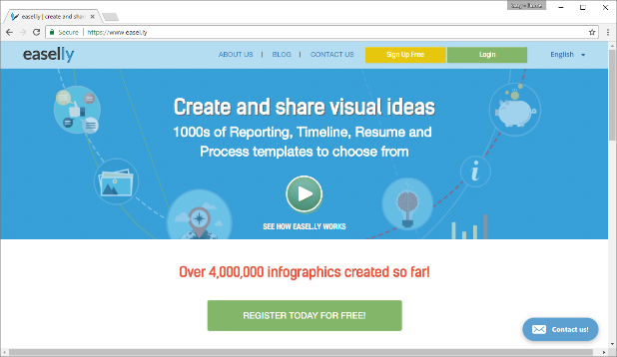
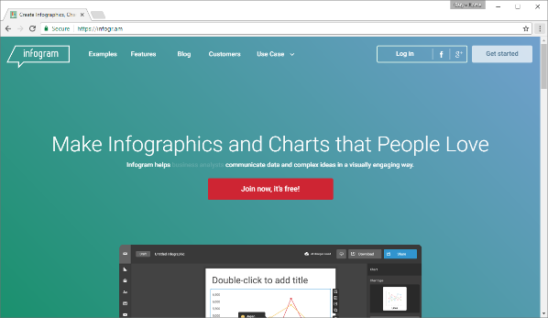
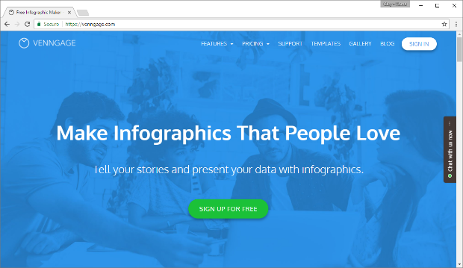
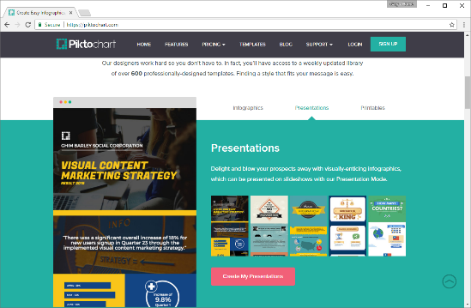
Infographics
Easel.ly, Venngage.com, Infogr.am, Piktochart.com

Slide 46


Content Management Systems
Drupal
Joomla, Drupal, Wordpress

Slide 47






Customer Relationship Management
vTigerCRM, SugarCRM, Microsoft Dynamics, CiviCRM, SuiteCRM, CapsuleCRM, Zurmo

Slide 48








eMail Marketing
ConstantContact, VerticalResponse, MailChimp,
Campayn, Freshmail, Aweber, GetResponse, CampaignMonitor

Slide 49








Social Networking
Facebook, LinkedIn, Twitter, Snapchat,
Google+, Instagram, Pintrest, YouTube

Slide 50





Online Security
LastPass, RoboForm, Dashlane, 1Password, KeePass*

Slide 51
Questions & Answers

Slide 52
Contact Information
Midland Shared Spaces
3500 N A St, Ste 1100
Midland, TX 79705
(432) 685-0400 main
ghires@midlandss.org
https://midlandss.org
Hires Consulting (website for this presentation)
http://hiresconsulting.com

