Slide 1
Technology
Web 2.0, Apps & the Cloud

Slide 2







Recommended Books

Slide 3
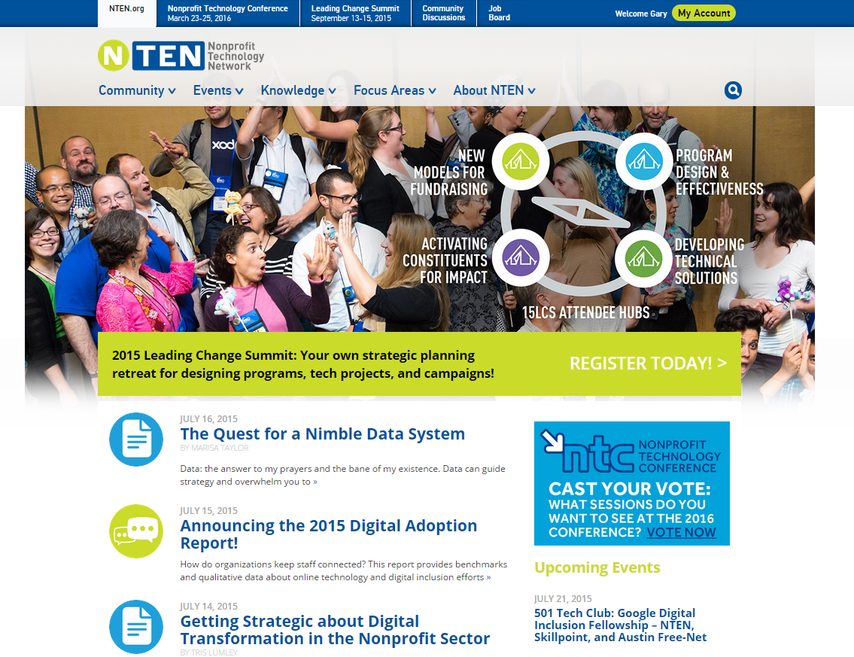
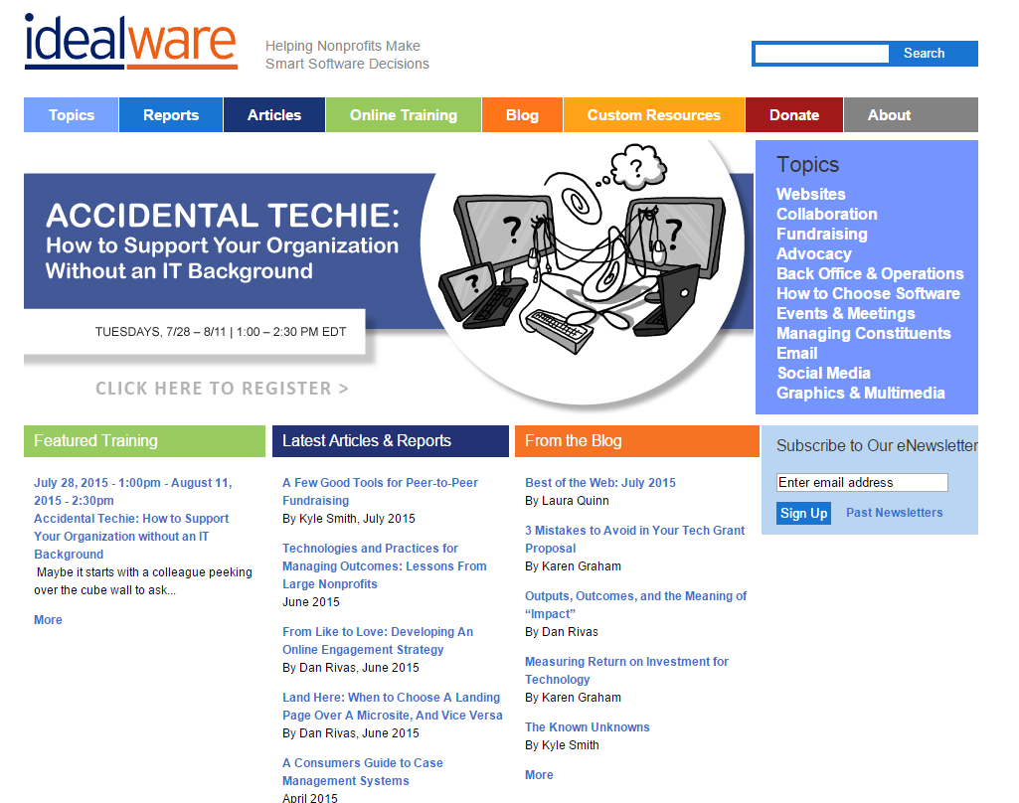
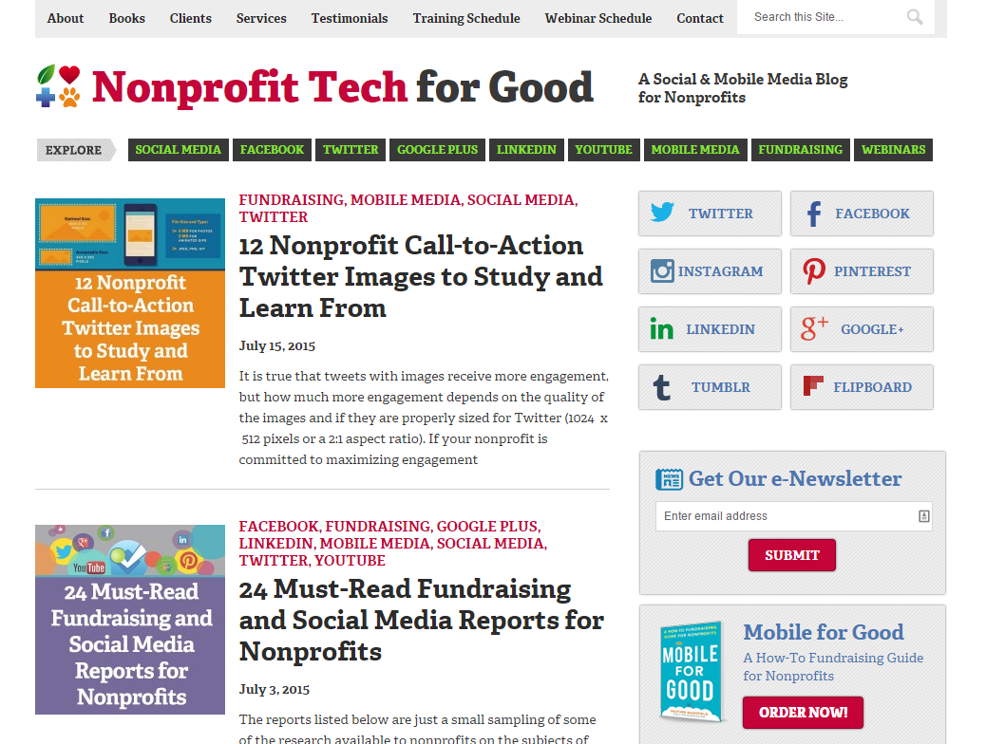
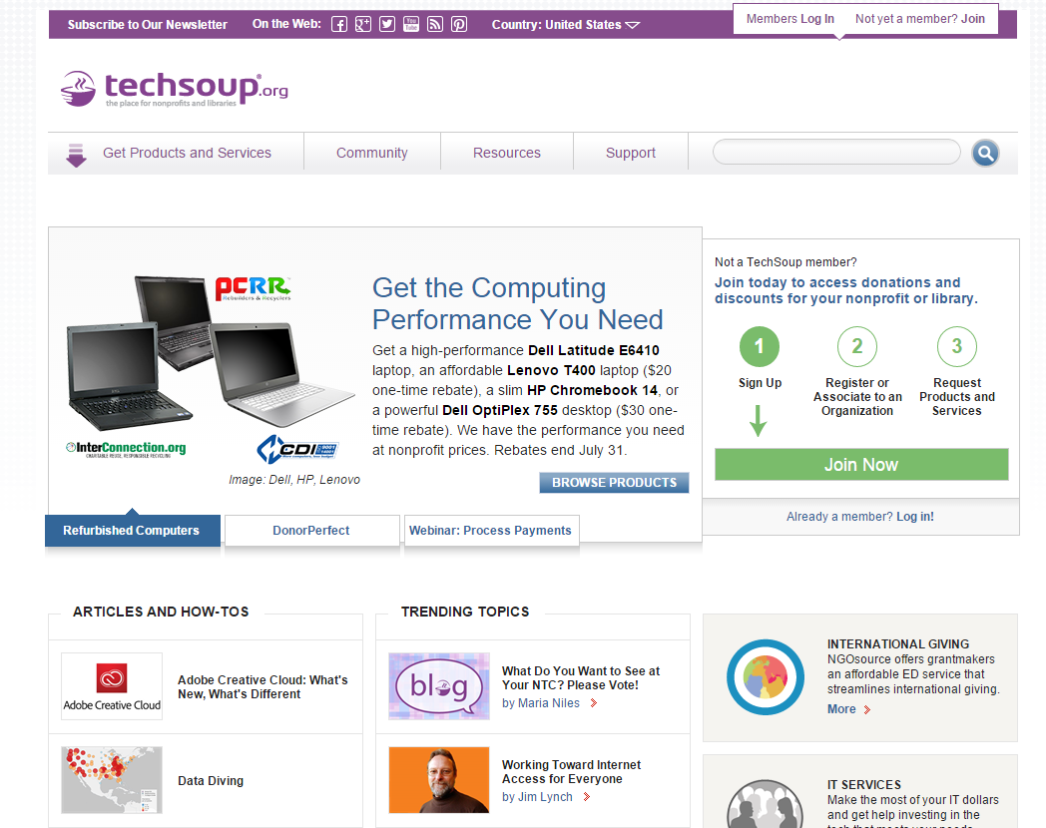
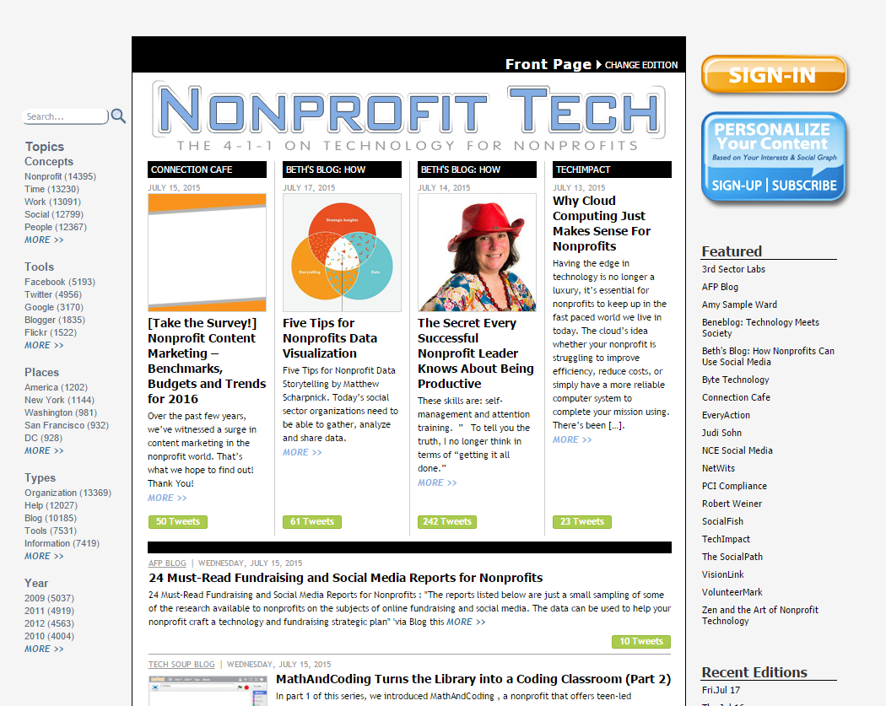
Recommended Online Resources
techsoup.org
nten.org
idealware.org
nonprofittech.org
nptechforgood.org

Slide 4
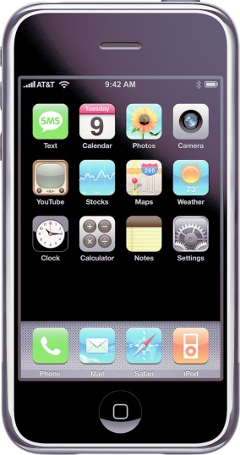
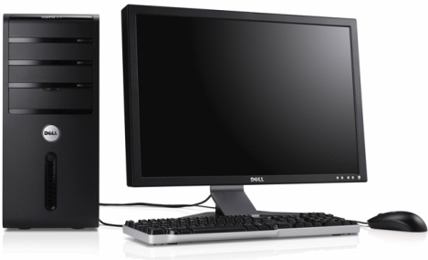
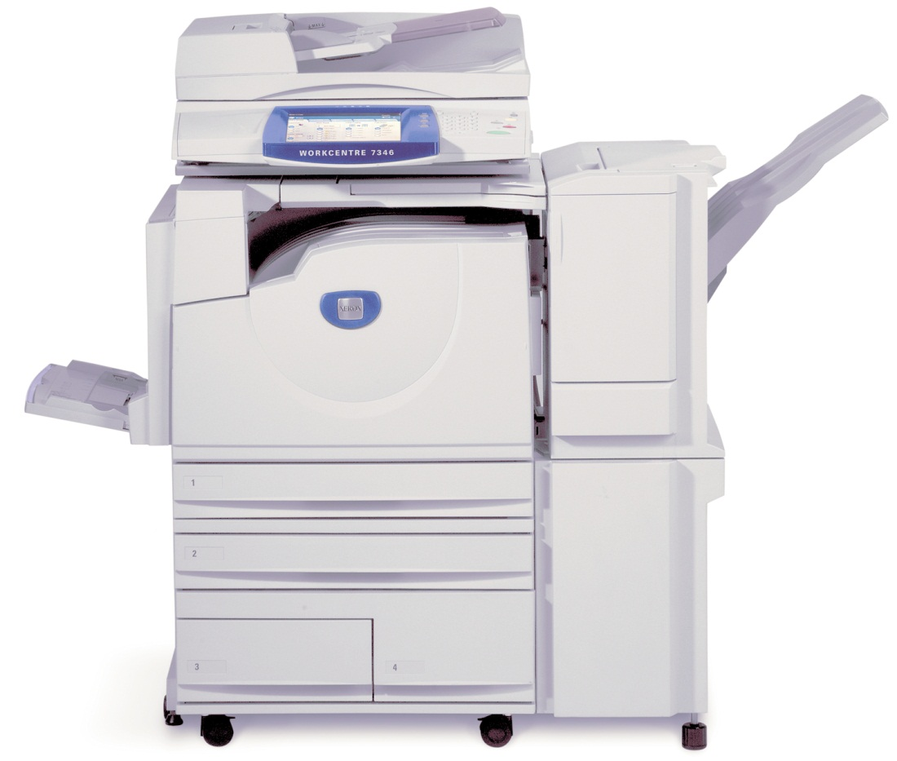
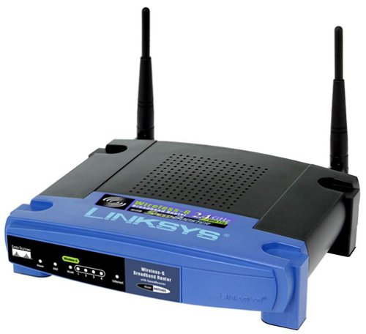
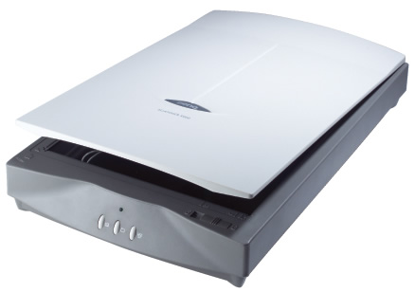
Technology Tools: Hardware

Slide 5








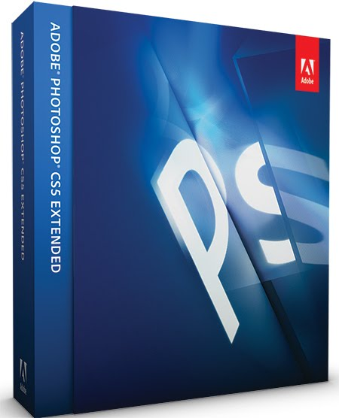

Technology Tools: Software

Slide 6
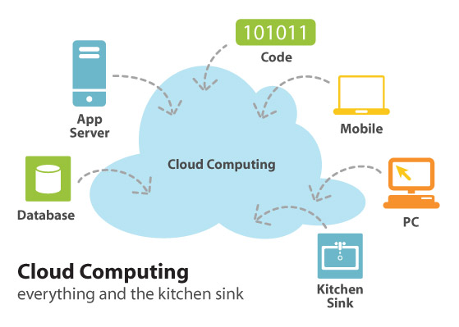

Future of Computing

Slide 7
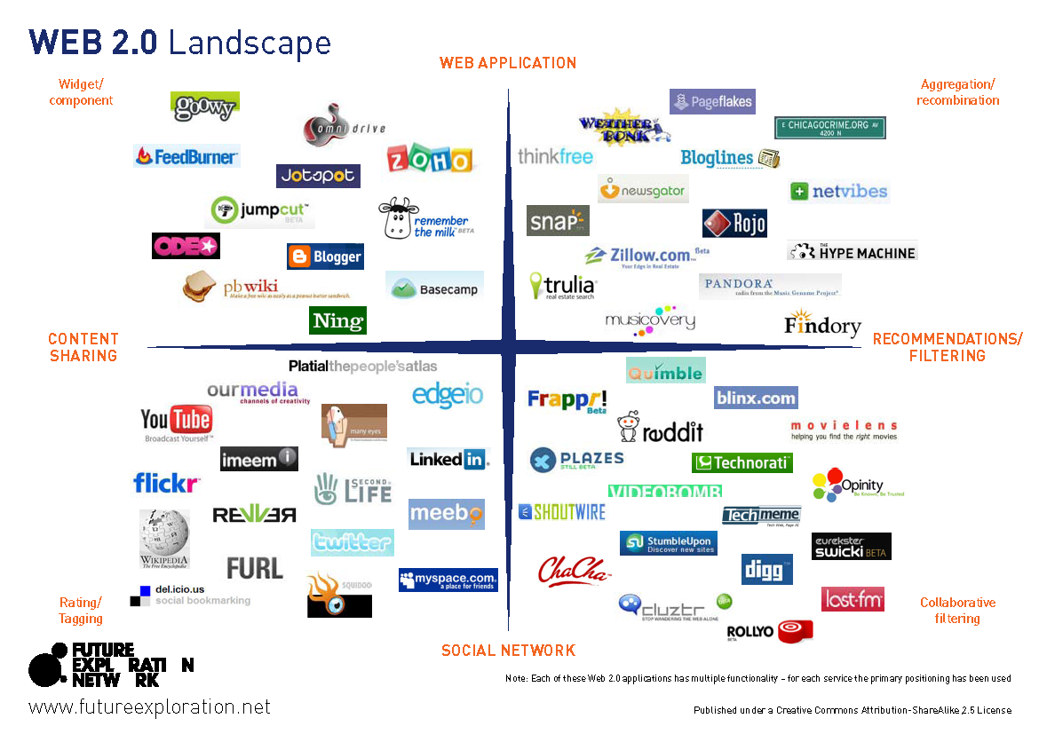

Slide 8
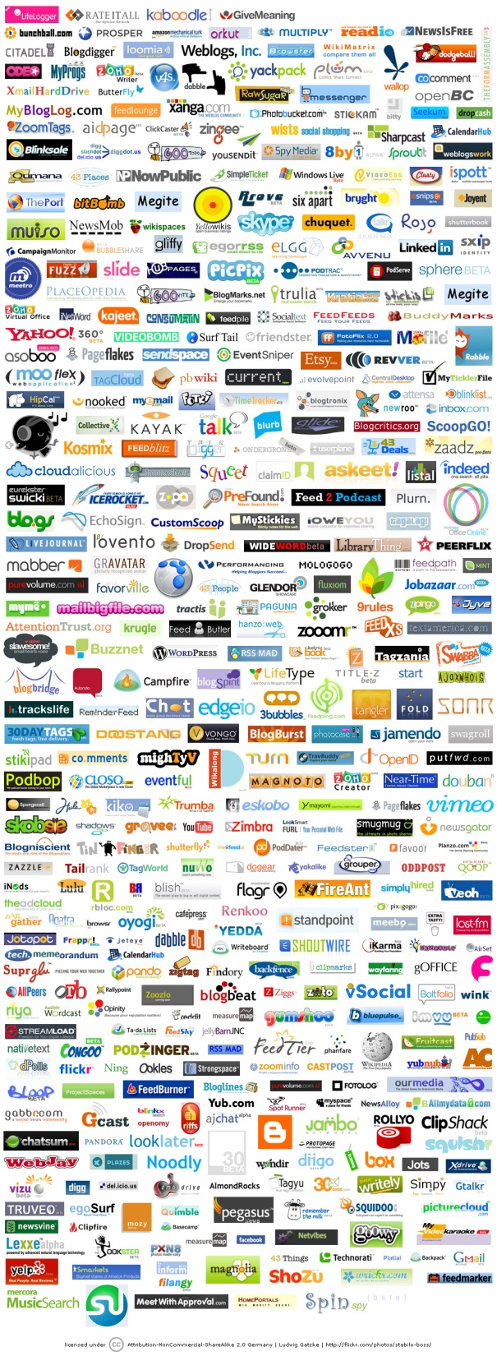

Slide 9











































Which one?

Slide 10
New Technology
Mission First

Slide 11
Technology Impact
“Information technology and telecommunications hardware, software and services turns out to be a powerful driver of growth, having an impact on worker productivity three to five times that of non-IT capital (e.g., buildings and machines).”
Atkinson, Robert D., and McKay, Andrew S. Digital Prosperity: Understanding the Economic Benefits of the Information Technology Revolution. The Information Technology and Innovation Foundation, 2007.

Slide 12
Steps to Assess Technology
Identify the need
Build on what you have
Talk to colleagues
Define your decision criteria
Define your decision-making process
Comparison shop

Slide 13
New Technology
People Second

Slide 14
Technology Planning
Business Process Management (BPM)
Strengths, Weaknesses, Opportunities
and Threats (SWOT)
Getting Buy-In
Measurable Outcomes

Slide 15
Productivity Tools - Desktop
Commercial
Freemium
Free Open Source Software (FOSS)

Slide 16
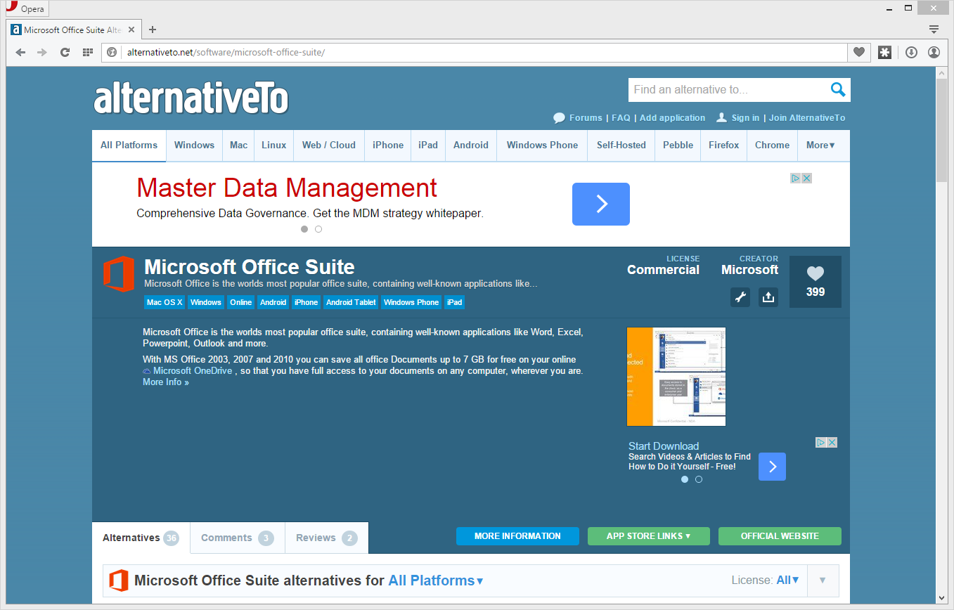
alternativeto.net

Slide 17
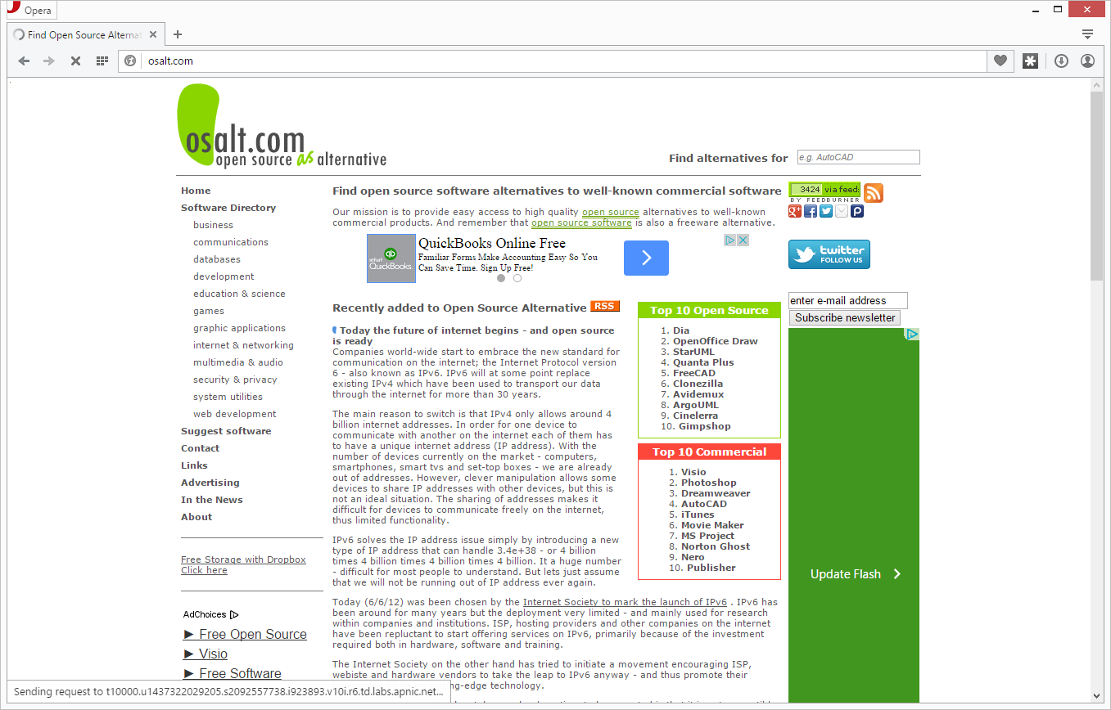
osalt.com

Slide 18
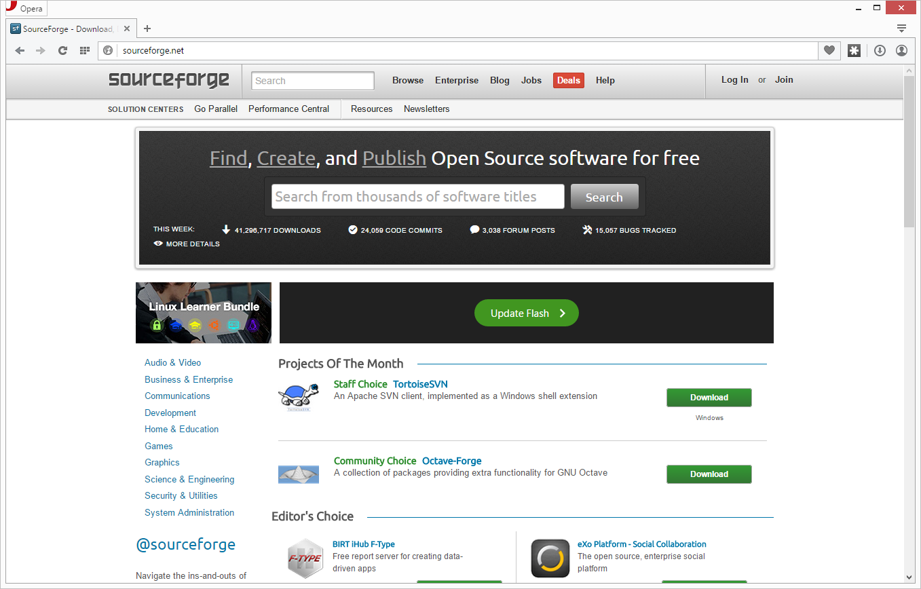
sourceforge.net

Slide 19
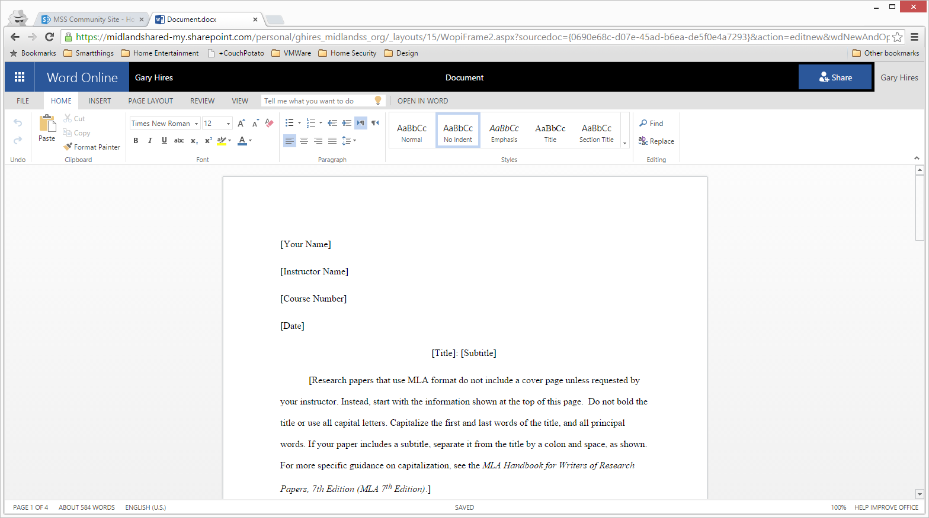
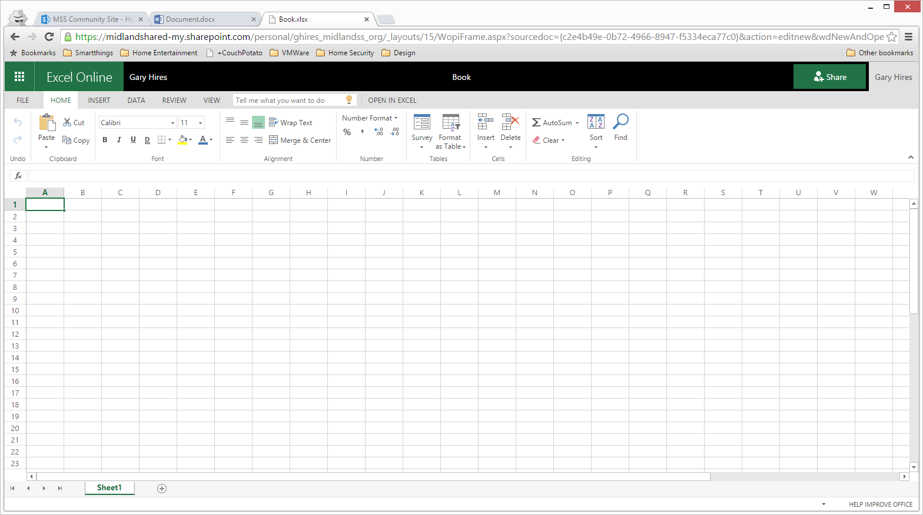
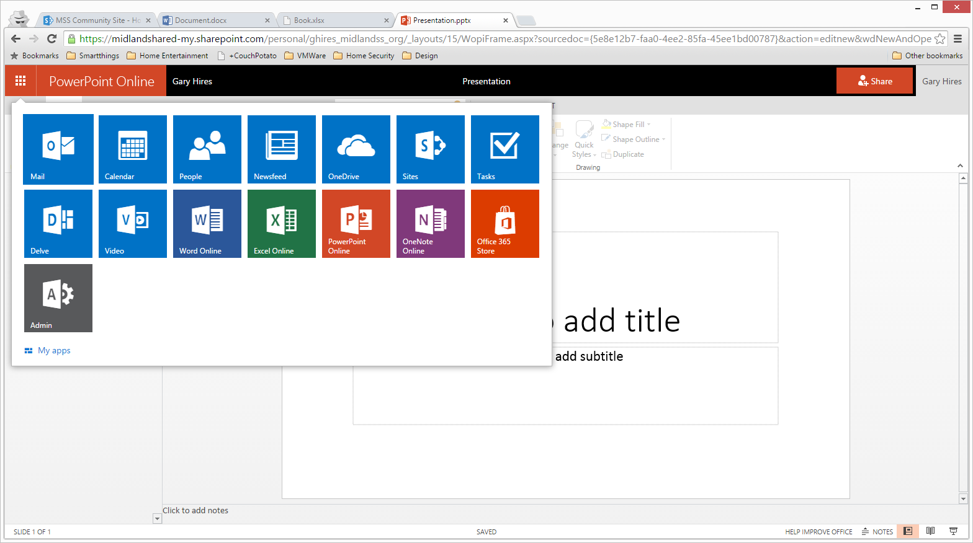
Microsoft Office365
(Free, $2.00 or $4.50 per user/month)

Slide 20
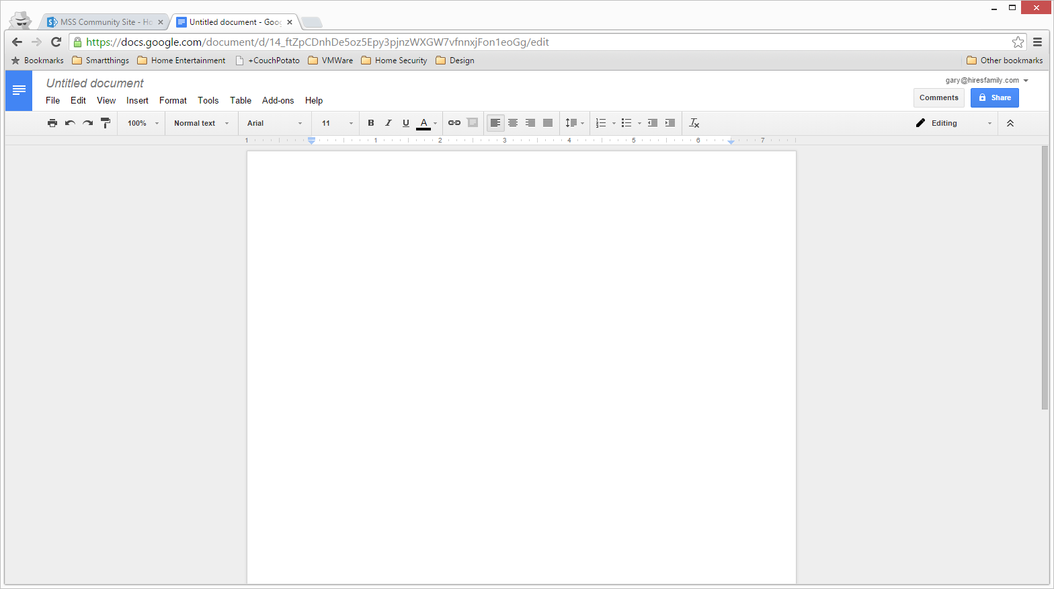
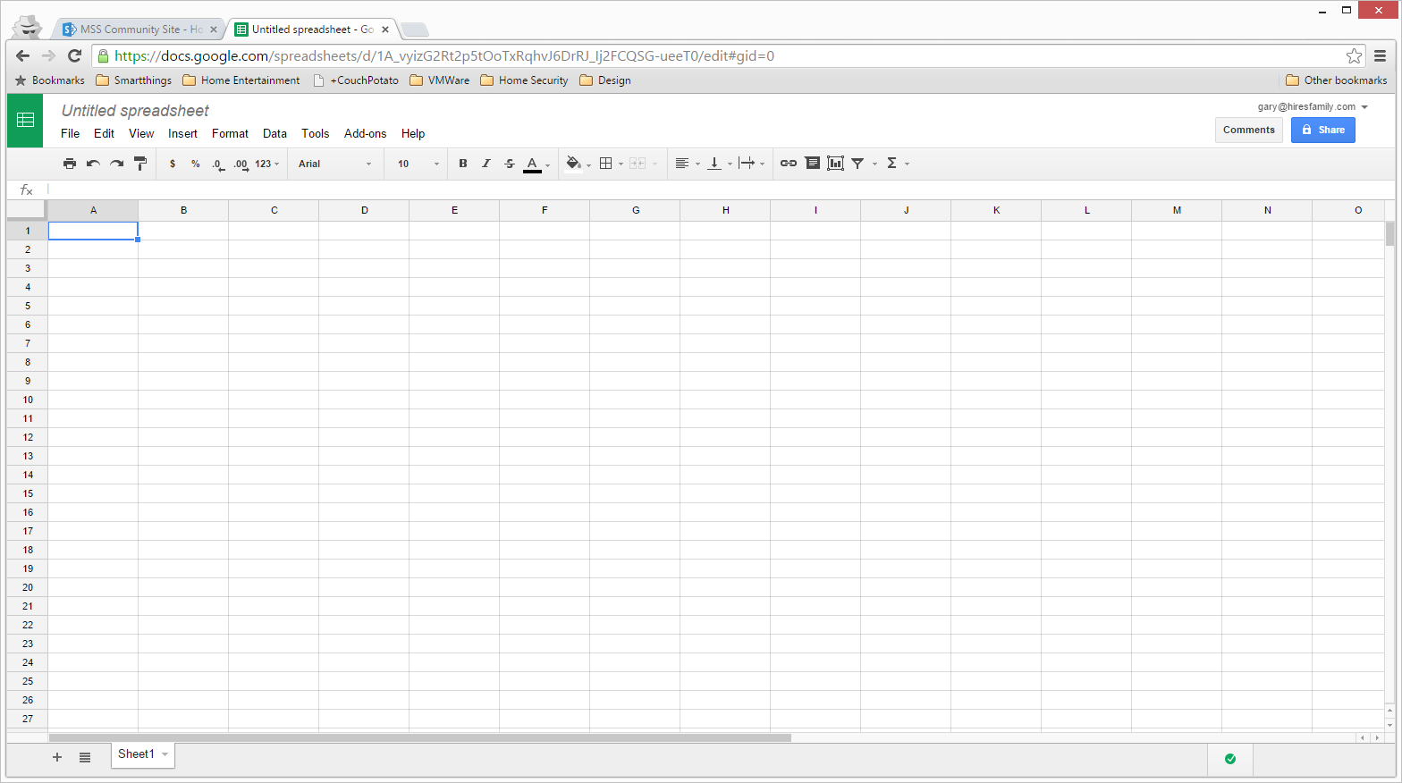
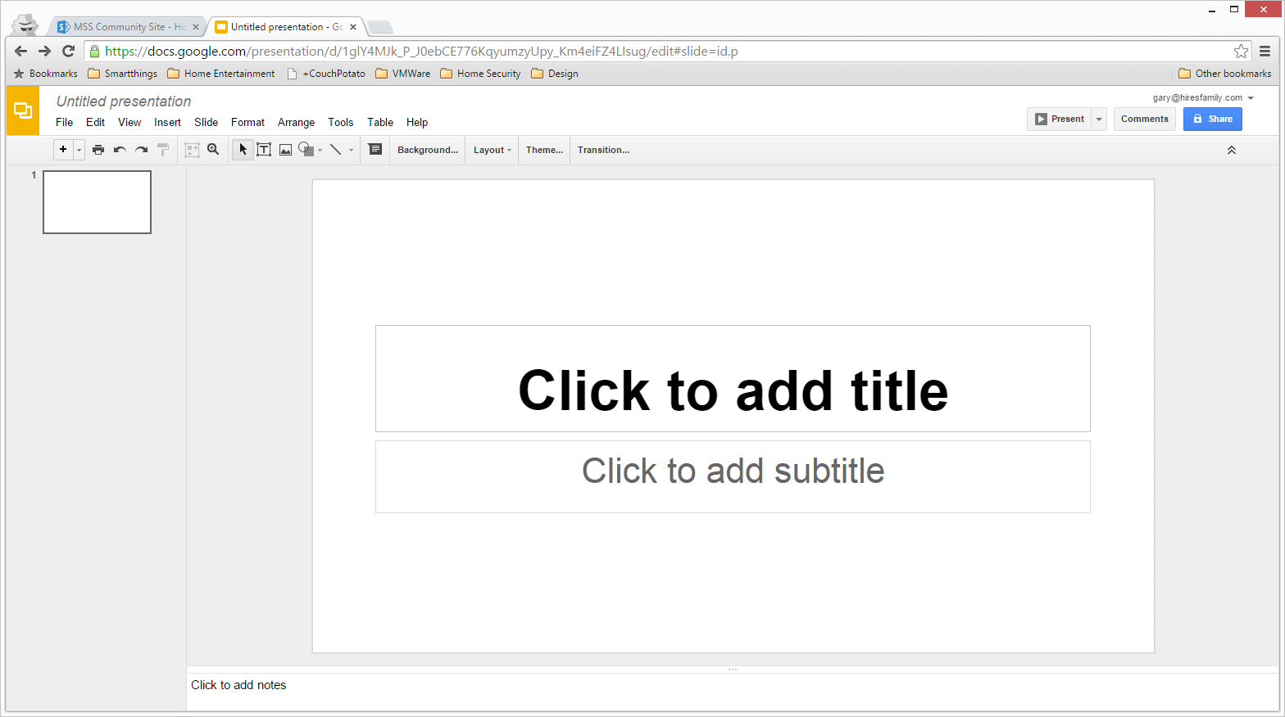
Google Apps for Nonprofits
(Free for Nonprofits)

Slide 21


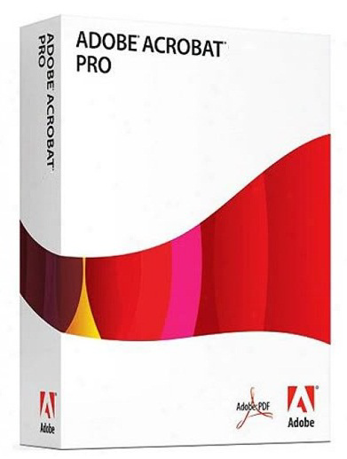


PDF Creation
Adobe Acrobat
(Techsoup: $55)
CutePDF
PDF Creator
PDF Converter (Online)

Slide 22
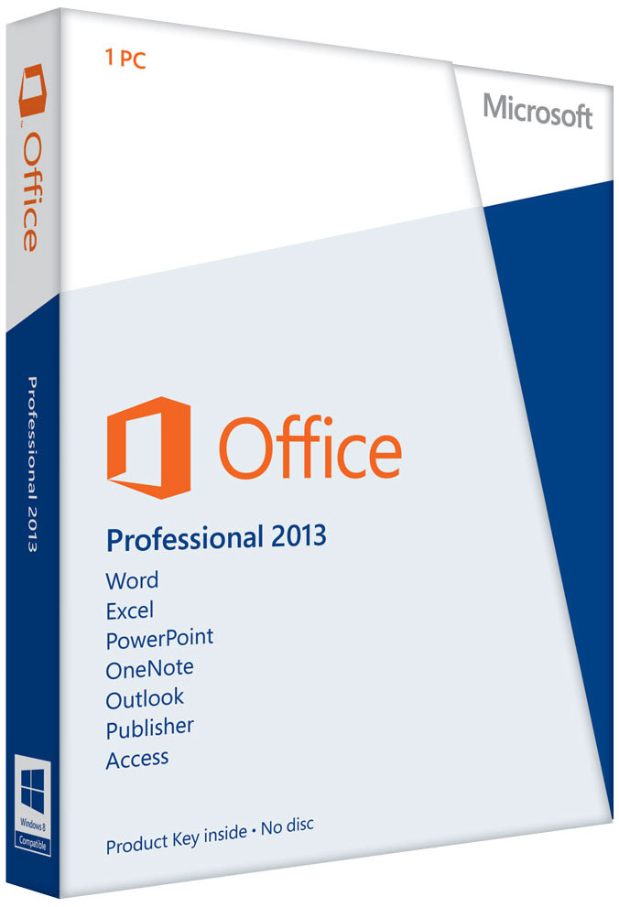


Office Productivity Suite
Microsoft Office
(TechSoup: $40)
OpenOffice
LibreOffice

Slide 23



Financial & Accounting
QuickBooks 2015
(TechSoup: $50)
PostBooks
GnuCash

Slide 24

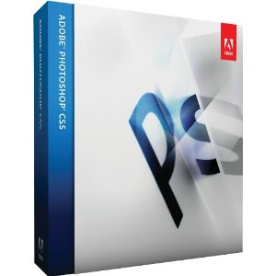

Picture Editing
Adobe Photoshop
(TechSoup: $27 – Photoshop Elements)
GIMP
Pixlr Editor (Online)

Slide 25





Computer Aided Design
AutoCAD
(TechSoup: $99 – AutoDesk Suite)
NanoCad, Google SketchUp
FreeCAD, DraftSight

Slide 26
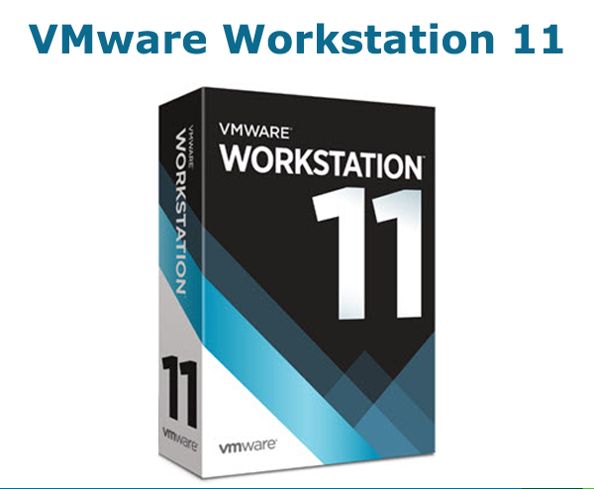

Virtual Machines
VMWare Workstation
Oracle VirtualBox

Slide 27


Cloning
Norton Ghost
Clonezilla

Slide 28



CD/DVD Burning
Nero Burning Rom
ImgBurn, CDBurnerXP

Slide 29
Productivity Tools - Hardware
Servers
Networked Attached Storage (NAS)

Slide 30


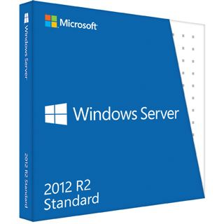


Server Operating Systems
Windows Server
(TechSoup: $66)
Linux Servers

Slide 31

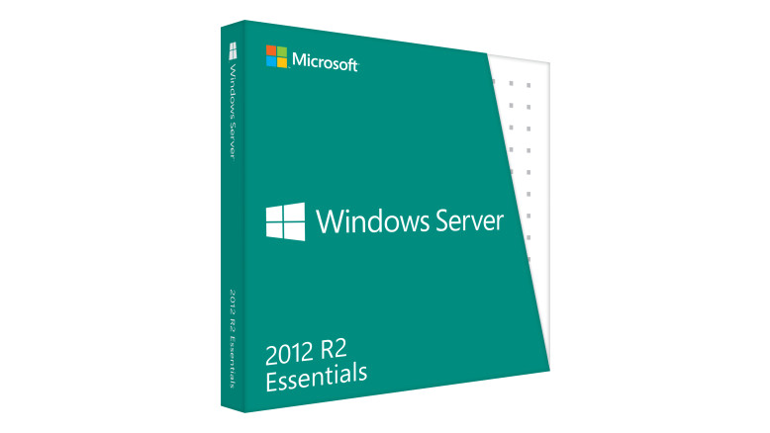

Server Business Operating Systems
Windows 2012 R2 Essentials
(TechSoup: $37.00)
Linux Servers
ClearOS, Zentyal

Slide 32
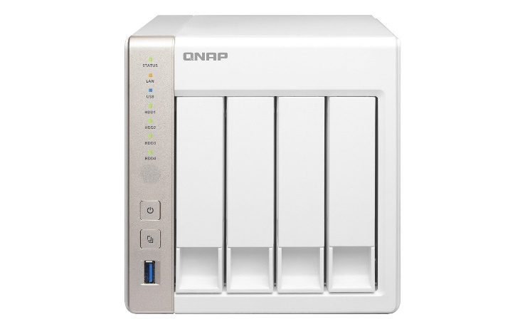
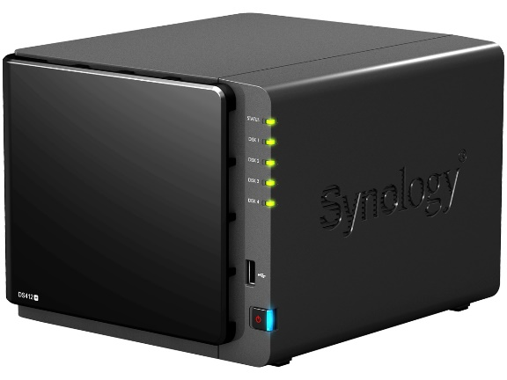
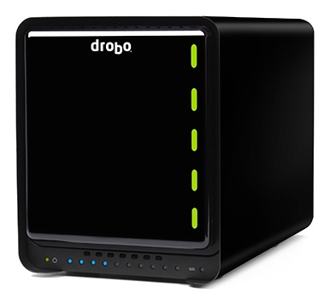
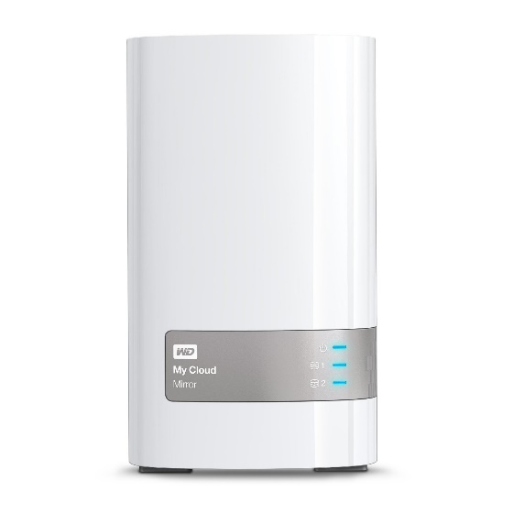
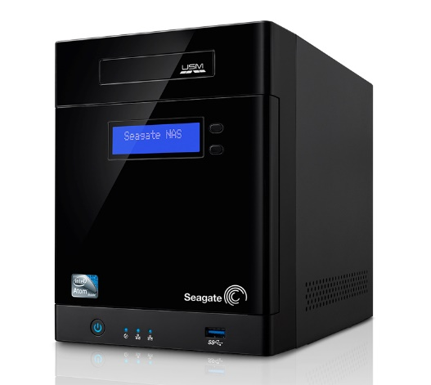
Network Attached Storage
Qnap, Synology, Drobo, Seagate, Western Digital

Slide 33











Server / NAS Applications
Apache, Asterisk, Drupal, Joomla, MySQL, PHP, Python, Tomcat, vTiger, Wordpress

Slide 34
Productivity Tools - Web
Web 2.0
  Hosted
  Software as a Service (SaaS)
Social Bookmarking & Networking

Slide 35



Blogs
Wordpress
Blogger, Tumblr

Slide 36
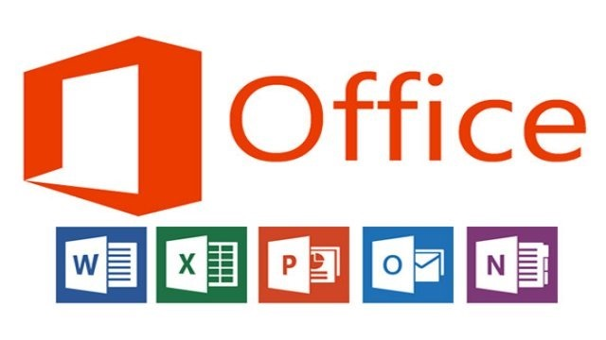


Office Suite
Google Docs, Office 365, Zoho Office

Slide 37



Note Taking

Slide 38



Photo Editing
Photoshop.com, Picnik.com, Pixlr.com

Slide 39


Content Management Systems
Drupal
Joomla, Drupal, Wordpress

Slide 40






Customer Relationship Management
vTigerCRM, SugarCRM, Microsoft Dynamics, CiviCRM, SuiteCRM, CapsuleCRM, Zurmo

Slide 41





eMail Marketing
ConstantContact, VerticalResponse, MailChimp,
Campayn, Freshmail

Slide 42




Bookmarking
Delicious, Xmarks, Diigo, Pocket

Slide 43






Social Networking
Facebook, LinkedIn, Twitter,
Google+, Instagram, Pintrest

Slide 44
Questions & Answers

